Slide 1
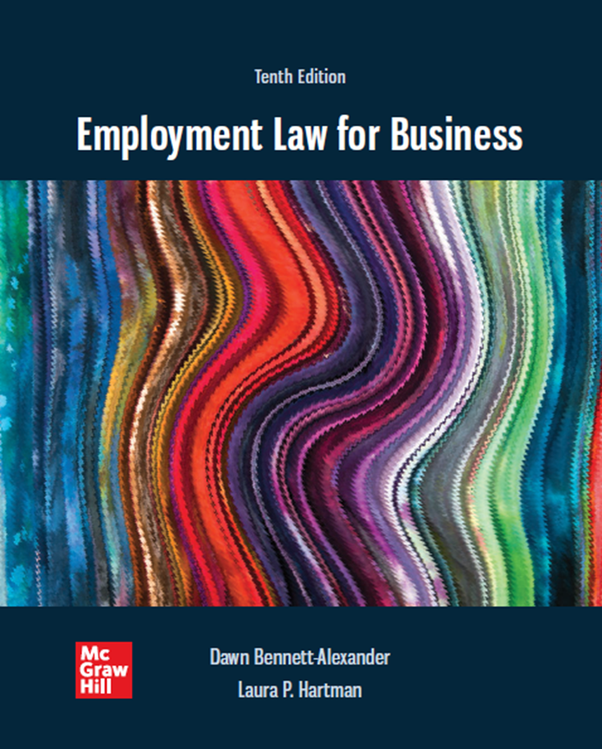
Chapter 12 Age Discrimination
2022 McGraw-Hill Education. All rights reserved. Authorized only for instructor use in the classroom. No reproduction or further distribution permitted without the prior written consent of McGraw-Hill Education.

Slide 2
Learning Objectives
Differentiate the reality of the value that an older worker could bring to the workplace from the bias that permeates some of our perception of them.
Describe the history of protection of older workers in the United States.
Distinguish the A D E A and state-based age discrimination laws.
Identify the legal options available to an employee who believes that he or she is a victim of age discrimination.
Articulate the prima facie case of discrimination based on age.
Describe the bona fide occupational qualification defenses available to employers under the A D E A.
Explain the difference between situations where disparate impact and disparate treatment apply in connection with age discrimination.
Analyze factual circumstances when employer economic concerns may justify adverse action against particular groups of workers.
Recognize necessary elements to establish pretext under the A D E A.
Define the parameters of a valid waiver of A D E A rights.

Slide 3
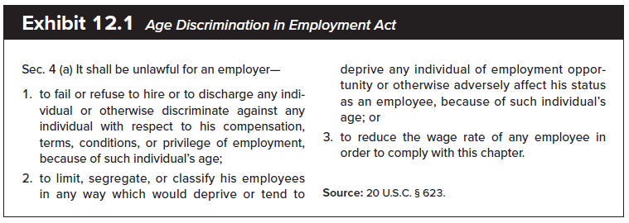
Statutory Basis - ADEA
This law is distinct from the Civil Rights Act of 1964, and its interpretations are not identical

Slide 4
Age Discrimination: Statutory Basis
Age Discrimination in Employment Act (ADEA) (1967)
Sec. 4(a). It shall be unlawful for an employer:
To fail or refuse to hire or to discharge any individual or otherwise discriminate against any individual with respect to his compensation, terms, conditions, or privileges of employment, because of such individual’s age;
To limit, segregate, classify his employees in any way which would deprive or tend to deprive any individual of employment opportunity or otherwise adversely affect his status as an employee, because of such individual’s age; or
To reduce the wage rate of any employee in order to comply with this chapter.
ADEA prohibits discrimination in employment on the basis of age; applies to individuals who are at least 40 years old. Individuals who are not yet 40 years old are not protected by ADEA and may be discriminated against on the basis of their age.

Slide 5
Age Discrimination Context 1
American culture values youth.
Ageist stereotypes regarding energy, innovation, interest and productivity declines.
Information technology industry in particular faces challenges to its ageist culture.
Examples: Zuckerberg’s speech to Stanford University audience and Google settlement with 54 year old former executive Brian Reid.
EEOC: “Despite decades of research finding that age does not predict ability or performance, employers often fall back on precisely the ageist stereotypes the ADEA was enacted [in the 1960s] to prohibit.”

Slide 6
Age Discrimination Context 2
Concurrently, older workers are tending to stay on the job longer
Better health
Lingering economic/savings effects of Great Recession
Older employees may be perceived as more expensive because of greater experience, seniority.
Research suggests experience may be under-valued, and Switching costs and effects not fully accounted-for
As always, generalizations lead to wrongful discrimination
Individualized consideration, conclusions required.

Slide 7
Realities About Older Workers and Age Discrimination
Employers need to be cognizant of the impact of terminations based on salary, since older workers may be higher paid (per seniority)
There is no ‘reverse discrimination’ cause of action available to younger workers ineligible because of minimum-age restrictions
Most mandatory retirement ages (e.g., 65) have been eliminated in U.S. economy
No upper age limit for coverage under A D E A.

Slide 8
What is Same/Different About Age?
Same
Broad inclusion in protected group: everyone lucky enough to reach 40 years of age can qualify
Different
Aging process: sooner or later, every worker is no longer ‘qualified’ for the job
‘older’ workers still under 40 are not protected

Slide 9
Regulation: Age Discrimination in Employment Act (A D E A)
Age Discrimination in Employment Act
Prohibits discrimination in employment on the basis of age > 40 (can legally discriminate on basis of age for candidates aged < 40)
Applies to individuals who are at least 40 years old, with no upper age limit
Applies to both PUBLIC and PRIVATE ER, unions, and by foreign companies operating in US with at least 20 EE
ER must be engaged in industry affecting commerce and have 20 or more EE
Claims increased around Great Recession
Claims decreased recently, likely based on economic conditions and arbitration effects.

Slide 10
Distinctions between A D E A and Title VII
ADEA is more lenient than Title VII regarding the latitude afforded employers’ reasons for adverse employment decisions
ADEA allows an employer to rebut a prima facie case of age discrimination
Employer needs to identify any “reasonable factor other than age” that motivated the decision
Employee is not barred from pursuing a claim simply because the employer treated another older worker better
e.g. both workers may be > 40, age gap preferred
ADEA only protects employees over 40 from discrimination
No protection from “reverse” discrimination, which Title VII gives (thirty-somethings not protected)
Addresses discrimination in the provision of benefits
Holds employers to an equal-benefit/equal-cost rule
Has specific record-keeping provisions for employers to ensure appropriate and adequate information exists as to age-related hiring practices

Slide 11
State Law Claims
State laws on age discrimination varies widely
Some have no age discrimination laws (ex. AL and MS)
Other have laws that track the ADEA
A large number of states’ laws provide greater protections than those afforded by the ADEA
Greater protection may include for following
State age discrimination laws apply to a wider range of employers
State age discrimination laws sometimes allow a wider range of damages (no punitives under ADEA)
States often provide longer filing periods
No state is permitted to extend the protection to someone younger than 40

Slide 12
Employee’s Options
Internal
Employee may file a complaint using the employer’s internal grievance procedures
Legal options
File a complaint with the federal Equal Employment Opportunity Commission (EEOC)
180 days from when the discrimination occurred
Extended to 300 days if the state has age discrimination laws and an administrative agency to oversee age discrimination complaints
Upon receiving the complaint, EEOC could:
Dismiss the complaint if it believes that the charges have no merit
Investigate the charges
Issues a right-to-sue letter
File a complaint with the state equivalent of the EEOC (if one exists)
File a lawsuit in federal court under the ADEA
ADEA-based lawsuit may be filed any time after 60 days from filing claim
Notice of Right-to-Sue not required
File a lawsuit in state court under state age discrimination laws

Slide 13
Employee’s Prima Facie Case: Disparate Treatment 1
Two types of discrimination exist under the ADEA:
Disparate treatment
Disparate impact
Four elements to persuade the court about a claim for age discrimination
Employee is a member of the protected class
Must show that she or he is 40 years old or older
Employee is Qualified for the Position
Able to meet the employer’s legitimate job requirements
Employee Suffered Adverse Employment Action
May include a decision not to hire the applicant or to terminate the employee
Employee Experienced Dissimilar Treatment
Others not in the protected class were treated more favorably…usually very difficult for employees to prove

Slide 14
Employee’s Prima Facie Case: Disparate Treatment
Burden shifting prior to the summer of 2009
Once evidence of discrimination was presented, burden of proof shifted to the employer to present a legitimate nondiscriminatory reason (LNDR) for its actions
Employer (ER) in a mixed-motives case has always been given the opportunity to establish legitimate non-discriminatory motivation
Age discrimination cases under the ADEA require proof that age was the “but for” cause of the adverse employment action
Burden on Claimant to establish absence of “Reasonable Factor Other than Age” (RFOA)…In other words, EE must show AGE was the “BUT FOR” cause of the adverse action
contrast Title VII, where the burden is on the defendant to establish legitimate non-discriminatory motivation
In mixed motive cases, “but-for” age discrimination, adverse action would not have been taken
This burden is more onerous than the burden of proof in cases of alleged discrimination under Title VII (on the basis of sex or race, for example), which requires only a showing that the protected trait or characteristic was a motivating factor.

Slide 15
Burden Shifting No More: Gross
Case: Gross v. F B L Financial Services. Inc.
No burden shifting occurs in A D E A cases: plaintiff must prove age was the "but-for" factor.
Mixed-motives age discrimination claims do not exist under the A D E A in disparate treatment cases.
Employee could recover only if the employment action would not have taken place but for age discrimination.
Gross has been difficult to apply: Courts of Appeal have since concluded:
Age need not be the Only factor, but Primary factor in employer decision
Burden of producing evidence has shifted to claimant, who has always borne the burden of persuasion in all discrimination cases.
Public sector cases: mixed motives standard applies

Slide 16
Employer Defenses
Bona Fide Occupational Qualification (B F O Q).
Age is one of the most consistently applied B F O Q s.
E E O C guidelines for employers in A D E A cases:
The age limit is reasonably necessary to the essence of the employer’s business. (Same BFOQ justification under Title VII)
All or substantially all of the individuals over that age are unable to perform the job’s requirements adequately.
Some of the individuals over the age possess a disqualifying trait that cannot be ascertained except by reference to age (per competent expert evidence – perception is inadequate)
Case: Western Airlines v. Criswell - individualized health assessments possible (note that EEOC requires individualized assessments re pandemic response
Employers may also observe terms of bona fide seniority system, voluntary retirement plans, and may discipline employees for good cause.

Slide 17
Summary: Employee’s Prima Facie Case Disparate Treatment
Disparate Treatment
Step 1: Employee’s prima facie case
The employee is in the protected class (i.e. employee is 40 years of age or older).
The employee is qualified for the position (i.e. EE met ER’s legitimate job requirements)
The employee suffered adverse employment action (i.e. she or he was not hired, terminated or demoted).
Others not in the protected class were treated more favorably (this is usually difficult for EE’s to prove).
Discrimination is ‘but-for’ factor in employer’s decision (i.e. when there is INDIRECT evidence or MIXED MOTIVE – one in which there is evidence of age discrimination together with some other motivation for job action)
Step 2: Employer defenses.
Bona fide occupational qualification.
Step 3: Employee may evidence pretext for employer actions.

Slide 18
Mandatory Retirements
Mandatory retirement: Employee must retire upon reaching a specified age.
Deemed illegal by the 19 86 amendments to the A D E A, with few exceptions.
Limited to:
Retirement at age 65 or beyond for high-level executives who receive a company pension of $44,000 or more.
Police officers and firefighters.
Employer cannot base employment decisions on age-related stereotypes.

Slide 19
Proving a Case of Age Discrimination: Disparate Impact
Step 1: Employee’s prima facie case
A facially neutral policy or rule is imposed by an employer.
Which has a different effect on an older group of workers.
No intent to discriminate is necessary.
Step 2: Employer defenses.
Reasonable factor other than age (R F O A).
Economic concerns (i.e. cost cutting, if unrelated to age).
Seniority.

Slide 20
Employee’s Prima Facie Case: Disparate Impact
Reasonable factors other than age: May include any requirement that does not have an adverse impact on older workers, as well as those factors that do adversely affect this protected class but are shown to be job-related
There is no RFOA defense in Title VII
Title VII Defense– ER justify a practice that has been shown to have a disparate impact by evidencing that it is job-related and consistent with business necessity (VERY SPECIFIC)
ADEA – An employment practice is based on an RFOA when it was reasonably designed and administered to achieve a legitimate business purpose in light of the circumstances, including its potential harm to older workers.
Example: If a police department decided to require applicants for patrol positions to pass a physical fitness test to be sure that the officers were physically able to pursue and apprehend suspects, it should know that such a test might exclude older workers more than younger ones. Nevertheless, the department's actions would likely be based on an RFOA if it reasonably believed that the test measured the speed and strength appropriate to the job, and if it did not know, or should not have known, of steps that it could have taken to reduce harm to older workers without unduly burdening the department
Cases
Schuster v. Lucent Technologies
Hazen Paper v. Biggins (pre-Gross disp. treatment)
RFOA and economic concerns, per EEOC
Factor is related to the employer’s stated business purpose
Factor was well defined and applied fairly and accurately
Employer limited supervisors’ subjective discretion
Employer assessed the effect of the employment practice on older workers
Degree of the harm to individuals within the protected age group
RFOA standard < Title VII ‘business necessity’

Slide 21
Employee’s Prima Facie Case: Disparate Impact - Economic concerns
Even when a prima facie case can be established, few ADEA disparate-impact challenges in the aftermath of City of Jackson and Meacham have survived the RFOA analysis because defendants have established that their rationale for engaging in the challenged behavior was reasonable.
Unlike the business necessity defense used in Title VII defenses, the RFOA inquiry includes no requirement to ask whether there are other ways for the defendant to achieve its goals that do not result in a disparate impact on a protected class

Slide 22
Employee’s Prima Facie Case: Disparate Impact - Economic concerns
Firm may opt to reduce its workforce (RiF) based in part on salary amounts in order to have the greatest impact.
Note: it is crucial to your credibility that discharges be made on the basis of an objective standard that serves the business.
A D E A does not prohibit termination of protected employees for budgetary reasons.
Such terminations constitute impermissible discrimination when the economic reasons given serve as pretext for age discrimination motive.

Slide 23
Defenses Based on Economic Concerns
ADEA specifically allows for ER to make economic or cost concerns business decisions, even if disparately impacts older workers. However decision has to be purely based on economic concerns, and not age.
Proper Example:
A nursing home decided to reduce costs by terminating its highest paid and least productive employees. To ensure that supervisors accurately assessed productivity and did not base evaluations on stereotypes, the employer instructed supervisors to evaluate productivity in light of objective factors such as the number of patients served, errors attributed to the employee, and patient outcomes. Even if the practice did have a disparate impact on older employees, the employer could show that the practice was based on an RFOA because it was reasonably designed and administered to serve the goal of accurately assessing productivity while decreasing the potential impact on older workers.
Bad Example:
The same employer asked managers to identify the least productive employees without providing any guidance about how to do so. As a result, older workers were disproportionately rated as least productive. The design and administration of the practice was not reasonable because it decreased the likelihood that the employer's stated goal would be achieved and increased the likelihood that older workers would be disadvantaged. Moreover, accuracy could have been improved and unfair harm decreased by taking a few steps, such as those discussed in the Example above.

Slide 24
Reductions in Force (R I F s)
Generally RFOA defense standard easier to meet that ‘business necessity’ defense under Title VII.
Case: Meacham v. Knolls Atomic Power Lab
Employer burden to establish RFOA defense
Employer need not meet every factor in EEOC rule, but it has the burden of persuasion that defense is appropriate to case facts.
Note: may higher paid, older workers be offered lower wage terms to avoid lay-off? No, per statute section 4(a)(3).
Some authority that failure to accept such an offer may lead to age discrimination if successor ultimately paid more.
In the event of an R I F, age discrimination may be proven where an employer:
Refuses to allow the discharged (or demoted) employee to bump others with less seniority.
Hires younger workers when the jobs become available after the employee was discharged (or demoted) at the prior salary of the older worker.
Section 4(a)(3) of the A D E A
“unlawful for any employer . . . to reduce the wage rate of any employee in order to comply with this Act.”

Slide 25
Defenses Based on Benefit Plans and Seniority Systems
A D E A specifically excludes bona fide retirement plans that distinguish based on age but are “not a subterfuge to evade the purpose of [the] Act.”
Bona fide voluntary retirement options must be truly voluntary.
Reasonable person would not feel compelled to retire under similar circumstances.

Slide 26
“Same Actor” Defense
When the same “actor” both hires and fires a worker protected by the A D E A, there is a permissible inference that the employee’s age was not a motivating factor in the decision.
Case: Lodis v. Corbis Holdings, Inc.
Defense may be subject to extenuating circumstances, including who ‘actually’ ordered the termination.

Slide 27
Retaliation
A D E A prohibits retaliation in response to an age discrimination complaint filed.
Protects the person filing the complaint and any other employee who might have participated in the claim.
Punitive damages.
Money over and above compensatory damages.
Imposed by a court to punish a defendant for willful acts and to act as a deterrent.
Designed to punish the employer.
Available for retaliation claims.

Slide 28
Employee’s Response: Proof of Pretext
Where there is direct evidence of discrimination, proof of pretext is not required.
Showing pretext:
Offered reasons for the adverse employment action have no basis in fact.
Offered reasons did not actually motivate the adverse employment action.
Offered reasons are insufficient to motivate the adverse action taken.
Case: Reeves v. Sanderson Plumbing Products.

Slide 29
Employee’s A D E A Prima Facie Case: Hostile Environment Based on Age 1
Recognized by some circuit courts – no USSCt precedent yet.
Prima facie case for hostile environment under the act:
Employer is 40 years old or older.
Employee was harassed, through words or actions, based on age.
Harassment unreasonably interferes with employee’s work performance and creates objectively intimidating, hostile or offensive work environment.
Basis for inferring liability to employer (e.g., complaints not responded-to)

Slide 30
Waivers under the Older Workers’ Benefit Protection Act of 19 90 1
Waiver: Intentional relinquishment of a known right.
Older Workers’ Benefit Protection Act (O W B P A) concerns the legality and enforceability of early retirement incentive programs and waivers of rights under the A D E A.
Prohibits age discrimination in the provision of employee benefits.
Requires that every waiver must be ‘knowing and voluntary’ to be valid.
Seven requirements met: checklist on pg. 655.

Slide 31
Waivers under the Older Workers’ Benefit Protection Act of 19 90 2
Waiver may not bar the employee from filing a claim with the E E O C.
If employee signs a defective waiver, the employee is not required to give back any benefits received under the waiver.
Case: Oubre v. Entergy Operations.
O W B P A also contains provisions in connection with early retirement plans.

Slide 32
Use of Statistical Evidence
Generally more useful in disparate impact cases.
Skepticism relating to statistical evidence in age discrimination cases because of normal attrition in the workforce.
Supreme Court guidelines.
Difference of more than two or three standard deviations variation can be considered suspect.
Context is crucial - Statistical evidence depends on all of the surrounding facts and circumstances.

Slide 33
A D E A Remedies
Equitable relief: Relief that is not in the form of money damages.
Reinstatement, promotions, and injunctions.
Not granted if adequate money damages (back pay or front pay) have been given.
Monetary damages for pain-and-suffering or emotional distress are not available under the A D E A.
Liquidated damages: Predetermined amount of damages, equal to the unpaid wage liability.
available in ‘willful’ cases (lack of training does not defeat willfulness claim

Slide 34
Employee Retirement Income Security Act (E R I S A)
Regulates private employee benefit plans, including retirement plan provisions and other benefits.
Protects employees from wrongful denial of all types of benefits.
No denial based on employee age, as long as she or he is at least 21 years of age and is a full-time employee with at least one year of service.

Slide 35
Management Considerations 1
Employers should:
Evaluate the true requirements of a position.
Test for those characteristics.
Locate those workers who are the most qualified for the position, while not excluding an older worker based on preconceived ideas.
Pay attention to the basis for decision making and selection in connection with training and development opportunities.

Slide 36
Management Considerations 2
Problems with R I F s:
Employers may not have retained adequate written analyses of performance.
Managers and supervisors will likely evaluate an employee as compared to other employees – record that all are good or better may undercut performance-based RiF.
RiF defense should describe processes and decision rules.
Defense has holes if process makes choices based on other factors, even humanitarian ones.
Be sure all employees periodically receive an objective, detailed, documented performance appraisal.

Slide 37
Management Tips 1
Any job requirement on the basis of age must be subject to your highest scrutiny.
Review all termination decisions carefully in order to ensure fair procedures, balanced across workforce.
RiFs are prone to problems on salary economics. Create objective system and work it.
Terminating an older worker and replacing her or him with another worker who is over 40 does not protect you from a charge of age discrimination.
Train managers to consider possible accommodations to age.

Slide 38
Management Tips 2
Review all recruiting literature to remove all age-based classifications.
You may not terminate an older worker on the basis of age.
Review the waiver of discrimination to ensure compliance with the OWBPA.
Employers should neither encourage nor permit age-based remarks, comments, or jokes to avoid liability under the A D E A for age-related harassment.
Employers should be sensitive about the inclination in the past to single out workers over 40 for medical exams.

Slide 39
Management Tips 3
Beware the situation where an older worker laid off for economic reasons offers to take a pay cut, especially if the offered pay cut is less than what would be paid to a younger replacement.
Remember that retaliation for filing a claim of age discrimination is forbidden.
The chances of retaliation occurring can be reduced by proper management training and by making sure that all employee handbooks adequately address the issue.
Make sure that all employee handbooks adequately address the issue of age discrimination.

