Slide 1
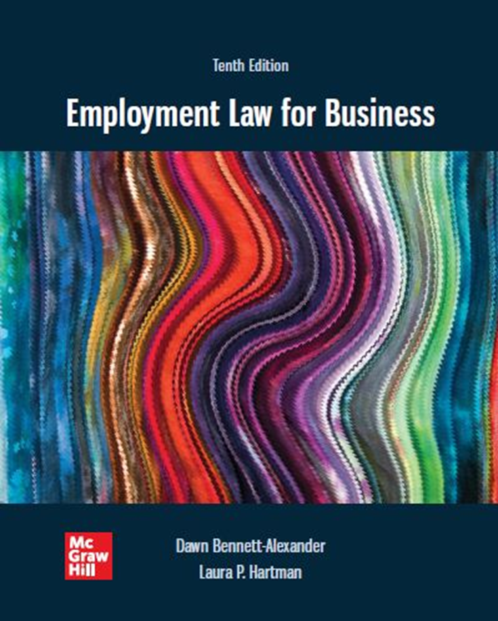
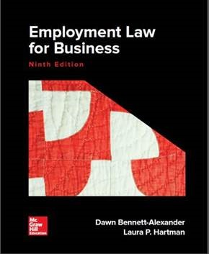
Chapter 11 Religious Discrimination
Copyright ©2022 McGraw-Hill Education. All rights reserved. No reproduction or distribution without the prior written consent of McGraw-Hill Education

Slide 2
Learning Objectives
Discuss the background of religious discrimination and give some contemporary issues.
Give Title VII’s definition of religion for discrimination purposes.
Explain religious conflicts under Title VII and give examples.
Define religious accommodation and guidelines to its usage.
Define undue hardship as it allows an employer defense to religious discrimination claims.
Describe religious harassment and give examples.
Identify the ways in which unions and religious conflicts occur.
List some ways in which management can avoid religious discrimination conflicts.

Slide 3
Statutory, Constitutional Bases
It shall be an unlawful employment practice for an employer—
(1) to fail or refuse to hire or to discharge any individual, or otherwise to discriminate against any individual with respect to his compensation, terms, conditions, or privileges of employment, because of such individual’s . . . religion . . . or
(2) to limit, segregate, or classify his employees or applicants for employment in any way which would deprive or tend to deprive any individual of employment opportunities or otherwise adversely affect his status as an employee, because of such individual’s religion . . . Title VII of the Civil Rights Act of 1964, as amended; 42 U.S.C. § 20002-2(a).
___
Congress shall make no law respecting an establishment of religion, or prohibiting the free exercise thereof . . . [First Amendment to the U.S. Constitution.]

Slide 4
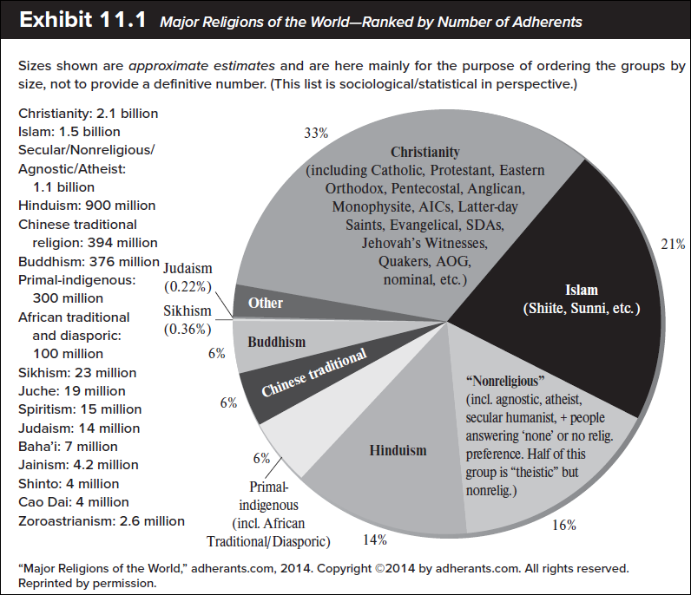
Major Religions of the World—Ranked by Number of Adherents

Slide 5
Major Religions in the U.S.
Top Organized Religions
Christianity | 76.5%
Judaism | 1.3
Islam | 0.5
Buddhism | 0.5
Hinduism | 0.4
Unitarian Universalist (Organized?) | 0.3
Wiccan/Pagan/Druid | 0.1

Slide 6
This Is Not Your Parent’s Religious Discrimination 1
As a nation of immigrants, the United States has always had a diversity of religions among its people.
Pilgrims and other sects emigrated from Great Britain and elsewhere in Europe because they wanted:
Right to practice religion freely (‘free exercise’) and
Not to be required to accept a government’s state-imposed religious beliefs (‘establishment’ clause).
Those values occupy a prominent place in the Bill of Rights.
Title VII prohibits discrimination in employment based on religion.

Slide 7
Not Your Parent’s Religious Discrimination 2
Original emphasis of Title VII protections dealt with exclusions from opportunities based on worker’s faith.
Number of claims small relative to other protections
Significant increase in cases involving Middle Eastern, South Asian-centered sects.
Increased religious workplace activism among Christian sects also generates claims.
EEOC Compliance Manual of 2008:
Claims of religious discrimination doubled between 1992 and 2007 (post-9/11).
As religious pluralism has increased, questions about religious discrimination have increased.
Public employees: Constitutional guarantees for federal, state, and local government employees when government is employer
Federal and state constitutional guarantees of due process, equal protection, and freedom of religion also provide protection for federal, state, and local government employees
Private employees: Title VII is the only legislation specifically prohibiting religious discrimination in employment
Gives consideration to constitutional issues where necessary

Slide 8
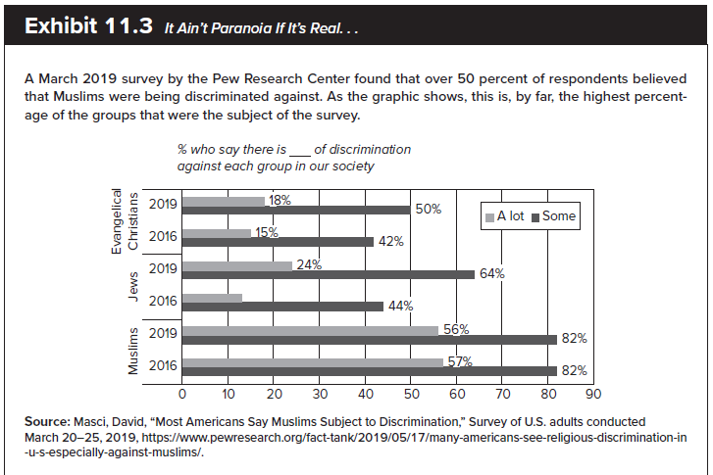
This Is Not Your Parent’s Religious Discrimination 3
Perceptions of anti-Muslim discrimination:

Slide 9
Not Your Parent’s Religious Discrimination 4
Religious organizations: Largely exempt regarding Title VII (professor thinks religious institutions are totally protected from Title VII compliance, regardless of position)
Ministerial exception (recall: Gannon case)
BFOQ for some other staff positions (e.g., academia)
Even some secular activities exempted (e.g., LDS gym janitor case)
Section 703(e)(1) and (2) of Title VII:
Not an unlawful employment practice for a school, college, university, or other educational institution to hire or employ those of that particular religion;
Religion is recognized as a basis for a Bona Fide Occupational Qualification (B F O Q) reasonably necessary to the normal operation of that particular business or enterprise.

Slide 10
Not Your Parent’s Religious Discrimination 5
‘Ministerial exception’: religious organizations have full authority to determine who their religious leaders are, and to apply their religious dictates even when those dictates conflict with workplace antidiscrimination laws.
Case: Hosana-Tabor Evangelical Lutheran Church v. EEOC. ‘Called’ teacher terminated after taking leave to treat narcolepsy. US Supreme Court upheld firing, but did not closely define to whom exception extends.
Out of respect for ‘free exercise’ clause, courts reluctant to insert selves into inner workings of religious institutions, even regarding secular activities
Case: Church of Jesus Christ of Latter Day Saints v. Amos – janitor at church-sponsored gym fired for failure to pay dues

Slide 11
Not Your Parent’s Religious Discrimination 6
Two Key Private Sector Concepts:
Duty to reasonably accommodate: Employer’s Title VII duty to try to find a way to avoid conflict between workplace policies and an employee’s religious practices or beliefs
Undue hardship: Burden imposed on an employer, by accommodating an employee’s religious conflict too onerous for the employer to bear
Case: Tyson v. Clarian Health Partners, Inc.

Slide 12
What Is Religion? 1
Exceptionally broad definition, interpreted broadly.
Section 701, Title VII, section (j)
Term "religion" includes all aspects of religious observance and practice, as well as belief
Unless an employer demonstrates that he or she is unable to reasonably accommodate an employee’s or prospective employee’s religious observance or practice without undue hardship on the conduct of the employer’s business
Two Key considerations for determining whether an employee's religion must be accommodated by an employer
Belief must be sincere and closely held by the employee
Takes the place of religion in the employee’s life
No particular beliefs or organizations or attendance
Atheism has been considered a “religion” for Title VII purposes
Church of FSM…maybe not so much (then again)
Case: Frazee v. Illinois Department of Employment Security, Peterson v. Wilmur Communications, Inc.

Slide 13
What Is Religion? 2
Employer's duty to ‘reasonably accommodate.’
Attaches to the conflict itself, not to when the conflict arises. Take employee as currently found, including later conversions, rebirths, etc. (after-hire conversions are protected)
Applies to religious practices, not religious beliefs. (Remember you can’t discrimination against one’s religious belief with respect to employment decisions; we are talking about ER reasonably accommodating religious practices in the workplace)
Requires a good faith attempt, via an ‘iterative process’ (discussion) to find an accommodation between the practice and business needs.
Example: conversion of janitorial closet to allow employee foot ‘ablutions’ (i.e. worship rituals), proselytizing at work, attire/grooming codes, etc.
Limit of Reasonable Accommodation duty is at the point it presents an ‘undue burden’ or hardship to the business.
Note: the Undue Burden limit is ‘de minimis’ – employer doesn’t have to do much to satisfy the duty, but must make a good faith attempt.

Slide 14
Religious Conflicts: prima facie case
Requirements for a prima facie case
Employee holds a sincere religious belief that conflicts with an employment requirement
Employee has informed the employer of the conflict
Employee was discharged or disciplined for failing to comply with the conflicting employment requirement
Case: Goldman v. Weinberger
Once prima facie case is established, the burden shifts to the employer to prove reasonable accommodation was offered OR undue hardship
Case: Wilson v. US West Communications (fetus button)

Slide 15
Religious Conflicts - Process
Employer considerations
Make sure the basis for conflict is a religious one
Attempt a good-faith accommodation of the religious conflict
Understand the limit of employer duty
If the employer has tried everything available that does not present an undue hardship, he or she has fulfilled their Title VII obligation and there is no liability
Case: Chalmers v. Tulon Company of Richmond
Scenarios 2 and 3
The right to be free of religious discrimination is not absolute

Slide 16
EmployeR’s Duty to Reasonably Accommodate
The duty to accommodate depends on the circumstances and will vary from situation to situation
Get creative!
Iterative process – engage employee regarding his/her interests, suggest possibilities
Employer relieved of liability if:
Employer reasonably accommodated or attempted to accommodate the employee
If an accommodation cannot be found, the employer made a good-faith attempt at an accommodation rather than simply dismissing the conflict
Case: Chalmers v. Tulon Company of Richmond

Slide 17
Employee’s Duty to Cooperate in Accommodation
Under Title VII, employer is not required to resolve the conflict in the way the employee wants.
Employee must cooperate with Employer’s attempt to find Reasonable Accommodation
Accommodation need not be the most reasonable or the one the employee wants.
May involve reassignment, demotion
Sometimes, accommodation cannot be found, despite effort
Case: Vargas v. Sears, Roebuck & Company.

Slide 18
Factors Determining Reasonableness of Accommodation
Whether the employer made an attempt at accommodation.
Size of the employer’s workforce.
Type of job in which the conflict is present.
Employer’s checking with other employees to see if anyone was willing to assist in the accommodation.
Financial cost of accommodation.
Administrative burdens of accommodation.

Slide 19
Factors in Undue Hardship 1
E E O C guidelines on factors determining undue hardship.
Nature of the employer’s workplace.
Type of job needing accommodation.
Cost of the accommodation.
Willingness of other employees to assist in the accommodation.
Possibility of transfer of the employee and its effects.
What is done by similarly situated employers.
Number of employees available for accommodation.
Burden of accommodation on the union (if any).

Slide 20
Undue Hardship - Conclusion
Courts find undue hardship if an employer must:
Violate the seniority provision of a valid collective bargaining agreement
Pay out more than a “de minimis” (i.e. MINIMUM) cost to replace a worker who has religious conflicts
Relatively low standard; contrast Disability cases in Chap 13
Force other employees who do not wish to do so to trade places with the employee who has a religious conflict
Case: Trans World Airlines, Inc. v. Hardison

Slide 21
Religion as a B F O Q
Title VII permits religion to be a bona fide occupational qualification
Must be reasonably necessary to the employer’s particular normal business operations
Specifically permits educational institutions to employ those of a particular religion if they are owned in whole or in substantial part by a particular religion
Case: Pime v. Loyola University of Chicago

Slide 22
Religious Harassment 1
One of the most active areas under religious discrimination recently. Two types:
harassment based on hostility toward beliefs (traditional)
harassment based in religious activism (e.g., proselytizing)
Under EEOC guidelines for federal employees (1997):
Should be permitted to engage in private religious expression in personal work areas.
Should be permitted to engage in religious expression with fellow employees, with reasonable restrictions
Are permitted to engage in religious expression directed at fellow employees, but cease when requested or unwelcome.

Slide 23
Religious Harassment 2
To avoid liability employer policies should:
Protect employees from those religious employees who attempt to proselytize others who do not wish to be approached about religious matters.
Protect employees with permissible religious practices who are given a hard time by those who believe differently.
Make sure that employees are given comparable opportunities to use workplace time and resources for religious practices.
Case: Peterson v. Hewlett-Packard Co.

Slide 24
Union Activity and Religious Discrimination
Unions are also under a duty to reasonably accommodate religious conflicts (as in Hardison case)
Conflicts with some religious beliefs emerge regarding:
Union membership.
Payment of union dues.
Engagement in concerted activity such as picketing and striking.
Employees also have objected to the payment of union dues as violating:
First Amendment right to freedom of religion.
Title VII’s prohibition against religious discrimination.
It violates Title VII for an employer to discharge an employee for refusal to join the union because of his or her religious beliefs.
Case: Tooley v. Martin-Marietta Corp.

Slide 25
Management Tips
Take all employee notices of religious conflicts seriously.
Once an employee puts the employer on notice of a religious conflict, immediately try to find ways to avoid the conflict (via ‘iterative process’).
Ask the employee with the conflict for suggestions on avoiding the conflict.
Ask other employees if they can be of assistance in alleviating the conflict.
Keep workplace religious comments and criticisms to a minimum.
Make sure all employees understand that they are not to discriminate in any way against employees on the basis of religion.
Once an employee expresses conflict based on religion, do not challenge the employee’s religious beliefs, though it is permissible to make sure of the conflict.
Revisit issues such as Christmas bonuses and Christmas parties and giving out Christmas turkeys or other gifts to see if it is more appropriate to use more inclusive language such as holiday to cover employees who do not celebrate the Christian holiday of Christmas. Further, revisit the issue of whether all employees are being fairly covered by such policies and events.
Revisit the issue of granting leave for religious events and make sure it does not favor one religion, such as paid leave for Christmas but no other Holidays. “Floating holidays” instead?
Make sure undue hardship actually exists if it is claimed.
Make sure food at workplace events is inclusive of all employees, regardless of religion, such as kosher items for Jewish employees, non-alcoholic beverages for those who do not drink for religious reasons, non-pork items for Muslims, etc. Asking employees about their religious dietary limitations, or having employees bring a dish to share is an easy way to handle this. It may seem a small thing to deal with, but it can be very significant. These types of things help to create (or not) a workplace that employees feel adheres to both the letter and spirit of the law. This, in turn, impacts an employee’s perception of non-discrimination and inclusion, leading to greater productivity and loyalty.

