Slide 1
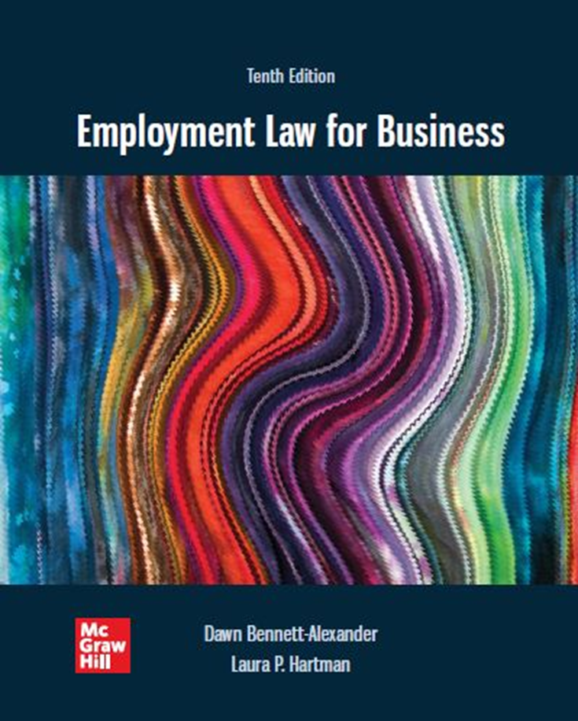
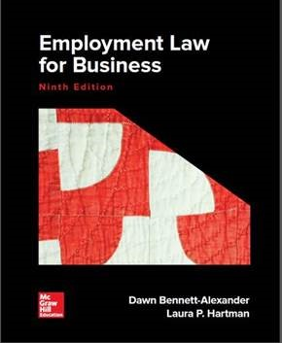
Chapter 9 Sexual Harassment
Copyright ©2022 McGraw-Hill Education. All rights reserved. No reproduction or distribution without the prior written consent of McGraw-Hill Education

Slide 2
Learning Objectives
Recognize the background leading up to sexual harassment as a workplace issue.
Explain quid pro quo sexual harassment and give the requirements for making a prima facie case.
Explain hostile environment sexual harassment and give the requirements for making a prima facie case.
List and explain employer defenses to sexual harassment claims.
Define the reasonable victim standard, and how and why it is used in sexual harassment cases.
Differentiate the sex requirement and anti-female animus in sexual harassment actions.
Explain employer liability for various types of sexual harassment claims.
Describe proactive and corrective actions an employer can take to prevent or lessen liability.

Slide 3
Statutory, Regulatory Bases
It shall be unlawful employment practice for an employer—
(1) to fail or refuse to hire or to discharge any individual, or otherwise to discriminate against any individual with respect to his compensation, terms, conditions, or privileges of employment, because of such individual’s . . . sex [gender] . . . . Title VII of the Civil Rights Act of 1964, as amended. 42 U.S.C. & 2000e2(a).
Unwelcome sexual advances, requests for sexual favors, and other verbal or physical conduct of a sexual nature constitute sexual harassment when (1) submission to such conduct is made either explicitly or implicitly a term or condition of an individual’s employment, (2) submission to or rejection of such conduct by an individual is used as the basis for employment decisions affecting such individual, or (3) such conduct has the purpose or effect of unreasonably interfering with an individual’s work performance or creating an intimidating, hostile, or offensive working environment. 29 CFR § 1604.11 (a) (EEOC Sexual Harassment Guidelines).
Sexual harassment class action trials are rarely litigated.
Also called “a white buffalo.”

Slide 4
Introduction
Unsavory topic, but crucial that HR professionals understand, manage and prevent disruptive, expensive, unfair and illegal behaviors in the workplace.
Recent wide publicizing of sexual misconduct demonstrates the frequency and breadth of problem
Sexual harassment in the workplace occurs more frequently than many realize
Results in:
Loss of opportunity to victims and organizational productivity
Unnecessary expenses of defense and damages
Management distraction and morale issues
Negative effects on personal lives.
Important and urgent to confront and minimize these situations.
Sexual harassment class action trials are rare
Also called the “white buffalo”
Two types of sexual harassment
Quid Pro Quo
Hostile Work Environment
Statutory basis: Civil Rights Act, Title VII
Cost to businesses, personal lives…1991 Amendment to CRA allowed for punitive & compensatory damages and jury trials
If HR ever matters (and it does), then liability is preventable through standard setting, process follow-through and enforcement

Slide 5
Since Eden, and counting … 1
Maltreatment of women in workplace goes back centuries, whether in slave fields, or textile mills
‘Harassment’ is subset of Title VII discriminatory behaviors (disparate treatment)
Although the Civil Rights Act has been around since 1964, sexual harassment cases are relatively new
U.S. Supreme Court did not hear its first sexual harassment case until 1986. (Meritor Savings case…dealt with Hostile Work Environment)
Anita Hill’s 1991 testimony v. Clarence Thomas US Supreme Court appointment confirmation.
Behaviors occurred when Thomas ran EEOC; Hill assisted him
Affected workplace environment.
Led to increase in complaints filed with the EEOC after the hearings.

Slide 6
Since Eden, and counting … 2
1996 - $multi-million award v. law firm that ignored chronic problem alerted US businesses to serious financial consequences
1998 - Supreme Court rules on Ellerth, Farragher cases, hoping to nip harassment-in-bud via policies, reporting
Prevention…IMPORTANT; it lays out Employer Defenses (more on this later)
Problem persists as more victims publicize misconduct by powerful execs. ‘Me, too’ movement spawned.
2017+ - Allegations of sexual misconduct reprised in Kavanaugh confirmation hearings, and against other public figures

Slide 7
Is It a Big Deal?
U.S. Merit Systems Protection Board studies: 19 80, 1987
42 percent of federal employees reported sexual harassment in each separate survey
More recent surveys by Working Woman, NY Times, National Law Journal and Parade consistently report 40-70% of women harassed in different work contexts
Emergence of class action claims, once considered ‘as rare as a white buffalo,’ now not unusual – and particularly expensive.

Slide 8
Where Do Sexual Harassment Considerations Leave the Employer?
Consensual relationships between employees NOT forbidden under the law.
‘Consent’ is a dynamic variable
Employees may date consistent with company policy
Company risk increases dramatically if one participant supervises the other.
See Model Sexual Harassment Policy, Exhibit 9.2
Problematic when actions directed toward employee are/become ‘unwelcome.’
Sexual Harassment concerns Unwelcome Activity – imposes terms and conditions that are different for one gender
Becomes a problem when:
Activity directed toward an employee is unwelcome
Terms or conditions different for one gender than are imposed
Sexual harassment policies, procedures and follow-through are keys to nipping unnecessary liability in the bud.
Several states now mandate regular supervisor and general employee training

Slide 9
Sexual Harassment in General
Two legal theories: Quid pro quo sexual harassment and Hostile Work Environment sexual harassment.
Quid pro quo sexual harassment: Sexual harassment in which the harasser extracts “sex” as a condition of employment (i.e. something given or received for something else)
Hostile environment sexual harassment: Sexual harassment in which the harasser creates an abusive, offensive, or intimidating environment for the harassee (gravamen: it makes that person’s job sig. harder to do as a result)
Distinction between the two terms need not be rigid according to the U.S. Supreme Court
Most sexual harassment takes place between males and females
Male as the harasser and the female as the harassee
Gender of the harasser need not be male and the gender of the parties does not matter
Males can be sexually harassed also (16% of claims in 2018)
Males bring fewer cases in part due to fear of ridicule
Sexual orientation is NOW covered under Title VII
Harassment cases can still be brought regardless of the gender(s) of the harasser and harassee (Orcale v. Sundowner Offshore Services, Inc.)

Slide 10
Quid Pro Quo Sexual Harassment
Quid pro quo sexual harassment: Abuse of power in that Harasser requests sexual activity from the harassee in exchange for workplace benefits under harasser’s control.
More obvious type of sexual harassment; not generally difficult to recognize.
But Note: per Ball State University v. Vance: harasser must have authority to hire/fire and not just direct work assignments

Slide 11
Hostile Work Environment Sexual Harassment
Hostile work environment sexual harassment: Harasser creates an abusive, offensive, or intimidating environment for the harassee.
Offensive work environment to which one gender is subjected but not the other.
Case: Meritor Savings Bank, FSB v Vinson
Prima facie case elements:
The harassment be unwelcomed by the harassee.
The harassment be based on gender.
The harassment be sufficiently severe or pervasive to create an abusive working environment.
The harassment affects a term, condition, or privilege of harassee’s employment.
The employer had actual or constructive knowledge of the sexually hostile working environment and took no prompt or adequate remedial action.

Slide 12
Comparison between Quid Pro Quo and Hostile Work Environment Sexual Harassment
Quid Pro Quo Sexual Harassment
Hostile Environment Sexual Harassment
Workplace benefit promised, given to, or withheld from harasser by harasser.
In exchange for sexual activity by harassee.
Generally accompanied by a paper trail.
Activity by harasser, toward harassee that:
Is unwanted by the harassee.
Is based on harassee’s gender.
Creates for harassee a hostile or abusive work environment.
Unreasonably interferes with harassee’s ability to do his or her job.
Is sufficiently severe and/or pervasive.
Affects a term or condition of harassee’s employment.
Basis for imposing liability on Employer (e.g., knowledge, acquiescence)

Slide 13
‘Unwelcomeness’ Requirement
Unwelcome activity: Unwanted activity by the harasser is the basis of hostile environment sexual harassment actions.
Case: Meritor Savings Bank v. Vinson, where numerous sexual contacts occurred over extended period: ‘Unwelcome’ does not mean ‘involuntary.’
Scenario 3: formerly welcome activity may become unwelcome.
Evidence may be direct (‘please stop’) or indirect (failure to join-in, any show of disapproval, body language, eye signals…any sign of disapproval)
Corporate culture, type of business does not give ER right to expose EE to “unwelcome” conduct
Ex. Strip clubs, Hooters, or businesses that exude sex, flirtation, etc. in its business does not absolve them of liability

Slide 14
‘Severe and Pervasive’ Requirement
Severe and/or pervasive activity: Harassing activity that is more than an occasional act, and is so serious that it interferes with the nature of the job
More frequent, physical, humiliating or serious occurrences make it more likely that severe/pervasive requirement will be met.
Not a civility code – focus is on victim’s right to do the job without pattern of unwelcome activities that make it more difficult to operate as an employee (does it unreasonably interferes with employee’s work performance?).
Also not a personal injury claim. Claims do not require findings of severe psychological harm to be actionable.
“… So long as the environment would reasonably be perceived, and is perceived, as hostile or abusive, there is no need for it also to be psychologically injurious.”

Slide 15
Perspective Used to Determine Severity
Courts’ perspective has evolved since Rabidue v. Osceola’s 1980s ‘boys-will-be-boys’ rhetoric
Reasonable person standard: Viewing the harassing activity from the perspective of a reasonable person
Harassing activity includes gender-specific sociological, cultural, and other factors
Reasonable victim standard (also known as Reasonable Woman Standard): Viewing the harassing activity from the perspective of a reasonable person in society at large
Generally tends to be the male view
Evolution in the case law over time: away from ‘take the workplace as you find it’ (an essentially ‘male’ standard) toward current ‘reasonable victim’ perspective (regardless of gender)
EEOC issued a policy statement
Required that the victim’s perspective also must be considered so as not to perpetuate stereotypes
Notion was labeled the “reasonable woman” or reasonable victim standard
U.S. Supreme Court decision on Oncale v. Sundowner Offshore Services, Inc.:
“The objective severity of harassment should be judged from the perspective of a reasonable person in the plaintiff’s position”

Slide 16
“Sexual” Requirement Explained
Harassing behavior need not involve sex, requests for sexual activity, sexual comments, or other similar activity.
Anti-female animus: recalling the bases for race or national origin harassment, hostility toward women and/or their ability to perform jobs or functions can qualify.
Usually manifested by negative language, actions and feelings about women and/or their ability to perform jobs or functions.
Harassment may include electronic means
Andrews v. Philadelphia hostile actions (e.g., vandalism) directed at female officers.

Slide 17
Employer Liability for Sexual Harassment 1
Supervisor toward Employee (Tangible Employment Action…demotion, firing, hiring, not hiring, etc.)
Generally quid pro quo sexual harassment
Employers are strictly liable for the tangible acts of their supervisors
Presence of a paper trail, which gives employers a measure of control in monitoring for actions

Slide 18
Employer Liability for Sexual Harassment 2
Supervisor toward Employee (No Tangible Employment Action)
Employer is not strictly liable…an ER may raise an affirmative defense to liability or damages subject to proof of preponderence of evidence
Ellerth/Farragher defense:
ER exercised any reasonable care to correct and prevent PROMPTLY claims of any sexual harassment (IMPORTANT…ER needs to have an effective prevention policy in-place);
EE “unreasonably” failed to take advantage of any preventive or corrective opportunities
Case: Burlington Industries, Inc. v. Ellerth (1998)

Slide 19
Employer Liability for Sexual Harassment 3
Co-worker harassment or third-party harassment of employee.
The harasser and harassee are on the same level.
Harasser is not employed by the employer (e.g., a client).
Employer is liable if the acts of harassment were known, yet no corrective action was taken by employer.
Case: Farragher v. City of Boca Raton (1998).
Scenario 1: ‘don’t look’ is inadequate employer response. Employer does have duty to respond effectively.

Slide 20
Determining the Truth of Allegations
The E E O C’s Policy Guidance on Harassment.
Inherent plausibility.
Demeanor.
Motive to falsify.
Corroboration.
Past record.
Other employees should be involved only on a “need to know” basis.

Slide 21
Retaliation and Employee Privacy
On reporting the sexual harassment, the alleged harasser must be told of the complaint for the employer to effectively address it.
Retaliation against harassee or witnesses illegal, and can have particularly severe consequences for employer.
Recent, dramatic rise in Retaliation claims at EEOC. Filed in conjunction with underlying discrimination claim, they constitute > 50% of all claims.

Slide 22
Corrective Action
Employers must take “immediate and appropriate corrective action.”
Specific remedies heavily dependent on context, but uniform goals:
Stop the harassment.
Not be out of proportion to the act - ‘zero tolerance’ often assumed to require discharge for very different acts.
Not have the effect of punishing the harassee (e.g. transfer often inappropriate. Harassee may excel and enjoy job, except for the harassment (therefore s/he reported it, instead of just leaving).

Slide 23
Damages and Jury Trials
Civil Rights Act of 19 91.
Employees suing for sexual harassment can:
Ask for up to $300,000 in compensatory or punitive damages and unlimited medical damages.
Request a jury trial.
NOTE: In some states (CA), harasser can be personally liable for damages, in addition to employer liability. (Be sure to mention this in your anti-harassment training.)
E E O C has institutionalized the use of alternative dispute resolution (A D R).

Slide 24
Tort and Criminal Liability
Harassment can be basis for other civil (‘tort’) or criminal liability arising out of the same actions (e.g. manager’s actions in Meritor Savings)
Tort actions
Assault – Intentionally putting the victim in fear or apprehension of unwanted touching.
Battery – Intentional unpermitted bodily touching.
Infliction of emotional distress.
False imprisonment.
Interference with contractual relations.
Action could form the basis of criminal prosecution for criminal assault, battery, and rape.

Slide 25
Management Tips
Adopt an anti-sexual harassment policy.
Take a top-down approach to deter sexual harassment.
Create and disseminate information about an effective reporting mechanism for harasses.
Consistently remind employees of the policy.
Provide employees with training and/or information that helps them to recognize sexual harassment.
Ensure that reported incidents of sexual harassment are taken seriously.
Ensure that the training employees receive is effective, interactive, and engaging.
Create an environment where sexual harassment is not tolerated.
Promptly investigate all sexual harassment claims.
Keep an eye out for anti-female animus.
Make sure the corrective action is commensurate with the policy violation.
Work to keep the workplace friendly, open and respectful.

