Slide 1
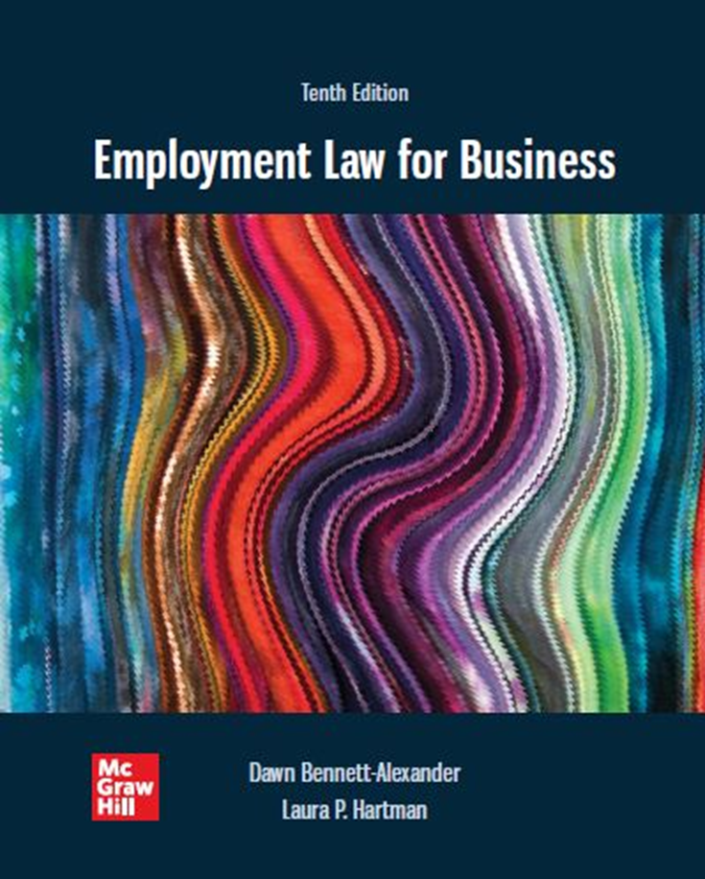
Chapter 8 Gender Discrimination
Copyright ©2022 McGraw-Hill Education. All rights reserved. No reproduction or distribution without the prior written consent of McGraw-Hill Education

Slide 2
Learning Objectives
Review Title VII and other laws relating to gender discrimination.
Understand the background of gender discrimination and how we know it still exists.
Recognize many different ways in which gender discrimination is manifested in the workplace.
Analyze a situation and determine if there are gender issues that may result in employer liability.
Define fetal protection policies, ‘gender-plus’ and pregnancy discrimination, workplace lactation issues, and gender-based logistical concerns.
Differentiate between legal and illegal grooming policies.
List common gender realities at odds with common bases for illegal workplace determinations.
Distinguish between equal pay and comparable worth and discuss proposed legislation.
Note: Reread the Preface regarding the use of gender terminology before reading this chapter.

Slide 3
Statutory Bases
It shall be an unlawful employment practice for an employer—
(1) to fail or refuse to hire or to discharge any individual, or otherwise to discriminate against any individual with respect to his compensation, terms, conditions, or privileges of employment, because of such individual’s . . . sex [gender] . . . [Title VII of the Civil Rights Act of 1964, as amended. 42 U.S.C. § 2000e-2 (a).]
(k) The term “because of sex” or “on the basis of sex” includes, but is not limited to, because of or on the basis of pregnancy, childbirth, or related medical conditions; and women affected by pregnancy, childbirth, or related medical conditions shall be treated the same for all employment-related purposes, including receipt of benefits under fringe benefit programs, as other persons not so affected but similar in their ability or inability to work. . . . [Pregnancy Discrimination Act, 42 U.S.C. § 2000e.]

Slide 4
Does it Really Exist?
EEOC stated: “Sex discrimination against males and females alike continues to be a problem in the 21st century workplace”
Gender discrimination covers both males and females
Majority of EEOC gender claims are filed by women
Merrill Lynch - First time a Wall Street firm was found to have engaged in systematic gender discrimination
Intersectionality: Experiencing more than one type of discrimination at a time
E.g., being black and female
In 2007, the EEOC issued “family responsibility discrimination” (FRD)
Women are more likely to suffer adverse employment actions taken against them because of their caregiving responsibilities
Focus of EEOC claims has shifted from hiring discrimination to on-the-job issues
Equal pay, promotions, harassment, pregnancy leave, lactation policies, caregiver responsibilities, and domestic violence
Statistical evidence of gender disparity
Women make up 46.8 percent of the workforce, but 57 percent of women participate in the labor force
Women have been earning more degrees than men
U.S. Census Bureau found that the gender-based wage gap is present in every profession
A 2011 White House Commission on Women and Girls report indicated that women earn 75 percent as much as men at all levels of educational attainment
In Fortune 1000 industrial and Fortune 500 service firms, 97 percent of top managers are white males
Prior to the 1964 Civil Rights Act, it was common for states to have laws that limited or prohibited women from working at certain jobs
Claimed that such laws were for the protection of women
Gender was not originally a part of the Civil Rights Act
Per Title VII, it is the person’s ABILITY that must be the basis for workplace decisions, not his or her gender

Slide 5
Does it Really Exist? 2
Steady growth in female CEOs, but 20 of Fortune 500?
Focus of EEOC claims has shifted from hiring discrimination to on-the-job issues.
Equal pay, promotions, harassment, pregnancy leave, lactation policies, caregiver responsibilities, and domestic violence.

Slide 6
Gender Stereotypes
Stereotypes impact how employees of a given gender are viewed in the workplace
Examples of gender stereotypes:
Women are better suited to repetitive, fine motor skill tasks
Women are too unstable to handle jobs with a great deal of responsibility or high pressure
Men make better employees because they are more aggressive
Men do not do well at jobs requiring nurturing skills, such as day care, nursing, elder care, and the like
When women marry they will get pregnant and leave their jobs
When women are criticized at work, they will become angry or cry
A married woman’s pay is only extra family income
A woman who changes jobs is being disloyal and unstable
A woman should not have a job that requires her to have lunch or dinner meetings with men
Women cannot have jobs that require travel or a good deal of time away from home

Slide 7
Gender Discrimination in General
Unless its BFOQ, Gender may NOT be the basis of any decision relating to employment, including:
Advertising for available positions and specifying a preferred gender
Sex-Specific Application/Interview questions that are only asked of one gender (i.e. asking for maiden names, and not “another” name, or asking females if they have proper day care but not males)
Requiring one gender to work different hours or job position (i.e. not allowing females to work at night)
Training opportunities (i.e. requiring only females to attend sensitivity training but not men)
Discipline, Termination differences (i.e. giving warnings to females for “talking back” to boss, but not doing same for men, or terminating females for fighting on job but not doing the same for men)
Some Seniority system effects (LIFO effect) (i.e. using seniority systems to favor a certain gender)
Pay and benefits disparities (violation of Equal Pay Act)
Different conduct standards, express or unconscious
Not considering legitimate differences between genders (i.e. firefighting apparel “fil”)
Case: Wedow v. City of Kansas City
Familiar Disparate Treatment and Disparate Impact claims available

Slide 8
Recognizing Gender Discrimination
Does a facially neutral policy exclude members of a particular gender from the workplace or some workplace benefit?
Case: Dothard v. Rawlinson
Do height and weight requirements statistically exclude certain groups? (disparate impact)
Do these requirements directly correlate to ability to do the job? (necessity)
Are there better, less discriminatory requirements?

Slide 9
‘Romantic Favoritism’

Slide 10
“Gender-Plus” Discrimination
“Gender-plus” discrimination: Employment discrimination based on gender and some other factor such as marital status or children
Males are not subject to the same limitations
Case: Phillips v. Martin Marietta Corp.
Employer had a policy of not hiring women with preschool-aged children
Domestic duties assumption basis
Court found discrimination, but mused whether employer might have claimed a B F O Q exception. See Justice Marshall’s response in his Concurring Opinion, next slide.
Court has not permitted BFOQs to be used in such ways to discriminate based on gender since this case

Slide 11
Aside: Phillips v. Martin Marietta Corp
“I cannot agree with the Court's indication that a ’bona fide occupational qualification reasonably necessary to the normal operation of’ Martin Marietta’s business could be established by a showing that some women, even the vast majority, with pre-school-age children have family responsibilities that interfere with job performance and that men do not usually have such responsibilities.
Certainly, an employer can require that all of his employees, both men and women, meet minimum performance standards, and he can try to ensure compliance by requiring parents, both mothers and fathers, to provide for the care of their children so that job performance is not interfered with.
But the Court suggests that it would not require such uniform standards. I fear that, in this case, where the issue is not squarely before us, the Court has fallen into the trap of assuming that the Act permits ancient canards about the proper role of women to be a basis for discrimination. Congress, however, sought just the opposite result.”
Note: If you ever needed a demonstration of why ‘diversity’ can be important, here it is. Marshall was the first and only minority Justice at the time of this case. BFOQ claims have found no traction in similar, later cases.

Slide 12
Gender Stereotyping
Gender stereotypes: The assumption that most or all members of a particular gender must act a certain way
Workplace decisions based on stereotypes are prohibited by Title VII
Ideas of how a particular gender should act or dress
What roles they should perform
Case: Price Waterhouse v. Hopkins
Female candidate denied partnership because of aggressive, typically ‘male’ personality and actions
Would she have qualified if she had met the female stereotype?
Even supporters considered her a "lady partner" candidate – company needed one set of criteria for one kind of partnership.
Echoes of case in EEOC approach to ‘sex’ in sexual orientation/transgender cases (chapter 10)

Slide 13
Gender Stereotyping, further examples
Notes:
Page 358-361

Slide 14
Grooming Codes
Title VII does NOT prohibit an employer from using gender as a basis for reasonable grooming codes
Needn’t be identical, if generally similar
Employer discretion: grooming codes rarely affect opportunity
Exception: Codes that doe affect opportunity or differentially impacts perception of the employee in the workplace (salesmen: suits, saleswomen: smocks) may be challenged
Gender-based grooming policy that subjects only one gender to different conditions of employment would not be allowed
Jesperson v. Harrah’s case may be an outlier.
Seek ‘reasonable’ standards of what is generally thought to be male- or female-appropriate attire in a business setting, monitor for impact
Notes:
Page 358-361

Slide 15
Customer or Employee Preferences
Customer, co-worker preference is not a legitimate and protected reason to treat otherwise-qualified employees differently based on gender
In other words, just because a customer MAY prefer a certain gender, it does not give the ER a BFOQ excuse (unless it pertains to necessary business practice)
The Hooters situation (Scenario 2) – legal defiance in favor of marketing to a hormonal male demographic. Male students invited to apply there and report back to us.
Note: policy would be defensible in adult entertainment context; Hooter’s calls itself a ‘family restaurant’ (crayons, even), Marketing effect endures (every semester more Qs)
1991 amendment to Title VII
Applicable to U.S. citizens employed by American-owned or -controlled companies doing business outside the United States (legal exception)

Slide 16
Logistical Considerations
Employers may not forgo hiring those of a certain gender because of logistical issues unless it involves an unreasonable financial burden.
Examples:
Female sports reporters going into male athletes’ locker rooms (and vice versa).
Female firefighters sleeping at a fire station.
Lack of bathrooms at a construction site, case: Lynch v. Freeman.
Breast-feeding or expressing milk at work.
ACA/Obamacare requires 50+ FTE employers to provide reasonable and private non-restroom facilities
Some state laws go further (CA) Check local requirements

Slide 17
Equal Pay and Comparable Worth 1
Statutory basis: (1) No employer . . . shall discriminate between employees on the basis of sex by paying wages to employees . . . at a rate less than the rate at which he pays wages to employees of the opposite sex . . . for equal work on jobs the performance of which requires equal skill, effort, and responsibility, and which are performed under similar working conditions, except where such payment is made pursuant to (i) a seniority system; (ii) a merit system; (iii) a system which measures earnings by quantity or quality of production; or (iv) a differential based on any other factor other than sex. . . . [Equal Pay Act, 29 U.S.C.A § 206(d).]

Slide 18
Equal Pay and Comparable Worth 2
Despite the Equal Pay Act, women earn on average 78.3 cents for every dollar earned by men.
Women’s salaries may be equal by the year 2050
The EPAct overlaps with Title VII’s general prohibition against discrimination in employment on the basis of gender.
EPAct concerns the practical content of the job, not title or description
Recent state laws put burden on ER to justify differences (CA)
Title VII’s Bennett Amendment
Exceptions permitted by the E P A (jobs compared in a Title VII unequal pay action need not be substantially equal).
Comparable worth: A Title VII action for pay discrimination based on gender
Jobs held mostly by women are compared with comparable jobs held mostly by men
Pay compared, to determine if there is gender discrimination
Lilly Ledbetter Fair Pay Act: extends statute of limitations period with each discriminatory paycheck.

Slide 19
Gender as a B F O Q
Title VII permits gender to be used as a bona fide occupational qualification under certain limited circumstances (e.g., theatrical roles).
“privacy” has been an interesting issue)
EEOC hostility to ‘legalized discrimination’ - guidelines for gender BFOQ are very strict.
Agency would limit to sperm donors or wet nurses.
EEOC v. Women’s Workout World illustrates tension between lingering privacy issues and routine customer preferences
BFOQ has been found by courts in limited circumstances (e.g., counselors at in-patient recovery center for victims of domestic abuse)

Slide 20
Pregnancy Discrimination
The Pregnancy Discrimination Act (P D A)
Prohibits discrimination based on pregnancy, childbirth, or related medical conditions.
Enacted following Supreme Court’s conclusion that discrimination on the basis of pregnancy was not gender discrimination under Title VII.
Two years later Congress passed the P D A, amending Title VII to expressly include pregnancy.
EEOC: 182% increase in the filing of pregnancy discrimination charges over the past 10 years.
Case: Young v. UPS (2015)
extension of ‘reasonable accommodation’ concept to assist pregnant employees, if company’s policies include other similar temporary disabilities.

Slide 21
Fetal Protection Policies
Fetal protection policies: Policies an employer institutes to protect the fetus or the reproductive capacity of employees.
Limit or prohibit employees from performing certain jobs or working in certain areas.
If health effects extend to both sexes, then limitation of policies to only fertile females is discriminatory.
E.g., UAW v. Johnson Controls.

Slide 22
Management Tips
Overall, send the message in word and deed that gender bias will not be tolerated.
Back up policy with appropriate enforcement.
Take employee claims seriously: promptly and thoroughly investigate all complaints.
Make sure any “punishment fits the crime.”
Conduct periodic training to remind employees about the anti-bias policy.
Conduct periodic audits and review workplace policies to make sure there is no adverse impact on any one gender. Pay gap audits may be particularly valuable
Actions taken to address gender issues need not make the workplace stilted or formal.

