Slide 1
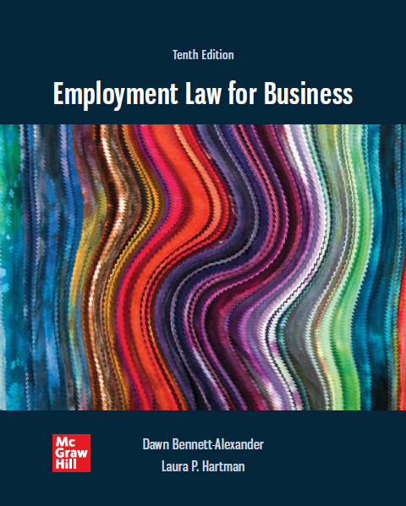
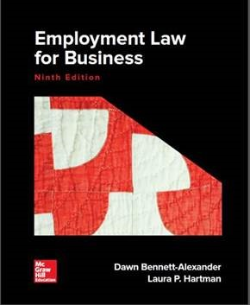
Chapter 3
Title VII of the Civil Rights Act of 19 64
Copyright ©2022 McGraw-Hill Education. All rights reserved. No reproduction or distribution without the prior written consent of McGraw-Hill Education

Slide 2
Learning Objectives
Explain the history leading up to passage of the Civil Rights Act of 19 64.
Give examples of the ways that certain groups of people were treated differently before passage of the Civil Rights Act.
Discuss what is prohibited by Title VII.
Recognize who is covered by Title VII and who is not.
State how a Title VII claim is filed and proceeds through the administrative process.
Determine if a Title VII claimant is able to proceed after receiving a "no reasonable cause" finding.
Distinguish among the various types of alternative dispute resolution used by E E O C.
Explain the post–Civil War Statutes, including what each is and what it does.
Discuss what management can do to ensure compliance with Title VII.

Slide 3
Statutory Basis
Title VII of the Civil Rights Act of 1964
(a) It shall be an unlawful employment practice for an employer—
(1) to fail or refuse to hire or to discharge any individual, or otherwise to discriminate against any individual with respect to his compensation, terms, conditions, or privileges of employment, because of such individual’s race, color, religion, sex, or national origin; or
(2) to limit, segregate, or classify his employees or applicants for employment in any way which would deprive or tend to deprive any individual of employment opportunities or otherwise adversely affect his status as an employee, because of such individual’s race, color, religion, sex, or national origin.
Title VII of the Civil Rights Act of 1964, as amended, 42 U.S.C.A. sec. 2000e et seq., sec. 703 (a).

Slide 4
An Historic Rights Act
  Civil Rights Act of 1964
  Primary focus is on racial discrimination
    Milestone in a centuries-long struggle for equality
    Abolitionism through Emancipation, Jim Crow laws, de jure and de facto segregation, post-War civil rights movement
    Result of racial discrimination supported by the Jim Crow laws
    Jim Crow Laws - a system of racial segregation that was enforced through law, the social system, and violence
    Other protected characteristics had discrimination histories in American culture: religion, ethnicity, gender
  Broad coverage: prohibits discrimination in housing, education, employment, public accommodations, and the receipt of federal funds on the basis of race, color, gender, national origin, or religion
  Employment (“Title VII’) included at JFK’s insistence; LBJ drove passage as President

Slide 5
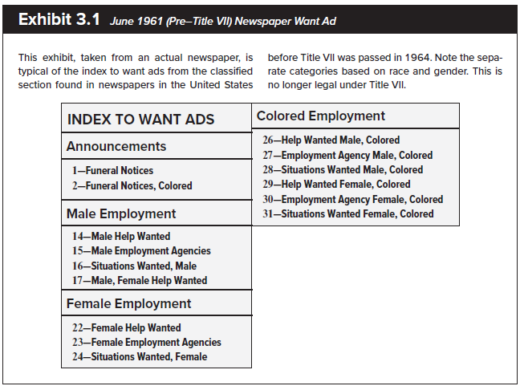
1961 Employment Want Ad

Slide 6
Title VII of the Civil Rights Act of 19 64 1
Title VII is the EMPLOYMENT section of the act.
    Prohibits workplace discrimination on the basis of race, color, gender, religion, and national origin.
    Applies to all aspects of HRM, including hiring, discharge, compensation, terms, conditions, or privileges of employment.
    Forbids segregation, unequal opportunities.
    Provides new rights to women and minorities
    Prohibits dismissal on the basis of discrimination
    Prohibits employers from employing or promoting based on bias
    Established the Equal Employment Opportunity Commission (EEOC)
    Many states and local governments later passed similar laws paralleling Title VII, some with broader coverage
      State laws also govern conduct of smaller firms federal law may not reach
    Passive Prohibitions: “Thou shalt not…”
    ‘discrimination’ is what HR does – this law prohibits several status factors in making those choices among candidates
    EEOC Regulations cover many specifics

Slide 7
Title VII of the Civil Rights Act of 19 64 2
Amendments to the Act
  Equal Employment Opportunity Act 1972
    Extension to government employees
    Title VII, 1972 amendment strengthens the enforcement powers of the EEOC
  Pregnancy Discrimination Act 1978
    Extends US Supreme Court interpretation of intended coverage
  Civil Rights Act of 1991
    Solidified Supreme Court’s interpretation of Disparate Impact as outlined in Griggs case (i.e. made it more clear and statutory)
    Jury trials, compensatory damages, punitive damages
    ‘Extra-territorial’ application: US employers abroad

Slide 8
Title VII Provisions
An employer cannot discriminate on the basis of:
  Race
  Color
  Gender – almost not included
  Religion
  National origin
What about Sexual Affinity (i.e. sexual orientation and gender identity)?
  On June 15, 2020, the United States Supreme Court held that Title VII’s prohibition on discrimination “because of…sex” includes discrimination on the basis of sexual orientation and gender identity
  EEOC regs predating Supreme Court’s 2020 Bostock decision, adding transgender (2012) and sexual orientation (2015)
Each status factor was an American tradition
  (not included: age, disability, other possible characteristics – law as product of the times)

Slide 9
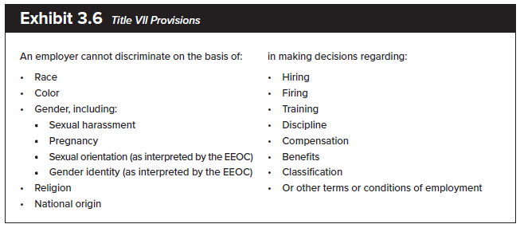
Title VII Provisions
Equal Employment Opportunity Commission (EEOC)
  Agency responsible for enforcing federal laws that make it illegal to discriminate against a job applicant or an employee because of the person's race, color, religion, sex (including pregnancy, gender identity, and sexual orientation), national origin, age (40 or older), disability or genetic information.
Applies to promote equal opportunity in the fundamentals of employment relationship:

Slide 10
Evolution of Title VII
Emphases and Interpretations have changed since 1964
    Early emphasis on hiring-related cases; more recent concerns for compensation, promotion
    Harassment law develops as subset of disparate treatment
    Religion claims change as more are brought by Muslims post-9/11, and religious workplace activism grows
    Retaliation claims rise
    Interpretation of ‘sex’ discrimination to include transgender to and sexual orientation
    Rise of concerns for diversity, equity and inclusion
    Catalyst to broaden common law ‘at-will’ exceptions generally

Slide 11
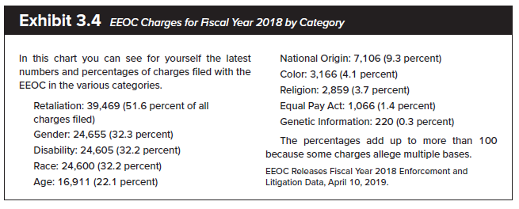
Charges Filed with EEOC, 2018
Note: ‘Retaliation’ claims are often filed in conjunction with other charges.

Slide 12
Who Must Comply?
    The following EMPLOYERS must comply with Title VII:
    Private employers engaged in interstate commerce with 15 or more employees (lower level of federal power).
    Unions.
    Joint labor and management committees making admission, referral, training, and other decisions.
    Employment agencies and other similar hiring entities making referrals for employment.
    Federal, state, and local governments (i.e Public Employers).

Slide 13
Employees Covered by Title VII
Employees of ALL public (governmental) and PRIVATE (non-governmental) organizations
  Title VII applies to ALL LEVELS and TYPES of employees (i.e. managers, first-line workers, etc.)
  Employers with 15 or more employees and engaged in interstate commerce
  Title VII applies to US citizens employed by American employers outside the US, and non-US citizens are protected in the US but not outside the US (even if employed by American employer)
Undocumented workers
  WHAT IS AN UNDOCUMENTED WORKER? An undocumented worker is an individual that is working off the payroll OR an individual that has not furnished to their employer the necessary identification to verify their legal status or authorization to work.
  Undocumented workers may not be eligible for certain forms of relief, such as reinstatement and back pay
  Claims of employment discrimination under Title VII is treated as a violation by the EEOC
    Employment discrimination against undocumented workers is illegal

Slide 14
Employees NOT Covered by Title VII
Employers having fewer than 15 employees
  Employers who are engaged in interstate commerce but do not employ 15 or more employees for each of 20 or more calendar weeks in the current or preceding calendar year
Employers NOT engaged in interstate commerce
Non-U.S. citizens employed outside the United States
U.S. citizens employed elsewhere, if local law specifically forbids compliance
Employees of religious institutions, associations, or corporations hired to perform work connected with carrying on religious activities
  Case: Petruska v. Gannon University
Members of Communist organizations
Native American employees living in or around Native American reservations
Employees of private clubs
Note: Recall that independent contractors are not ‘employees’

Slide 15
Equal Employment Opportunity Commission (EEOC)
Administrative agency established by Civil Rights Act to oversee discrimination claims
  Specialized expertise and case volume
Agency handles about 100,000 filings/year
  See chart for relative volume
Doctrine: exhaustion of administrative remedies
  Claims must go through agency before court (why?)
  Scenario 1

Slide 16
Filing Claims under Title VII
Claimant/charging party: The person who brings an action alleging violation of Title VII. (no filing fee)
Respondent/responding party: Person alleged to have violated Title VII, usually the employer.
  E E O C Investigator: Employee of E E O C who reviews Title VII complaints for merit.
  Record keeping and reporting requirements
    EEOC requires personnel records relating to a charge be kept until final disposition. Other EEOC records regs also exist

Slide 17
Statute of Limitations
Statute of limitations - relatively brief
Limitations period: time between alleged act and filing claim
    Nonfederal government employees have 180 days and federal employees have 45 days to file a claim after the discriminatory event.
    ‘continuing violations’ claims may consider actions outside limitations period
Lilly Ledbetter Fair Pay Act: limitations period resets with every discriminatory paycheck.
    Scenario 2.

Slide 18
State Law Interface in the Filing Process
706 agency - State and local enforcement.
    Work-sharing agreement with the E E O C.
    Receives and process claims of discrimination.
    Expanded filing time from 180 days to 300 days.
    If the claim is not satisfactorily disposed of, it may be taken by the E E O C for litigation.

Slide 19
Proceeding Through the E E O C
Generally, Title VII – resolution by ‘conciliation’ preferred
    Attempts to reach agreement on a claim through discussion, without resort to litigation.
    EEOC Process
    Within 10 days of the claim, the EEOC serves notice of the charge to the employer.
    Title VII includes antiretaliation provisions.
    It is a separate offense for employers to retaliate against an employee under Title VII.

Slide 20
Mediation
    Attempt to streamline the E E O C case-handling process: parties engage mediator to facilitate settlement.
    “Referral-back” program - Private sector employment discrimination claims are sent back to employer for mediation.
    E E O C universal mediation agreements encourage employer participation.
    Participation is voluntary, process confidential and settlement agreements reached are binding.

Slide 21
E E O C Investigation
Process to determine merit of claim(s)
  Meeting with EEO investigator
  Outcomes are ‘reasonable cause’ or ‘no reasonable cause’ to believe prohibited discrimination occurred
  Vast majority of charges are sifted out of the system
  ‘No reasonable cause’ finding in 64 percent of cases
  Agency pursues conciliation, issues Right-to-sue letter
No reasonable cause found
  Employee is given a dismissal and notice of rights, known as a right-to-sue letter
    Employee can file suit against employer in federal court within 90 days
Reasonable cause found
  Parties meet with an EEO investigator to conciliate/settle the claim
    EEOC can file suit on behalf of claimant in federal court if the claim is not settled

Slide 22
Judicial Review
Judicial review: Court review of EEOC’s decision in federal district court.
Jury trial if requested by either party.
De novo review: Complete new look at claim by the reviewing court, via trial of case.
    EEOC’s litigation success rate is 90%.

Slide 23
Mandatory Arbitration Effects
Arbitration (private judging) popular with employers as alternative to EEOC/Court processes
Less expensive, quicker, final (no appeals), success rate
Claimants forced to arbitrate if proper agreement terms when hired
Traditional EEOC hostility as barrier to agency’s mission
2019 – EEOC policy change under Trump administration
  Post-2020 impacts unclear

Slide 24
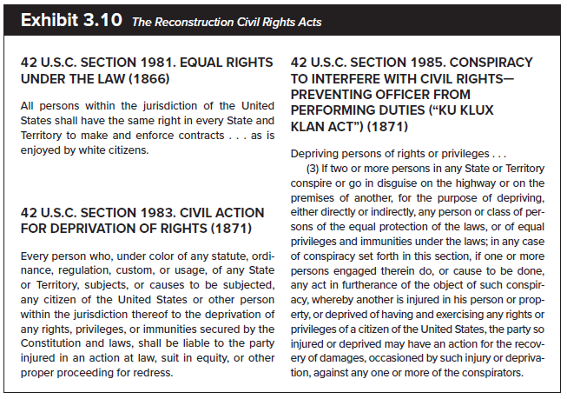
The Reconstruction Civil Rights Acts
42 U.S.C. Section 19 81 - Equal Rights under the Law (18 66)
  Patterson v. McLean Credit Union.
42 U.S.C. Section 19 83 - Civil Action for Deprivation of Rights (18 71)
42 U.S.C. Section 19 85 - Conspiracy to Interfere with Civil Rights (18 71)
    Preventing officer from performing duties - The Ku Klux Klan Act.

Slide 25
The Reconstruction Civil Rights Acts
Post-Civil War laws prohibit denial of civil rights
Alternatives to Title VII
  direct court access, fees, no agency process
  Some current use when outside limitations period, or v. government employer
  Case: Patterson v. McLean Credit Union

Slide 26
Important Notes
Discrimination claims must be proved just as any other lawsuit – burden on plaintiff/claimant
    Employee must offer evidence to support any claims.
  Case: Ali v. Mount Sinai Hospital, Scenario 3.
Employers do well against these charges if they have a system and work it: consistently treating employees in a protected class just as they would those of any other similarly situated employees

Slide 27
Management Tips
Make sure that all employees understand
    What Title VII is, what it requires, and to whom it applies.
    How the employees’ actions can bring about liability for the employer.
    What kinds of actions will be looked at in a Title VII proceeding.
    That all employees have a right to a workplace free of illegal discrimination and the employer will not allow Title VII violations.

