Slide 1
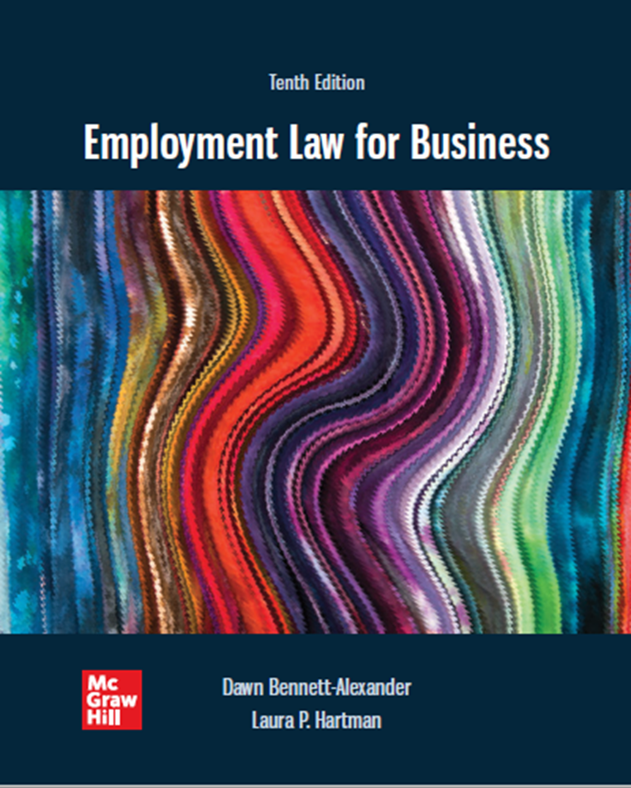
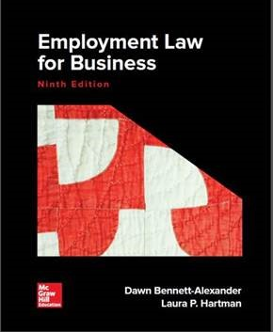
Chapter 2 The Employment Law Toolkit: Resources for Understanding the Law and Recurring Legal Concepts
Copyright ©2022 McGraw-Hill Education. All rights reserved. No reproduction or distribution without the prior written consent of McGraw-Hill Education.

Slide 2
Guide to Reading Cases
Stare decisis (i.e. the thing decided…‘stand by a decision’) and Legal Precedent
Courts use prior decisions to determine rules to judge new cases with similar facts.
Provides stability, predictability to law
Precedents may be overturned to allow evolution of law
Recorded Opinions may be Majority, Concurrence or Dissent
Federal government and states have separate, parallel court systems
Trial court → intermediate courts of appeals → supreme court.
Interplay between states and the federal court system
U.S. Supreme Court decisions final.
State Supreme Court decisions final on most state law matters.
When Court interprets a statute, Congress can enact a new law to change that law if it believes the Court’s interpretation is not as it intended.
Case information
Case name: (parties to litigation), Plaintiff sues, Defendant responds
Citation: where report can be found, court name and date
Outcomes: ‘Affirm’ lower court, ‘Reverse’ it, or ‘Remand’ for further handling in lower court
Note: case opinions in Bennett text heavily edited to exclude material not relevant to this course.

Slide 3
Guide to Reading Cases: Understanding the Case Parties
Key Terms | Meaning
Plaintiff | One who brings a civil action in court (i.e. the party suing)
Defendant | One against whom a case is brought (i.e. the party who is being sued)
Appellant | One who brings an appeal
Appellee | One against whom an appeal is brought
Petitioner | One who appeals a case to the Supreme Court
Respondent | One against whom a case is appealed at the Supreme Court

Slide 4
Guide to Reading Cases Understanding the Case: Information
Key Terms | Meaning
Law reporter | Book in which court opinions are placed
Case citation | The volume and pages in the Law Reporter where the case opinions can be found
Motion to dismiss | Defendant’s request for the court to reject plaintiff’s case for some defect (e.g., no prima facie case stated)
Motion for summary judgment | Defendant’s request for the court to rule on the plaintiff’s case based on the documents submitted, alleging there are no triable issues of fact to be decided
Per curiam | Brief determination made by an appellate court, not issued by a particular judge

Slide 5
Prima Facie Case (“On The Face of It”)
Cause of action: Right provided by law for a party to sue for remedies when certain legal rights are violated.
Prima facie case: Presentation of evidence that fits each requirement of a Cause of Action.
Establishes basis for plaintiff’s claim to relief.
Requires defendant to appear and rebut plaintiff’s claims or establish defenses.

Slide 6
At-Will Employment
At-will employment: Employment relationship where there is no contractual obligation to continue for an agreed time.
Agreement renews itself every second, until it doesn’t
Either party may terminate, without liability to the other
Not at employment relationships are considered “Employment At-Will”
Exclusions from At-Will Employment:
Government employment, or
Employment governed by Contracts that define the terms and duration
Collective Bargaining Agreement (group, i.e. labor union)
Individual Contract
Key concept and general rule: either Party may terminate the employment relationship, at any time, for a good reason (incompetence, better offer), or no-reason-at-all (including many stupid reasons) – just not a bad or illegal reason = one that falls within one of the few exceptions to the doctrine (next).
Most private-sector employment is at-will
Note: Per Civil Rights Act, Title VII, employer cannot terminate a worker based on race, color, sex, religion, or national origin.

Slide 7
Exclusions from At-Will Employment, Damages
Violation of Employment Law Statute:
Ex. Title VII of Civil Rights Act, Age Discrimination Act, OHSA, Fair Labor Standards Act, WARN, etc. (these laws will be discussed in other chapters)
Violation of Public Policy (other law, legal right, recognized in SC)
Breach of Implied Contract (i.e., handbook terms that limit employer discretion, recognized in SC)
Breach of the Implied Covenant of Good Faith and Fair Dealing (CA and a few other states, not in SC)
Other that work in conjunction with above:
Wrongful Discharge/Wrongful Termination/Unjust Discharge/Unjust Dismissal – Terminating an EE from job for an illegal reason (reason not supported by law)
Retaliatory Discharge – Terminating an EE for exercising rights provided by law
Constructive Discharge - Occurs when the EE is given no reasonable alternative but to end the employment relationship; considered an involuntary act on the part of the EE
Damages for Wrongful Discharge/Wrongful Termination/Unjust Discharge/Unjust Dismissal:
Compensatory Damages – Money that court orders to be paid by one who harmed another to compensate for the hard done (i.e to make the injured party whole)
Punitive Damages – Money ordered by a court to be paid by harming party to harmed party, above the actual loss suffered, for purposes of punishing the one doing the hard and to send a message to society that the activity is not to be done (i.e. intended to punish wrongdoer and deter others)
IMPORTANT TO CONSIDER:
Aside from Violation of Employment Law Statutes, exceptions to Employment At-Will are dealt by individual states’ statutes and common law and not by the federal government (for most part)
Not all states recognize these exceptions

Slide 8
Violation of Public Policy
Public policy: Legal concept intended to ensure that no ‘person’ lawfully do that which may injure the public or damage the public good
States vary widely regarding recognition of this exception, however it is the most common exception…at least 44 states recognize this exception including South Carolina
Arises when termination follows employee’s exercise of a right or duty, or refusal to disobey a law.
Violations of public policy usually arise when the employee is terminated for acts such as refusing to violate a criminal statute on behalf of the employer, exercising a statutory right, fulfilling a statutory duty, or reporting violations of statutes by an employer.
While the courts that have adopted the public policy exception agree that the competing interests of employers and society require that the exception be recognized, there is considerable disagreement in connection with what the public policy is and what constitutes a violation of the policy (for example not being there for one’s family or refusing to work overtime does NOT constitute violation of public policy).
Green v. Ralee Engineering Co.
EE, an inspector of airplane parts, was terminated after complaining to supervisor about ER manufacturing defective airline parts
ER hired less experienced EE; EE sued for wrongful termination (retaliation and violation of public policy)
Holding: Yes, ER violated public policy; public safety regulations governing commercial airline safety serves as basis for public policy claim
Whistle-blowing (Occurs when an EE reports an ER’s wrongdoing to public, press or ER supervisors)
Various federal and state Acts and provisions (including South Carolina)

Slide 9
Breach of Implied Contract
Implied contract: Contract term that is not expressed but is created by other words or conduct of the parties involved
Courts have found contracts implied from off-hand statements made by employers during pre-employment interviews.
Employee Handbook statements may imply termination only for ‘just cause’
Employee handbook terms must be drafted with care to avoid implication that employment not at-will. (see Employment At-Will example disclaimer on page 59)
Specific at-will term
Disclaimers of alternative interpretations

Slide 10
Breach of Implied Covenant of Good Faith and Fair Dealing
Implied contractual obligation to act in good faith in the fulfillment of each party’s reasonable contractual expectations
The covenant of good faith and fair dealing is the duty that requires an employer to treat employees fairly and requires the employer to only fire employees when they have good cause.
Applies to employees with employment contracts or who work under employment at-will basis
Not every employment agreement can include every aspect/reason for hiring or firing. The agreements don’t have to include everything. For example, long time employees who have consistently received favorable evaluations might claim that their length of service and positive performance reviews were signs that their job would be secure as long as they performed satisfactorily, therefore they shouldn’t be terminated without good cause.
The court examines the parties’ actions to ascertain whether termination demonstrated bad faith (e.g., termination to avoid paying bonus earned, but due if employed at year-end).
Critics of this implied agreement argue that, where an agreement is specifically nondurational, there should be no expectation of guaranteed employment of any length
Narrowly construed – most risks do not qualify, and only a few states recognize this claim (only 20 states recognize this exception)
Case: Guz v Bechtel National, Inc.

Slide 11
At-will Exceptions: Retaliatory Discharge
Retaliatory Discharge: Terminations in response to an employee exercising rights provided by law
E.g., filing a claim charging discrimination
Constitutional Protections – Taking adverse employment action against an EE on the basis of the EE’s engagement in constitutionally protected activities
Limited in PRIVATE sector, but applies to all Public ERs (recurring theme)
State action – no free speech in the private sector(!)
Smyth v. Pillsbury Co. dealt with email
EE sent emails threatening management
ER (which was a private ER) assured EE’s emails were confidential and privileged
ER terminated EE
Issue: Did ER violate public policy (right to privacy, unreasonable search and seizure) when they fired EE?
Ruling: No, employment at-will virtually absolute and there must be a “clear mandate of public policy,” constitutional rights do not apply to EE of private ER
A GOVERNMENT ER is prohibited from terminating a worker or taking other adverse employment action against a worker on the basis of the worker’s engaging in constitutionally protected activities

Slide 12
Retaliatory Discharge: Prima Facie Case

Slide 13
At-will Exception: Promissory Estoppel
Similar to the implied contract claim, except that the promise, implied or expressed, does not constitute a contractual term.
Specific statutory exceptions to employment at-will
Occupational Safety and Health Act (safe workplace).
Fair Labor Standards Act (fair pay).
Pregnancy Discrimination Act (pregnancy).

Slide 14
Constructive Discharge
Constructive discharge: Occurs when employer creates intolerable workplace conditions, such that employee has no reasonable alternative but to leave.
Intentional targeting of employee
Deliberate creation of intolerable conditions and
Aggravating factors justified resignation.
Heavy burden-of-proof on employee
Examples: police officer required to undergo remedial firearms training (no)
Egyptian-born doctor subjected to extreme pattern of national origin discrimination (yes)

Slide 15
Other Restrictions on At-Will Doctrine
The Worker Adjustment and Retraining Notification Act (W A R N)
Requires employers with over 100 employees to give 60 days’ advance notice of a plant closing or ‘mass layoff’ (as defined) to affected employees.
Exceptions.
‘Faltering company’ exception.
‘Sudden, dramatic, unexpected’ business changes (e.g., certain natural calamities).
Similar state laws may vary application, exceptions

Slide 16
Wrongful Discharge Based on Other ‘Tort’ Liability.
‘Tort’ is a non-contractual civil wrong for which the law provides a Cause of Action. Employer actions can qualify.
Intentional and outrageous conduct.
Infliction of emotional distress.
Defamation.
Wrongful invasion of privacy.
Damages may be limited by workers compensation statutes.

Slide 17
Employment Discrimination Concepts
Federal law, and many states prohibit employment discrimination on the basis of race, color, gender, religion, national origin, age, disability, and genetic information.
Generally two types of discrimination claims on any of the above bases:
Disparate treatment.
Disparate impact.

Slide 18
Disparate Treatment
Disparate treatment: Treating similarly situated employee differently because of a characteristic prohibited under Title VII of Civil Rights Acts or other employment discrimination law factors
Considered INTENTIONAL…Intentional Acts or Intentional Discrimination: e.g., “Mexicans need not apply”
Disparate treatment is considered intentional discrimination, but the plaintiff need not actually know that unlawful discrimination is the reason for the difference.
How to Prove Disparate Treatment? SC gave us direction in McDonnell Douglas Corp. v. Green ruling

Slide 19
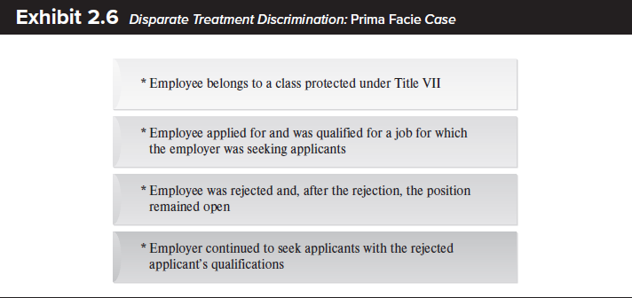
Disparate Treatment: Prima Facie Elements

Slide 20
Disparate Treatment: Defenses
Legitimate, Nondiscriminatory Reason (LNDR)
Permissible rationale justified employer action
The LNDR is a rebuttable presumption (i.e. a legal determination arising from proven evidence that can be refuted to the contrary) and may be virtually anything that makes sense and is not related to prohibited criteria.
Employee’s counter – Employee can counter with evidence that the employer’s legitimate, non-discriminatory reason was a mere pretext (i.e. window dressing...other reason) for the employer to discriminate
___
Bona Fide Occupational Qualification (BFOQ)
Permissible discrimination if legally necessary for employer’s particular business.
Legalized discrimination, narrowly construed by EEOC, courts. VERY LIMITED… and not available in race cases. RACE CAN NEVER SERVE AS A VALID BFOQ!
2 Part BFOQ Test:
Does the job require that the employee be of one gender (or prohibited category)?
If yes, is that reasonably necessary to the “essence” of the employer’s particular business?
Case: Wilson v. Southwest Airlines Company.

Slide 21
Disparate Treatment Summary
How to Prove a Prima Facie case?
You belong to a minority (or protected class under Title VII)
You’re qualified and applied for the job
Despite qualifications, you were rejected
Position remained open or was given to someone else equally or less-qualified
Conditions are modified for situation (i.e. hiring, termination, promotion, etc.)
If EE proves Prima Facie case and ER does nothing, EE wins;
If ER articulates a legitimate, non-discriminatory or BFOQ reason, then the ER wins unless the EE proves the alleged reason is a pretext or excuse.
How to prove pretext?
Is the decision reasonable?
Balanced?
Made consistently?
Justification job related?

Slide 22
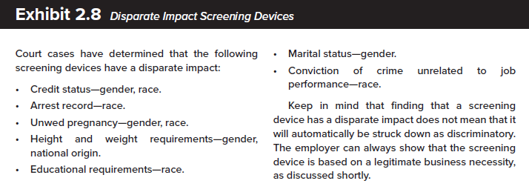
Disparate Impact
Disparate impact: Discriminatory effect of a facially neutral policy on a Title VII group.
Facially neutral policy: Workplace policy that applies equally to all covered employees, regardless of protected status, often an HR ‘screening device’ (see next slide)
Unnecessary practice, perhaps unintentional, that results in workplace discrimination
Key distinction: needn’t prove Intent to discriminate; key consideration is differential effect on protected group
Case: Griggs v. Duke Power Co.: “built-in headwinds;” test results as servants, not masters…codified into law as part of 1991 amendment to Civil Rights Act
2 part question:
Does “test” discriminate?
If so, does test relate to performance? In other words, is the test warranted? ER has to prove job relatedness or business necessity in this discrimination
ER need to have their tests “validated” to prove job relatedness and fairness

Slide 23
Disparate Impact (cont.)
Screening device: Mechanism (normally a test) used to separate applicants from the general pool of candidates
Four-fifths rule: Minority must do at least 80 percent (four-fifths) as well as majority on screening device or presumption of disparate impact arises (see business necessity defense, next slide)
Subjective or objective criteria may qualify (see Watson v. Fort Worth Bank)
Pre-employment interviews
Employment applications
Scenario 4
If the requirement is not met, a presumption arises that the screening device has a disparate impact on the minority group and must be shown to serve a legitimate business necessity.

Slide 24
Disparate Impact (cont.)
Troublesome areas:
Subjective vs. Objective screening standards applied
Preemployment interviews
Employment applications.
Business necessity defense: Defense to a disparate impact case based on the employer’s need for the policy as a legitimate requirement for the job.
Employee Rejoinder: less discriminatory alternative to the screening device used.

Slide 25
Key Discrimination Claims Cases, Other Defenses
Landmark/defining US Supreme Court Cases
McDonnell Douglas Corp. v. Green
Established Disparate Treatment sequence: prima facie case, Legitimate Non-discriminatory Reason or BFOQ Defense, Pretext for intentional cases
Griggs v. Duke Power
Established Disparate Impact sequence for non-intent cases: prima facie case, Business Necessity defense, Better Alternatives
Other Defenses
Employee’s evidence is not true: claimant/plaintiff has burden of proof and persuasion
“preponderance of the evidence” standard in civil cases
Employer’s “bottom line” comes out correctly?
No – key is equal opportunity, not equal numbers (Conn. V. Teal)

Slide 26
Other Common Concepts
Reasonable Accommodation: Employer duty in some Title VII cases and ADA claims to seek to accommodate workplace conflicts.
Limit: ‘undue hardship’ to the employer.
Extent of duty varies between religious and disability accommodations.
Exhaustion of Administrative Remedies
All claims must go through EEOC processes before filing lawsuit in court.
All claimants receive Right to Sue letter if case does not settle in agency
Retaliation
employees claiming discrimination may file separate claims for negative consequences experienced from employers for pursuing their lawful rights.
.

Slide 27
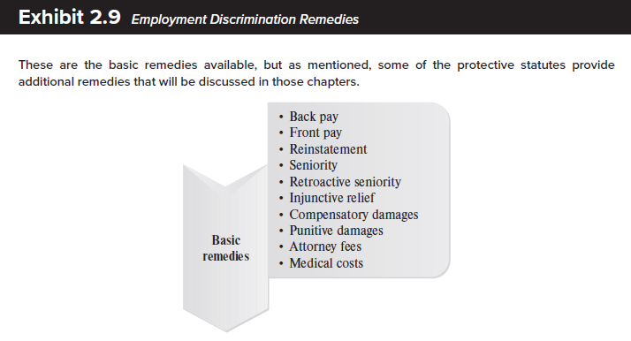
Exhibit 2.9 - Employment Discrimination Remedies

Slide 28
Employment Discrimination Remedies
Key Terms | Meaning
Back pay | Money awarded for time employee was not working because of illegal discrimination
Front pay | Equitable remedy of money awarded to claimant when reinstatement is not possible or feasible
Retroactive seniority | Seniority that dates back to the time the claimant was treated illegally
Make-whole relief | Attempt to put the claimant in position he or she would have been been in had there been no discrimination
Compensatory damages | Money damages given to a party to compensate for direct losses due to an injury suffered
Punitive damages | Money over and above compensatory damages, imposed by a court to punish employer or deter future acts

Slide 29
Additional Legal Resources
Law Libraries.
Found everywhere from private law firms to public courthouses
Vary widely as to size and breadth of collection
The Internet.
Includes legal databases for public consumption.
Most resources available on the web, often for a subscription fee – see ever-expanding list in text, page 91 et seq.

Slide 30
Management Tips
Employers always allowed to hire best person for a job, and have broad discretion in management. Important to avoid expensive mistakes in limited areas of prohibition.
Transparency and safe communication of concerns promote preventive management. Prevention beats cure.
Documentation and strong systems useful in convincing a court or jury that employer’s actions were legitimate.
Retaliation against an employee for filing claim is a separate offense. Avoid even its appearance.
Review termination decisions internally; avoid unilateral or emotional decisions.
Carefully manage lay-offs: documentation, preparation, communication, empathy and candor.
Train employees to understand policies and their rights.
Some claims will require seeking ‘reasonable accommodation’ via ‘iterative’ (discussion) process.
Monitor policies for potential adverse impacts and compliance issues; update as needed.

