Slide 1

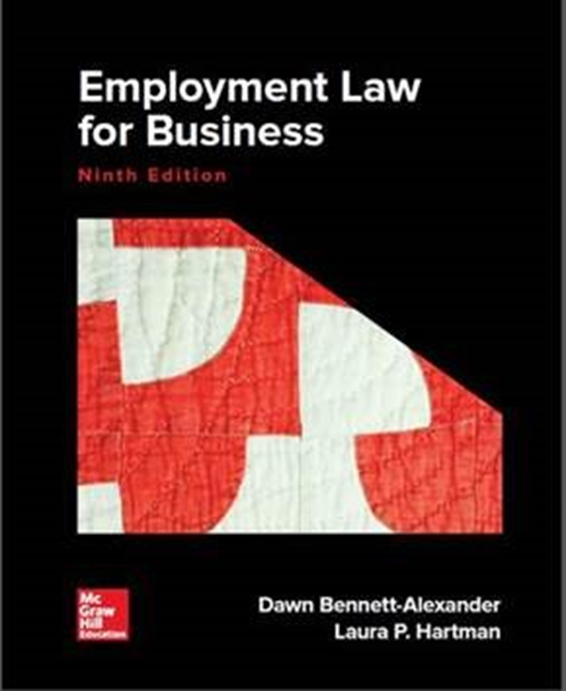
Chapter 1
The Regulation of Employment
Copyright ©2022 McGraw-Hill Education. All rights reserved. No reproduction or distribution without the prior written consent of McGraw-Hill Education

Slide 2
Intro to Employment Law
What is Law?
  Rules developed by a society to govern the conduct of and relationships among its members
What is Employment (Labor) Law?
  Rules that govern the conduct of and relationships between employers and employees
2 Parties in Labor Law
  Employer (ER)
  Employee (EE)
Labor Law Today
  Very Complex
  Need to be comfortable with employment law in order to avoid and recognize problems
  Employment law has teeth
    Can be sued
    Firm can lose money
    Lose your job
    Go to jail
  You will work with the law on a daily basis

Slide 3
Approaches to Understanding Law
Legal Positivism
  Philosophy of law that emphasizes the conventional nature of law that is socially constructed
  Laws are made by the legislature or considered as common/case law (rendered by courts)
  The Law is WHAT WE SAY IT IS
  Hard Nose Approach (laws are not necessarily connected to morals)

Slide 4
Legal Positivism
Law can be used as PREDICTION
  Oliver Wendell Holmes (US Supreme Court Justice, 1902-1932) said law is about “prophecies about courts do in fact”
  A PREDICTION OF COURTS WILL DO…the meaning of any written law is determined by the individual judges interpreting them
  Lawyers and judges are schooled in same legal thought process
  Predictions are never 100% accurate
    Competency
    Emotion
    Knowledge

Slide 5
Approaches to Understanding Law (cont.)
Natural Law
  Philosophy that certain rights or values are inherent by virtue of human nature & can be universally understood through human reason
  Legal Positivism doesn’t know difference between tax collector & a gunman…laws are of no validity if contrary to the “laws of God” (Sir William Blackstone)
  Moral elment of law
  Not a valid law if not consistent with “law of nature”
  Natural law has influences in common/case law (rules created by court decisions) and Declaration of Independence and US Constitution

Slide 6
Sources of Law
Constitutions – US, State
Statutes – Congress, State, County
Court Decisions – Interpret and Make Law
  Common/Case Law – the body of law created
  by court decisions
  Stare Decisis = “stand by previous decision”
Administrative Rulings and Regulations
  Regulations created by gov’t agencies established
  by legislative bodies
  Ex. EEOC, EPA, FTC, UCC
Order of Importance

Slide 7
The Court System
US Supreme Court
State Supreme Court
US Court of Appeals
State of Appeals
Federal District Courts
Original Jurisdiction
(Trial Court)

Slide 8
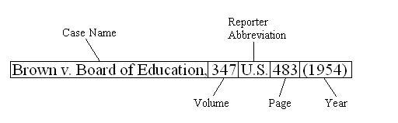
Guide to Reading Cases
District Court
  Plaintiff – The party suing (the party that files a formal complaint with the court).
  Defendant – The party being sued (the party against whom a lawsuit is filed).
Appeals Court
  Appellant – The party appealing a district’s court decision, usually seeking reversal of that decision.
  Appellee – The party opposing the appellant’s appeal, usually seeking to persuade the appeals court to affirm (uphold) district’s court decision.
Supreme Court
  Petitioner - The party who presents a petition to the court. On appeal, the petitioner is usually the party who lost in the lower court. This can be either the plaintiff or defendant from the court below, as either of the parties can present the case to a higher court for further proceedings.
  Respondent - The party against whom a petition is filed, especially one on appeal. The respondent can be either the plaintiff or the defendant from the court below, as either party can appeal the decision thereby making themselves the petitioner and their adversary the respondent.

Slide 9
Guide to Reading Cases
Majority Opinion
  A judicial opinion agreed to by more than half of the members of a court. A majority opinion sets forth the decision of the court and an explanation of the rationale behind the court's decision. Not all cases have a majority opinion.
  What the law is; written first (main thing to read).
Concurring Opinion
  A written opinion by one or more judges of a court which agrees with the decision made by the majority of the court, but states different (or additional) reasons as the basis for his or her decision (i.e. Agree with outcome, but different reasoning)
Dissenting Opinion
  Is an opinion in a legal case written by one or more judges expressing disagreement with the majority opinion of the court which gives rise to its judgment (i.e. Judges who disagree with outcome and why they disagree).

Slide 10
Introduction to the Regulatory Environment
Freedom to contract is crucial to marketplace freedom
  Employment relationship is a contract: the exchange of labor for compensation
  Most private-sector employment relationships are “at-will” agreements (more on this in Ch. 2)
  An employee may choose to work or not to work for a given employer.
  An employer may choose to hire or not to hire a given applicant and either party may terminate the relationship at any time, with some exceptions. System is theoretically symmetrical.
  Government enacts laws to resolve power imbalances between an employer and employees. Examples:
    Set minimum wage, overtime, safety and health.
    Collective bargaining rules.
    Anti-discrimination laws based on race, gender, other characteristics.
    Exceptions to “At-Will” doctorine.

Slide 11
Is Regulation Necessary?
  Proponent view. (regulation is necessary)
    Statistics demonstrate that regulation of discrimination and other elements of work relationship is necessary to ensure equal opportunities.
    Human beings often do not act rationally.
    Economic forces do not provide complete assurance against employment discrimination.
      Market imperfections: biased firms can remain competitive while discriminating.
  Opponent view. (regulation is not necessary)
    Market forces encourage employers’ rational, nonbiased behavior.
    Decisions based on race or gender are inefficient.
    Employers should be free to manage their companies as they see fit.

Slide 12
Worker Classification
How workers are ‘classified’ has crucial implications for rights and duties of both parties.
  Generally, workers are classified as either:
    Employees (EE)
    Independent Contractors (IC)
  as workplaces become more flexible, resolving this issue correctly can be difficult.
  Origins in the law of ‘Agency.’
    Traditional designations of master and servant.

Slide 13
Classification of workers: two types
Employee (EE)
  One person (EE) acts as authorized on behalf of another party (ER).
  The EE is the AGENT and the Employer is the PRINCIPAL (i.e. “Law of Agency” concept) .
  EE serves the Employer’s interests according to instructions (i.e. the Employer controls the work of the EE).
  Employer is obligated to exercise good faith in the relationship; and ensure that no harm comes to the EE during the relationship.
  IRS: EE receives an IRS form W-2 (wages) from ER
Independent contractor (IC)
  Person who contracts with a principal to perform a task according to his or her own methods
  The principal does not have right to exercise control over the physical details of the work
  IRS: IC receives an IRS form 1099 (payments received) from ER

Slide 14
Classifications of workers: two types
Discrimination: Title VII of Civil Rights Act applies to EEs, not to ICs(also EEs protected from discrimination under ADA, ADEA)
‘Safety net’ laws: EEs protected under other employment laws. No minimum wage/OT, workers compensation (injuries on the job) or unemployment compensation eligibility for ICs.
Employer payroll deductions
  Employee → Employer responsible for deductions, such as Social Security (FICA), federal unemployment compensation (FUTA), IRS federal income tax withholdings, Medicare, and state taxes. In addition, it is the employer’s responsibility to withhold a certain percentage of the employee’s wages for federal income tax purposes.
  Independent Contractor → responsible for their own taxes, including deductions
Benefits
  ER not legally required to offer to EE, but EE is eligible to receive them (ex. Sick/vacation pay, parking spot, 401k, health/dental insurance, etc.)
  Independent Contractor → no access to Employer benefits
Cost Reductions
  Classifying workers as IC may offer the ER some cost savings…remember the goal of business is to make profit (minimize expenses, increase revenues)
  Vicarious Liability of ER for mistakes made by EEs, third-party injuries
  See Next Slide

Slide 15
Why Use Independent Contractors?
Specialized skills or Intermittent needs.
Seasonality.
Cost factors.
      Compensation, benefits and avoided administration
      Avoids work-related expenses (e.g., insurance, tools, etc.).
      Avoids Overtime - pay for production, not time.
      Liability for worker mistakes
    Vicarious Liability – the imposition of liability on one party for the wrongs of another.
    Liability may extend from an EE to the ER on this basis if the EE is acting within the scope of his/her employment at the time the liability arose.
    Generally, ERs are not liable for IC mistakes

Slide 16
Costs of Misclassification
Inaccurate classification of workers is a violation of
  Federal tax laws
  The National Labor Relations Act of 1935
  The Fair Labor Standards Act of 1938
  Employee Retirement Income Security Act
  Social Security Act
  State worker’s compensation and unemployment compensation laws
  CA: willful miss-classification subject to severe penalties
The fines for each violation are substantial
  If a worker is unintentionally classified as an independent contractor but later is found to be an employee, the punishment by the IRS is harsh. The employer is not only liable for its share of FICA and FUTA taxes but is also subject to an additional penalty equal to 20 percent of the FICA taxes that should have been withheld. In addition, the employer is liable for 1.5 percent of the wages received by the employee.
    FICA – Federal Insurance Contribution Act (Social Security and Medicare), i.e. “old people” retirement and hospitalization insurance
    FUTA – Federal Unemployment Tax Act (Unemployment Insurance), i.e. compensation in between jobs
  Where the IRS determines that the worker was deliberately classified as an independent contractor to avoid paying taxes, the fines and penalties can easily run into six figures for even the smallest business.

Slide 17
Independent Contractors: Safe Harbors (I R S)
The Internal Revenue Service (IRS) provides ER with Safe Harbor protection
What does Safe Harbor mean?
  A safe harbor is a provision in a law or regulation that affords ERs with protection from liabilities or penalties under specific situations or if certain conditions are met.
  This is done when ERs attempt to reclassify its workers from ICs to EEs.
  Sometimes a safe harbor reduces liability if "good faith" is demonstrated.
    IRS Classification Settlement Program penalty avoidance where:
The business must have never treated the worker as an employee for the purposes of employment taxes for any period
All federal tax returns with respect to this worker were filed consistent with the worker being an independent contractor
The company has treated all those in positions substantially similar to that of this worker as independent contractors
The company has a reasonable basis for treating the worker as an independent contractor (see next slides)
    2011 – Voluntary Classification Settlement Program
      companies not under review may voluntarily reclassify and avoid some taxes, fines, penalties and interest.

Slide 18
Worker Classification Tests – EE or IC?
Legislative definitions are circular, unhelpful to classification process
Courts, agencies use ‘duck tests’ to analyze nature of working relationships
    Common-law agency test – most common.
    Emphasis on which party has the right to control the work (exercised or not).
    Example: IRS 20-factor analysis
    Elements that reflect control or independence
    Useful as a general guide, but not a “tally” out of 20
    Economic Realities Test – Dept. of Labor
      Emphasis on economic in/dependence of worker
    ABC Test – trending - CA, elsewhere
      Employee default, unless 3 stringent criteria met re: supervision, integration and independence
      ‘gig’ economy controversy
      See next slide

Slide 19
What’s happening in California?
The ABC test, an employment-classification test in California that presumes workers are employees rather than independent contractors, was first adopted in April 2018 by the California Supreme Court in Dynamex Operations West, Inc. v. Superior Court.
Under this test, the burden is on the employer to demonstrate that every worker is not an employee by proving all three of the following:
  The worker is free from the control and direction of the hirer in connection with the performance of the work, both under the contract for the performance of such work and in fact.
  The worker performs work that is outside the usual course of the hiring entity's business.
  The worker is customarily engaged in an independently established trade, occupation or business of the same nature as the work performed for the hiring entity.
The California ABC test doesn't apply to all EE/IC misclassification claims. The new ABC test is for the limited purpose of interpreting California's wage-order rules, such as overtime, unpaid wages, and meal/rest breaks.
The ”other” tests used to properly classify EEs still apply for other purposes, such as workers' compensation claims, tort claims for wrongful termination in violation of public policy and California Labor Code violations.
See how confusing this can be for ERs?

Slide 20
Other Non-traditional work relationships
Deloitte study: 40% US workforce in alternative work arrangements – temporary, part-time or ‘gig’
Contingent or temporary workers
  Work is temporary, sporadic, or differs from the norm of a full-time employment.
  Often supplied by staffing agency - typically, agency acts as ‘employer’
  May also include ‘gig’ workers – rules evolving regarding their classification
  Interns, Trainees and Volunteers
    Trainees: workers exempt from FLSA minimum wage and OT while receiving formal vocational training (6 criteria)
    Interns: “primary beneficiary test” determines paid (employee) or unpaid status
    Volunteers: limited to work for public service, religious, humanitarian or similar non-profit organizations; for-profit entities excluded

Slide 21
Contingent Workers and Joint Liability
Important to recognize whether staffing agency or client bears employment burdens, potential liabilities
    Staffing firms can be employer
    Example: worker is paid by agency, training provided.
    Provide workers’ compensation coverage.
    Client can also be (usually ‘joint’) employer
      Degree of training, supervision
      Continuity
    ‘Joint and several liability’ of both firms
    Contract of engagement sets terms – careful review
    ‘Third Party Interferer’ liability if client discriminates illegally

Slide 22
Management Tips: Worker Status
Understand implications of worker classification
Written agreement recommended, with understood classification by the parties (not dispositive – see ‘ducks’)
If employment contemplated, state duration or ‘at-will’ (see chapter 2)
If independent contractor contemplated, articulate worker’s control and outcomes anticipated
Specify tax responsibilities
Preferable to pay independent contractors for results rather than time.
Any training provided is a strong indication of employee status.
Independent contractors hire their own assistance.
For close questions, seek legal advice, or file for IRS advice ruling, Form SS-8.
  See complete list, page 21.
Always remember that the writing is important, but the actual performance is key.

Slide 23
Defining ‘Applicant’ (i.e. not an EE yet)
‘Applicant’: documentation requirements and anti-discrimination laws extend to ‘Applicants’
Four general requirements: To be covered as an “Applicant:”
Person submits expression of interest;
Persons exhibits basic qualifications for a posted position;
Employer considers person for employment in a particular position;
Person does not remove him/herself from selection process or signify disinterest (no removal from candidacy)

Slide 24
Defining ‘Employer’ (ER)
‘Important to recognize that entity must be an “Employer” for many regulations to attach.
Employer: important to determine who must comply
Usually evident (‘private clubs’ exception)
Supervisors rarely personally liable for misconduct
Per US Constitution, federal jurisdiction limited to ‘interstate commerce’ (see next slide)
Issues may arise when:
  an entity claims to be a private membership club
  the entity is a multinational company
  the entity is close to lower jurisdictional limits of federal laws (Commerce Clause proxy)
  The entity supplies goods or services to government
  The number of EE an ER employs

Slide 25
Federal Statutory Definitions of ‘Employer’
Examples, See Exhibit 1.6
Title VII of the Civil Rights Act: 15 or more workers for specified period
Age Discrimination in Employment Act: 20 or more workers for specified period
Americans with Disabilities Act: 15 or more workers
Fair Labor Standards Act: ‘individual’ and ‘enterprise’ coverage (see Chapter 16)
Note: many states have similar legislation with lower thresholds

Slide 26
Non-compete Agreements
    Every employee owes ‘duty of loyalty’ while employed
    Non-compete: Employee specifically agrees not to:
      enter into competition with the employer for a specified period of time and/or within a specified region, or
      solicit employees or customers, or
      disclose the employer’s confidential information.
    Trend: 27% of workforce in 2019, up from 18% in 2014.
    Powerful deterrent to switching jobs
    States vary widely as to coverage and enforcement; some federal interest to limit uses (e.g., void in California)
    ‘Forum selection clauses’ may try to stipulate which state’s law that applies to it.

Slide 27
Non-compete Agreements
What constitutes a valid non-compete?
    It protects a legitimate business interest and is ancillary to a legitimate business relationship.
    It is no more broad than necessary to protect those interests (i.e. needs to be somewhat specific).
    It is “reasonable” in job scope, territory and duration, in the context of the specific industry.
    It is not contrary to the public interest (i.e. can’t prevent hospitals from hiring nurses).
      Inter-company agreements not to hire-away each other’s employees should be avoided (anti-trust concern)
      Variations include non-solicitation of customers or suppliers, no raiding of former colleagues

Slide 28
Non-competes and Trade Secrets
Trade secrets: information that has value because it is secret, and company takes reasonable steps to keep it so.
    May include confidential information, customer preferences, marketing strategies, etc.
    Non-disclosure Agreements (NDAs) with key employees should include Trade Secrets coverage.
‘Doctrine of Inevitable Disclosure’ in some states.
    Employers are protected against disclosure of trade secrets in highly specialized situations.
    Court can prohibit a former employee from working for a competitor.

Slide 29
Management Tips
    Evaluate and classify workers carefully, and monitor ongoing work; mistakes are costly.
    Hiring an independent contractor is not a safe harbor from liability for misconduct.
    Staffing firms’ contracts must be carefully negotiated to clearly spell-out responsibilities and covered risks.
    Understand your states’ enforceability of non-compete agreements, and draft for reasonableness.
    Carefully compose non-disclosure agreements to protect intellectual property, especially trade secrets.

