Slide 1
Chapter 5 Small Business, Entrepreneurship, and Franchises

Slide 2
What is Small Business?
Small Business -- Independently owned and operated, not dominant in its field of operation and meets certain standards of size*.
*Generally less than 500 employees and less than $2.5m in annual sales
Businesses are “small” in relation to other businesses in their industries.

Slide 3
TABLE 5-1 Industry Group-Size Standards
Industry Group | Size Standard
Manufacturing, mining industries | 500–1,500 employees
Wholesale trade | 100–250 employees
Agriculture | $750,000
Retail trade, barber shops, beauty salons | $7.5 million
General and heavy construction (except dredging) | $36.5 million
Dredging | $27.5 million
Special trade contractors | $15 million
Travel agencies, tour operators | $20.5 million
Department stores | $32.5 million
Discount department stores | $29.5 million
Furniture stores | $20.5 million

Slide 4
Small Business: A Profile
Over 70% of all small businesses fail within first year of operation
Why?
There are 28 million small businesses in the U.S.
Over 99% of all businesses are considered small.
Small businesses account for over 50% of the GDP.
Small businesses have generated 65% of new jobs since 1995.
About 80% of U.S. workers’ first jobs were in small business.
Can be operated on a part-time or full-time basis
Small business offer several unique advantages

Slide 5
The Small-Business Sector
Out of the 28.8 million businesses in the United States, only 18,600 of these employ more than 500 workers—enough to be considered large.
During the last decade, the number of small businesses in the United States has increased 49 percent.
According to a recent study by the U.S. Small Business Administration (SBA):
About 80 percent of businesses started in 2014 survived until 2015, the largest share since 2005.
From 2004 to 2014:
An average of 78.5 percent of new businesses survived one year.
About half of all firms survived five years or longer.
About one-third of firms survived 10 years or longer.

Slide 6
The Importance of Small Business
More PERSONAL customer service. (and personal service to employees!)
The ability to respond quickly to opportunities (i.e. ADAPTABILITY and FLEXIBILITY).
Fosters innovation
Provides competition
Fulfills market niches
Serves the needs of larger businesses

Slide 7
The Importance of Small Businesses in Our Economy (slide 1 of 3)
Providing Technical Innovation
Small firms produce two-and-a-half times as many innovations as large firms relative to the number of persons employed.
Small firms employ 43 percent of all high-tech workers such as scientists, engineers, and computer specialists.
More than half of the major technological advances of the 20th century originated with individual inventors and small companies.
Examples: Air-conditioning, FM radio, helicopter, instant camera, personal computer

Slide 8
The Importance of Small Businesses in Our Economy (slide 2 of 3)
Providing Employment
Seven out of the ten industries that added the newest jobs were small-business-dominated industries.
Small firms hire a larger proportion of employees who are younger workers, older workers, women, or workers who prefer to work part time.
Small businesses provide 67 percent of workers with their first jobs and initial on-the-job training in basic skills.
Small businesses represent 99.7 percent of all employers, employ more than 50 percent of the private workforce, and provide about two-thirds of the net new jobs added to our economy.

Slide 9
The Importance of Small Businesses in Our Economy (slide 3 of 3)
Providing Competition
Small businesses cause larger, established firms to become more efficient and more responsive to consumer needs.
Filling Needs of Society and Other Businesses
Small firms provide a variety of goods and services to each other and to much larger firms.
Example: General Motors relies on more than 32,000 companies for parts and supplies and depends on more than 11,000 independent dealers to sell its automobiles and trucks.

Slide 10
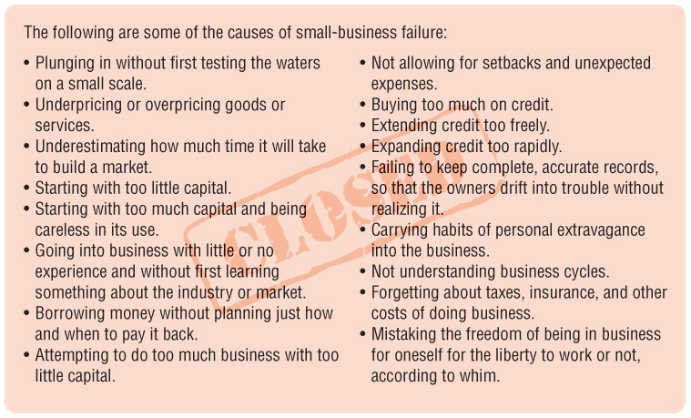
Why Do Small Businesses Fail?
Lack of Knowledge and Experience
Competition
Too Little Money
High Stress Level
Personal extravagance
Lack of self-discipline

Slide 11
Pros and Cons of Small Business
Advantages
Personal relationships with customers and employees
Ability to adapt to change
Simplified record keeping
Independence
Profit retention
Ease of start-up
Ability to keep secrets
Disadvantages
High risk of failure
Limited potential
Limited ability to raise capital

Slide 12
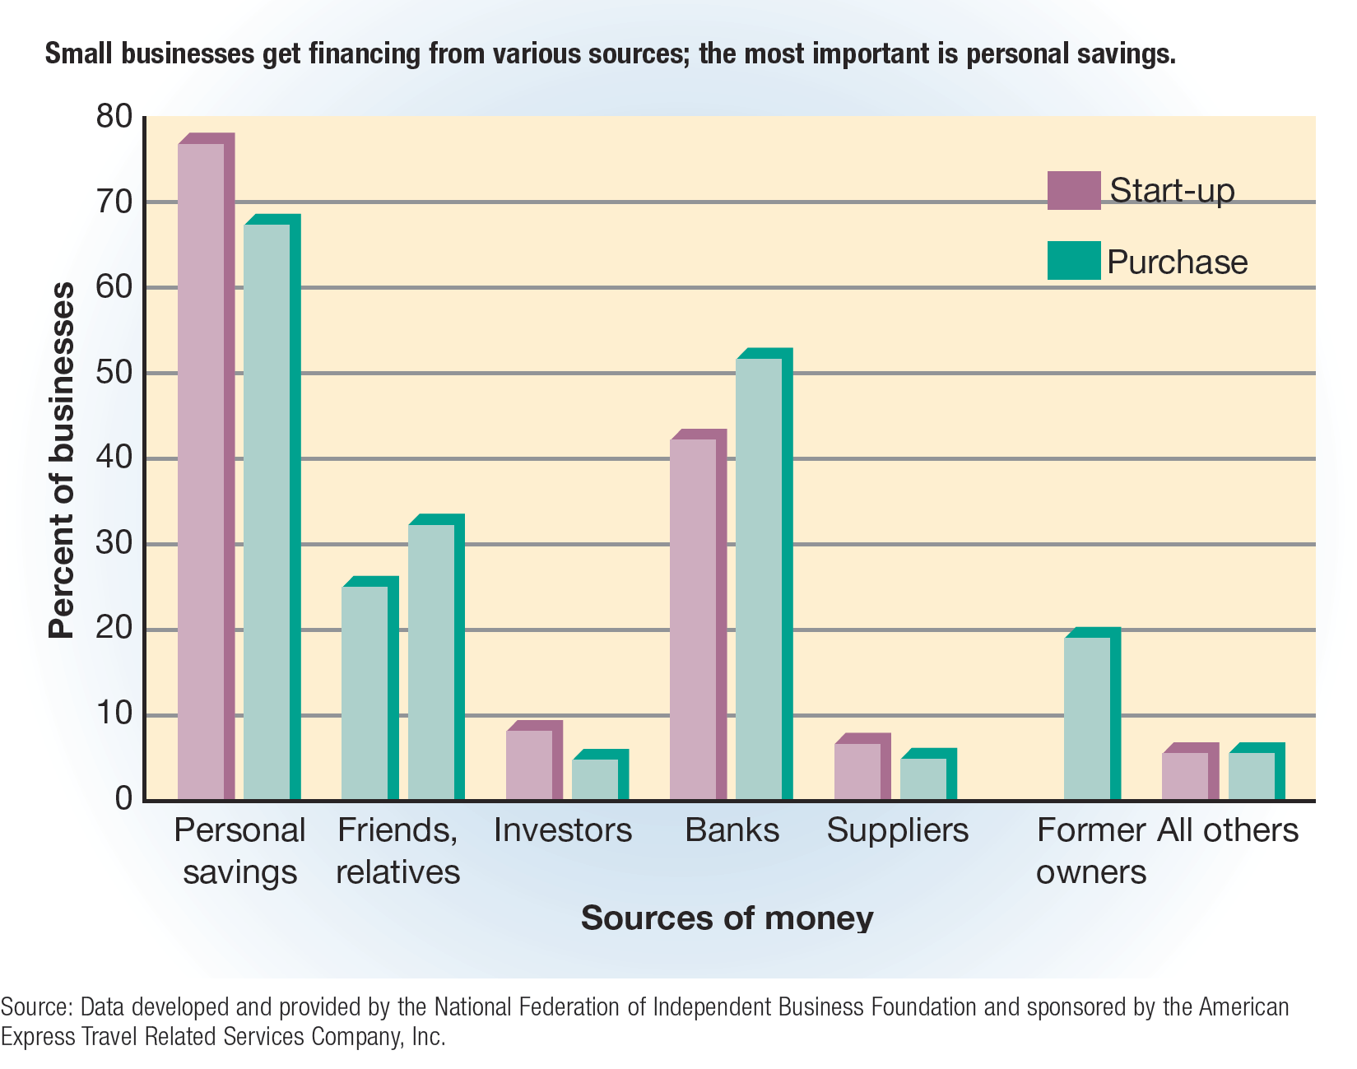
FIGURE 5-2 Sources of Capital for Entrepreneurs

Slide 13
The People in Small Businesses: The Entrepreneurs (slide 1 of 3)
Researchers have suggested a variety of personal factors as reasons why people go into business for themselves.
Entrepreneurial spirit
Independence
A desire to determine one’s own destiny
A willingness to find and accept a challenge
Family background
Age
Motivation
Entrepreneur -- Someone who risks their time, effort and money owning and operating a business
Entrepreneurship -- Accepting the risk of starting and running a business.

Slide 14
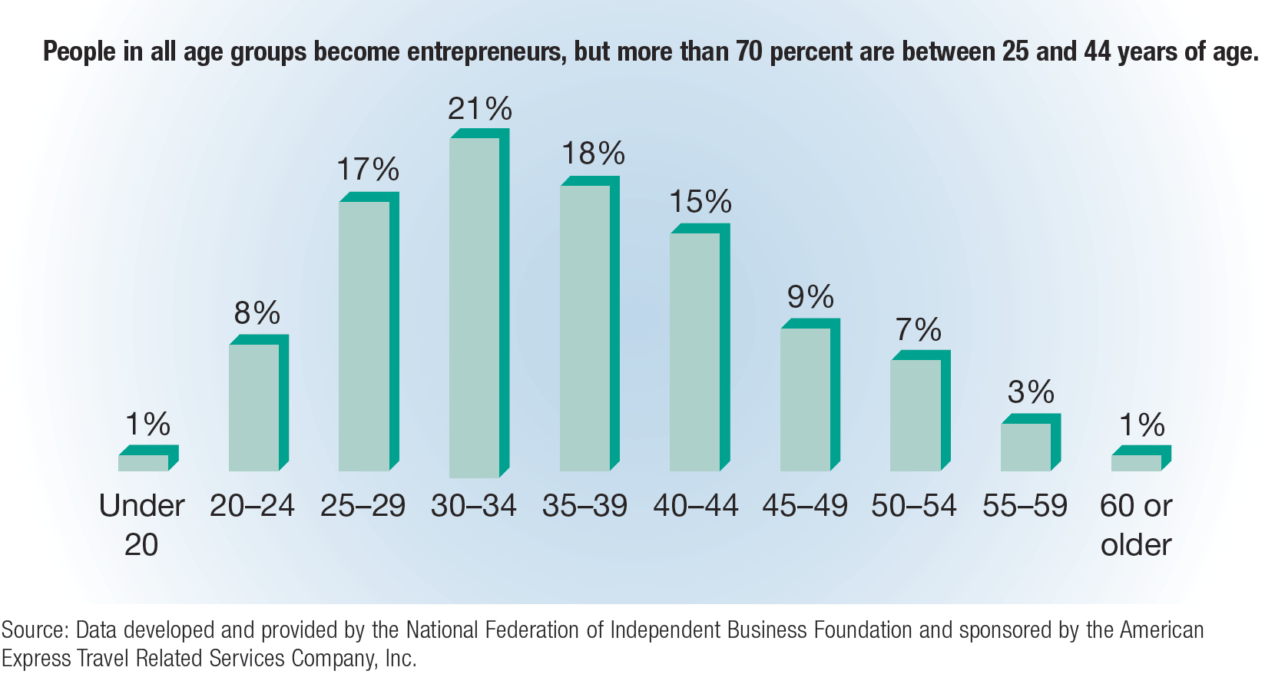
FIGURE 5-1 How Old Is the Average Entrepreneur?

Slide 15
The People in Small Businesses: The Entrepreneurs (slide 2 of 3)
Women as Small-Business Owners
According to the latest 2017 data available from the SBA:
Women own at least 36 percent of all small businesses.
Women own 66 percent of the home-based businesses in this country.
About 9.9 million women-owned businesses in the United States provide almost 8.8 million jobs and generate $1.4 trillion in sales.
More than 40 percent of women-owned businesses in the United States have been in business for 12 years or more.
Women-owned businesses are financially sound and credit-worthy, and their risk of failure is lower than average.
Compared to other working women, self-employed women are older, better educated, and have more managerial experience.

Slide 16
The People in Small Businesses: The Entrepreneurs (slide 3 of 3)
Teenagers as Small-Business Owners
High-tech teen entrepreneurship is exploding.
Immigrants as Entrepreneurs
Entrepreneurship has been growing among immigrants.

Slide 17
The Importance of a Business Plan
Business plan – a carefully constructed guide for the person starting a business (a written blueprint for your business idea)
A business plan has three basic purposes:
Communication
A business plan serves as a concise document that potential investors examine to see if they would like to invest or assist in financing a new venture.
Management
A business plan helps to track, monitor, and evaluate the progress.
It serves to establish time lines and milestones and allows comparison of growth projections against actual accomplishments.
Planning
The business plan guides a businessperson through the various phases of business.
The business plan should answer four questions:
What exactly is the nature and mission of the new venture?
Why is this enterprise a good idea?
What are the businessperson’s goals?
How much will the new venture cost?

Slide 18
Starting a Small Business
Recognize Opportunity
New Business, Existing Business, Franchise
Business Plan
“Blue print for business,” a carefully constructed guide for the person starting the business
SBA, SBDC, Score
Write on a 4th Grade Level
Seek Capital
$100,000 avg “seed” money
Lenders/Investors
What do they look at?
Family or Friends
File and Register Business
Operate and Manage

Slide 19
Resources for Entrepreneurs
SBA
Small Business Administration (SBA) – a governmental agency that assists, counsels, and protects the interests of small business in the United States
SCORE
The SCORE Association – a group of businesspeople who volunteer their services to small business through the SBA
SCORE consists of more than 11,000 retired and active businesspeople who have worked for corporations such as General Electric, IBM, and Procter & Gamble.
Experts in areas of accounting, finance, marketing, engineering, and retailing provide counseling and mentoring to entrepreneurs.

Slide 20
SBA Financial Assistance
Regular Business Loans
Most of the SBA’s business loans are actually made by private lenders such as banks, but repayment is partially guaranteed by the agency.
That is, the SBA may guarantee that it will repay the lender up to 90 percent of the loan if the borrowing firm cannot repay it.
Guaranteed loans approved may be as large as $5.0 million.
The average size of an SBA-guaranteed loan is about $300,000, and its average duration is about eight years.

Slide 21
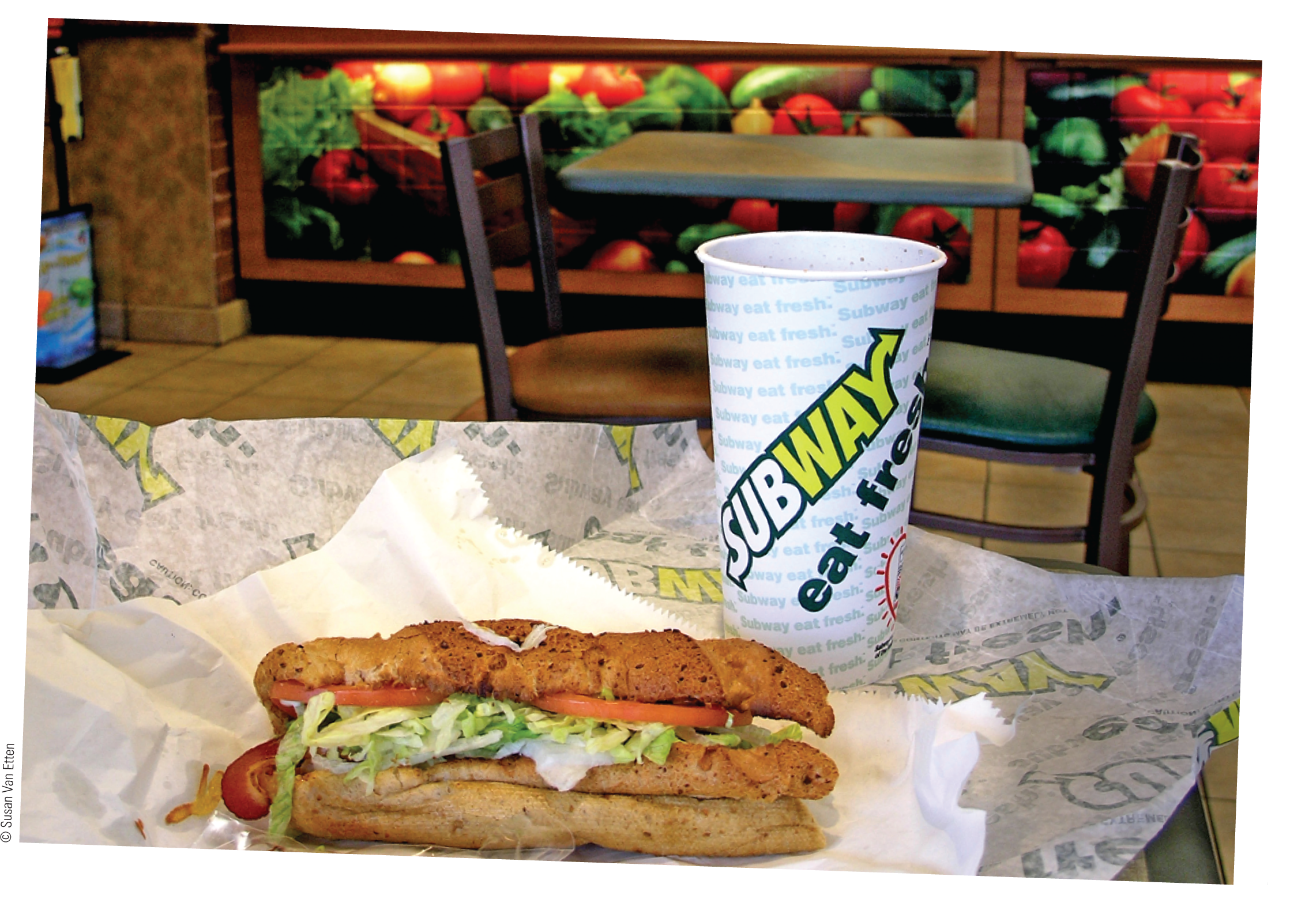
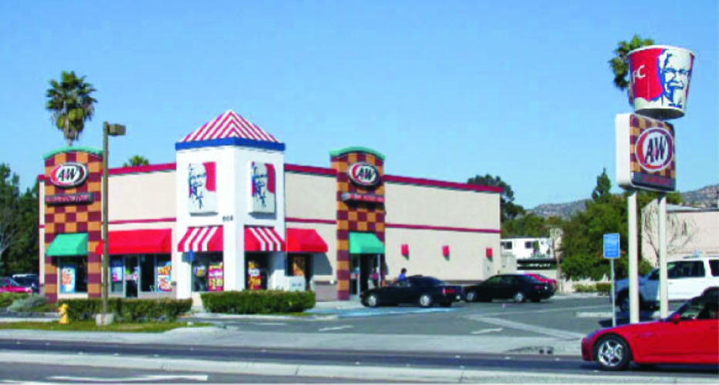
Common Business Opportunities
New Business – starting a brand-new business from scratch
Existing Business – buying an existing business
Franchises – the right to operate an individually owned business as though it was a part of a chain or outlet of stores

Slide 22
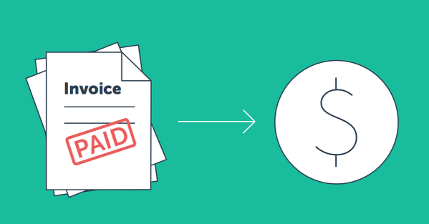
Starting a Brand New Business
ADVANTAGES
Control you own destiny
Personal satisfaction – It’s your business, you started it
Unlimited income potential
True independence
DISADVANTAGES
High risk of failure
Long hours and hard work
High stress levels
Complete responsibility

Slide 23
Buying an Existing Business
Pros
Cons
Ease of start-up
Existing customer base
Financing opportunities
Purchase price may be high
Inheriting the previous owner’s mistakes
Unknowns in transition
Alienated customers? Employees?

Slide 24
Franchising
Franchise – a license to operate an individually owned business as though it were part of a chain of outlets or stores
Examples: McDonalds, H&R Block, AAMCO Transmissions
Franchising – the actual granting of a franchise
Franchisor – an individual or organization granting a franchise
Supplies:
A known and advertised business name
Management skills
The required training and materials
A method of doing business
Franchisee – a person or organization purchasing a franchise
Supplies labor and capital
Operates the franchised business
Agrees to abide by the provisions of the franchise agreement

Slide 25
TABLE 5-4 Basic Rights and Obligations Delineated in a Franchise Agreement (slide 1 of 3)
Franchisee rights include:
Use of trademarks, trade names, and patents of the franchisor;
Use of the brand image and the design and décor of the premises developed by the franchisor;
Use of the franchisor’s secret methods;
Use of the franchisor’s copyrighted materials;
Use of recipes, formulae, specifications, processes, and methods of manufacture developed by the franchisor;
Conducting the franchised business upon or from the agreed premises strictly in accordance with the franchisor’s methods and subject to the franchisor’s directions;
Guidelines established by the franchisor regarding exclusive territorial rights; and
Rights to obtain supplies from nominated suppliers at special prices.

Slide 26
TABLE 5-4 Basic Rights and Obligations Delineated in a Franchise Agreement (slide 2 of 3)
Franchisee obligations include:
To carry on the business franchised and no other business upon the approved and nominated premises;
To observe certain minimum operating hours;
To pay a franchise fee;
To follow the accounting system laid down by the franchisor;
Not to advertise without prior approval of the advertisements by the franchisor;
To use and display such point-of-sale advertising materials as the franchisor stipulates;

Slide 27
TABLE 5-4 Basic Rights and Obligations Delineated in a Franchise Agreement (slide 3 of 3)
Franchisee obligations include:
To maintain the premises in good, clean, and sanitary condition and to redecorate when required to do so by the franchisor;
To maintain the widest possible insurance coverage;
To permit the franchisor’s staff to enter the premises to inspect and see if the franchisor’s standards are being maintained;
To purchase goods or products from the franchisor or his designated suppliers;
To train the staff in the franchisor’s methods to ensure that they are neatly and appropriately clothed; and
Not to assign the franchise contract without the franchisor’s consent.

Slide 28
Types of Franchising
Franchising arrangements fall into three general categories:
A manufacturer authorizes a number of retail stores to sell a certain brand-name item.
Used by sellers of passenger cars and trucks, farm equipment, and shoes
A producer licenses distributors to sell a given product to retailers.
Most commonly found in the soft drink industry
A franchisor supplies brand names, techniques, or other services instead of a complete product.
Used by travel-related companies (Avis, Hampton Hotels) and restaurants (McDonald’s, SUBWAY)

Slide 29
The Growth of Franchising (slide 1 of 2)
Franchising, which began in the United States around the time of the Civil War, was used originally by large firms to distribute their products.
Franchising has been increasing steadily in popularity since the early 1900s, and has experienced enormous growth since the mid-1970s.

Slide 30
The Growth of Franchising (slide 2 of 2)
Franchising is attracting more women and minority business owners in the United States than ever before.
One reason is that special outreach programs designed to encourage franchisee diversity has been developed.
Example: Wendy’s, McDonald’s, and Burger King have special corporate programs to attract minority and women franchisees.
Dual-branded franchises, in which two franchisors offer their products together, are a new small-business trend.
Example: An agreement between Doctor’s Associates, Inc., and TCBY Enterprises, Inc., now allows franchisees to sell SUBWAY sandwiches and TCBY yogurt in the same establishment.

Slide 31
Are Franchises Successful?
The success rate for businesses owned and operated by franchises is significantly higher than the success rate for other independently owned small businesses.
However, franchising is not a guarantee of success for either franchisees or franchisors.
Too rapid expansion, inadequate capital or management skills, and a host of other problems can cause failure for both franchisee and franchisor.

Slide 32
Advantages of Franchising
To the Franchisor
Fast and well controlled distribution of its products
No need to construct and operate its own outlets
More working capital available for expanded production and advertising
Franchising agreements maintain product and quality standards
Motivated work force of franchisees
To the Franchisee
Opportunity to start a proven business with limited capital
Guaranteed customers
Franchisor available for advice and guidance
Materials for local promotional campaigns and participation in national campaigns
Cost savings when purchasing in cooperation with other franchisees

Slide 33
Disadvantages of Franchising
To the Franchiser
Failure of the franchisee to operate franchise properly
Disputes with and lawsuits by franchisees over the terms of the franchise
To the Franchisee
It can be expensive
Royalty Fees
Franchise Fees
Franchisor retains a large amount of control over the franchisee’s activities
Franchisor opening competing franchises within the franchisee’s market

