Slide 1
Chapter 2
Ethics and Social Responsibility in Business

Slide 2
Business Ethics and Social Responsibility: A Close Relationship
ETHICS
Beliefs about
right and wrong
SOCIAL
RESPONSIBILITY
The obligation of a business
to contribute to society
(businesses concern for
welfare of society)

Slide 3
Business Ethics Defined
Ethics – the study of right and wrong and of the morality of the choices individuals make
  An ethical decision or action is one that is “right” according to some standard of behavior.
What’s Ethical?
  Different standards for different people, cultures, countries, etc.
  Gray areas?
  More than just following the law
  Fundamental standards (respect for life, honesty, integrity, etc.)
Business ethics – the application of moral standards to business situations
Organizations should focus on ethics - Good ethics is good business!

Slide 4
Ethical Issues
Ethical issues often arise out of a business’s relationship with investors, customers, employees, creditors, suppliers, or competitors.
    Each of these stakeholder groups has specific concerns and usually exerts pressure on the organization’s managers.
Four General Areas of Ethical Issues
  Fairness and Honesty
  Organizational Relationships
  Conflicts of Interest
  Communications

Slide 5
Fairness and Honesty
Businesspeople are expected to refrain from knowingly deceiving, misrepresenting, or intimidating others.
  Example: The Federal Trade Commission ruled that Gerber’s claim that its Good Start Gentle baby formula can prevent or reduce allergies in children lacked scientific evidence and asked the company to remove the statement from its advertising and product labels.
  Businesspeople should follow the “GOLDEN RULE” – treat others how you would like to be treated!

Slide 6
Organizational Relationships
Businesspeople should not place their personal welfare above the welfare of others or the welfare of the organization.
Relationships among co-workers often create unethical problems.
  Includes:
    Not meeting one’s commitments in a mutual agreement
    Pressuring others to behave unethically
    Plagiarism – knowingly taking someone else’s words, ideas, or other original material without acknowledging the source

Slide 7
Conflicts of Interest
Conflicts of interest occur when a businessperson takes advantage of a situation for his or her own personal interest rather than for the employer’s interest.
  Examples: a manager dating a subordinate, a firm that advises clients without informing them that it has a relationship with some of the products it recommends
  Conflicts of interest may occur when payments and gifts make their way into business deals.
  Bribes—gifts, favors, or payments offered with the intent of influencing an outcome—are illegal in the U.S. and abroad.

Slide 8
Communications
False and misleading advertising is illegal and unethical.
  Example: Advertisers of health-related products must take precautions to guard against deception when using such descriptive terms as low fat, fat free, and light.

Slide 9
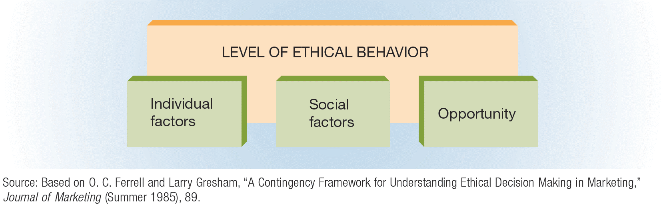
FIGURE 2-1 Factors That Affect the Level of Ethical Behavior in an Organization

Slide 10
Factors Affecting Ethical Behavior
Individual Factors Affecting Ethics
How much an individual knows (personal knowledge)
Moral values and central, value-related attitudes
Personal goals and the manner in which these goals are pursued
Social Factors Affecting Ethics
Cultural norms
Actions and decisions of co-workers
Values and attitudes of “significant others” (spouses, friends, and relatives)
The use of the Internet
Opportunity as a Factor Affecting Ethics
Opportunity – the amount of freedom an organization affords an employee to behave unethically if he or she makes that choice
Degree of enforcement of company policies, procedures, and ethical codes

Slide 11
Encouraging Ethical Behavior
(slide 1 of 3)
Government’s Role in Encouraging Ethics
The government can encourage ethical behavior by enacting more stringent regulations.
  Sarbanes-Oxley Act of 2002 – provides sweeping new legal protection for employees who report corporate misconduct
Trade Associations’ Role in Encouraging Ethics
Trade associations can and often do provide ethical guidelines for their members.
  Example: A pharmaceutical trade group adopted a new set of guidelines intended to end the extravagant dinners and expensive gifts sales representatives often give to physicians to persuade them to prescribe a particular medicine.

Slide 12
Encouraging Ethical Behavior
(slide 2 of 3)
Individual Companies’ Role in Encouraging Ethics
Codes of ethics are perhaps the most effective way to encourage ethical behavior.
  Code of ethics – a guide to acceptable and ethical behavior as defined by the organization
  Today, about 95 percent of Fortune 1000 firms have a formal code of ethics or conduct.
  In the wake of a number of corporate scandals and the Sarbanes-Oxley Act, many large companies now have created a new executive position, the chief ethics (or compliance) officer.

Slide 13
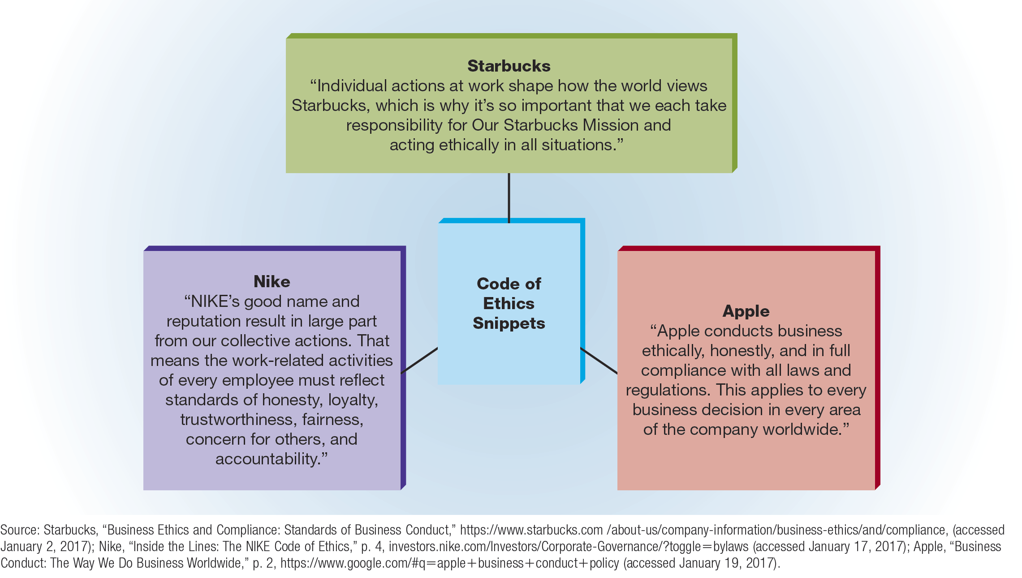
FIGURE 2-2 Defining Acceptable Behavior at Starbucks, Nike, and Apple

Slide 14
Encouraging Ethical Behavior
(slide 3 of 3)
Individual Companies’ Role in Encouraging Ethics (cont.)
Employees with high personal ethics may take a controversial step called whistle-blowing.
  Whistle-blowing – informing the press or government officials about unethical practices within one’s organization
  The Sarbanes-Oxley Act of 2002 protects whistle-blowers who report corporate misconduct.
  Federal employees who report misconduct are protected by the Whistleblower Protection Act of 1989.
  Other ways a company’s organization environment can encourage ethical behavior:
    Reward ethical behavior / Discipline unethical behavior
    Reduce opportunity
    Provide a forum for reporting
    Employ an Ethics officer
    Provide Employee training and development
    Practice good Leadership & Communication (REMEMBER GOOD ETHICS START AT THE TOP!)

Slide 15
TABLE 2-1 Guidelines for Making Ethical Decision
Listen and learn | Recognize the problem or decision-making opportunity that confronts your company, team, or unit. Don’t argue, criticize, or defend yourself—keep listening and reviewing until you are sure that you understand others.
Identify the ethical issues | Explain how co-workers and consumers are affected by the situation or decision at hand. Examine how you feel about the situation, and attempt to understand the viewpoint of those involved in the decision or in the consequences of the decision.
Create and analyze options | Try to put aside strong feelings such as anger or a desire for power and prestige and come up with as many alternatives as possible before developing an analysis. Ask everyone involved for ideas about which options offer the best long-term results for you and the company. Then decide which option will increase your self-respect even if, in the long run, things don’t work out the way you hope they will.
Identify the best option from your point of view | Consider it and test it against some established criteria, such as respect, understanding, caring, fairness, honesty, and openness.
Explain your decision and resolve any differences that arise | This may require neutral arbitration from a trusted manager or taking “time out” to reconsider, consult, or exchange written proposals before a decision is reached.

Slide 16
Facing an Ethical Dilemma?
    Ask yourself these questions:
      Is it legal?
      Is it balanced?
      How will it make me feel about myself?

Slide 17
Social Responsibility
Social responsibility – the recognition that business activities have an impact on society and the consideration of that impact in business decision making
Social responsibility costs money!
How socially responsible a firm acts may affect the decisions of customers to do or continue to do business with the firm
Consider:
  How is it different from ethics?
  Why is it good business?

Slide 18
Corporate Citizenship
Corporate citizenship – adopting a strategic approach to fulfilling economic, ethical, environmental, and social responsibilities
Consider:
How many of the social programs in the text were you familiar with before you read the chapter?

Slide 19
TABLE 2-2 Corporate Responsibility Magazine’s 10 Best Corporate Citizens
Microsoft Corporation
Intel Corp.
Hasbro Inc.
Johnson & Johnson
Ecolab, Inc.
Bristol-Myers-Squibb Company
Xerox Corp.
Lockheed Martin Corp.
Lexmark International, Inc.
Campbell Soup Co.

Slide 20
Historical Evolution of Business Social Responsibility
During the first quarter of the 20th century, government protection of workers and consumers was minimal.
During this period, consumers generally were subject to the doctrine of caveat emptor—a Latin phrase meaning “let the buyer beware.”
Before the 1930s, most people believed that competition and the action of the marketplace would, in time, correct abuses.
The collapse of the stock market on October 29, 1929, triggered the Great Depression, and public pressure soon mounted for the government to “do something” about the economy and about worsening social conditions.
Soon after Franklin D. Roosevelt became president in 1933, he instituted programs to restore the economy and improve social conditions.
As government involvement has increased, so has everyone’s awareness of the social responsibility of business.

Slide 21
TABLE 2-3 Early Government Regulations That Affected American Business
Government Regulation | Major Provisions
Interstate Commerce Act (1887) | First federal act to regulate business practices; provided regulation of railroads and shipping rates
Sherman Antitrust Act (1890) | Prevented monopolies or mergers where competition was endangered
Pure Food and Drug Act (1906) | Established limited supervision of interstate sales of food and drugs
Meat Inspection Act (1906) | Provided for limited supervision of interstate sales of meat and meat products
Federal Trade Commission Act (1914) | Created the Federal Trade Commission to investigate illegal trade practices
Clayton Antitrust Act (1914) | Eliminated many forms of price discrimination that gave large businesses a competitive advantage over smaller firms

Slide 22
Two Views of Social Responsibility
Economic model of social responsibility (Passive Contribution)– the view that society will benefit most when business is left alone to produce and market profitable products that society needs
Socioeconomic model of social responsibility (Active Contribution)– the concept that business should emphasize not only profits but also the impact of its decisions on society

Slide 23
Two Views of Social Responsibility
Economic Model Emphasis | Socioeconomic Model Emphasis
Production | Quality of life
Exploitation of natural resources | Conservation of natural resources
Internal, market-based decisions | Market-based decisions with some community controls
Economic return | Balance of economic return and social return
Firm’s or manager’s interest | Firm’s and community’s interests
Minor role for government | Active government
Consider:
Is there a middle ground?

Slide 24
The Pros and Cons of Social Responsibility (slide 1 of 2)
Pros:
  Because business is a part of our society, it cannot ignore social issues.
  Business has the technical, financial, and managerial resources needed to tackle today’s complex social issues.
  By helping resolve social issues, business can create a more stable environment for long-term profitability.
  Socially responsible decision making by firms can prevent increased government intervention, which would force businesses to do what they fail to do voluntarily.

Slide 25
The Pros and Cons of Social Responsibility (slide 2 of 2)
Cons:
  Business managers are responsible primarily to stockholders, so management must be concerned with providing a return on owners’ investments.
  Corporate time, money, and talent should be used to maximize profits, not to solve society’s problems.
  Social problems affect society in general, so individual businesses should not be expected to solve these problems.
  Social issues are the responsibility of government officials who are elected for that purpose and who are accountable to the voters for their decisions.

Slide 26
Consumerism (slide 1 of 3)
Consumerism – all activities undertaken to protect the rights of consumers
The fundamental issues pursued by the consumer movement fall into three categories:
  Environmental protection
  Product performance and safety
  Information disclosure

Slide 27
Consumerism (slide 2 of 3)
The Basic Rights of Consumers
The Right to Safety
  Products that consumers purchase must be safe for their intended use, must include thorough and explicit directions for proper use, and must be tested by the manufacturer to ensure product quality and reliability.
The Right to Be Informed
  Consumers must have access to complete information about a product before they buy it.
The Right to Choose
  Consumers must have a choice of products, offered by different manufacturers and sellers, to satisfy a particular need.
The Right to Be Heard
  Someone will listen and take appropriate action when customers complain.

Slide 28
Consumerism (slide 3 of 3)
Additional Consumer Rights
The Right to Consumer Education
  People are entitled to be fully informed about their rights as consumers.
The Right to Service
  Consumers are entitled to convenience, courtesy, and responsiveness from manufacturers and sellers of consumer products.
Major Consumerism Forces
Consumer advocates and organizations
Consumer education programs
Consumer laws

Slide 29
TABLE 2-4 Major Federal Legislation Protecting Consumers Since 1960 (slide 1 of 5)
Legislation | Major Provisions
Federal Hazardous Substances Labeling Act (1960) | Required warning labels on household chemicals if they were highly toxic
Kefauver-Harris Drug Amendments (1962) | Established testing practices for drugs and required manufacturers to label drugs with generic names in addition to trade names
Cigarette Labeling Act (1965) | Required manufacturers to place standard warning labels on all cigarette packages and advertising
Fair Packaging and Labeling Act (1966) | Called for all products sold across state lines to be labeled with net weight, ingredients, and manufacturer’s name and address
Motor Vehicle Safety Act (1966) | Established standards for safer cars

Slide 30
TABLE 2-4 Major Federal Legislation Protecting Consumers Since 1960 (slide 2 of 5)
Legislation | Major Provisions
Truth in Lending Act (1968) | Required lenders and credit merchants to disclose the full cost of finance charges in both dollars and annual percentage rates
Credit Card Liability Act (1970) | Limited credit-card holder’s liability to $50 per card and stopped credit-card companies from issuing unsolicited cards Required credit bureaus to provide credit reports to consumers regarding their own credit files; also provided for correction of incorrect information
Consumer Product Safety Commission Act (1972) | Established an abbreviated procedure for registering certain generic drugs
Fair Credit Billing Act (1974) | Amended the Truth in Lending Act to enable consumers to challenge billing errors

Slide 31
TABLE 2-4 Major Federal Legislation Protecting Consumers Since 1960 (slide 3 of 5)
Legislation | Major Provisions
Equal Credit Opportunity Act (1974) | Provided equal credit opportunities for males and females and for married and single individuals Provided for minimum disclosure standards for written consumer-product warranties for products that cost more than $15
Amendments to the Equal Credit Opportunity Act (1976, 1994) | Prevented discrimination based on race, creed, color, religion, age, and income when granting credit
Fair Debt Collection Practices Act (1977) | Outlawed abusive collection practices by third parties
Nutrition Labeling and Education Act (1990) | Required the Food and Drug Administration to review current food labeling and packaging focusing on nutrition label content, label format, ingredient labeling, food descriptors and standards, and health messages

Slide 32
TABLE 2-4 Major Federal Legislation Protecting Consumers Since 1960 (slide 4 of 5)
Legislation | Major Provisions
Telephone Consumer Protection Act (1991) | Prohibited the use of automated dialing and prerecorded-voice calling equipment to make calls or deliver messages
Consumer Credit Reporting Reform Act (1997) | Placed more responsibility for accurate credit data on credit issuers; required creditors to verify that disputed data are accurate and to notify a consumer before reinstating the data
Children’s Online Privacy Protection Act (2000) | Placed parents in control over what information is collected online from their children younger than 13 years; required commercial Web site operators to maintain the confidentiality, security, and integrity of personal information collected from children

Slide 33
TABLE 2-4 Major Federal Legislation Protecting Consumers Since 1960 (slide 5 of 5)
Legislation | Major Provisions
Do Not Call Implementation Act (2003) | Directed the FCC and the FTC to coordinate so that their rules are consistent regarding telemarketing call practices including the Do Not Call Registry and other lists, as well as call abandonment
Credit Card Accountability, Responsibility, and Disclosure Act (2009) | Provided the most sweeping changes in credit card protections since the Truth in Lending Act of 1968
Dodd–Frank Wall Street Reform and Consumer Protection Act of 2010 | Promoted the financial stability of the United States by improving accountability and responsibility in the financial system; established a new Consumer Financial Protection Agency to regulate home mortgages, car loans, and credit cards; became Public Law on July 21, 2010

Slide 34
Public Health
Many people believe that businesses have a basic responsibility to contribute to the general wellbeing of the public.
Beyond this basic responsibility, however, there is contention with regard to how far businesses’ responsibility to public health extends, especially about issues such as:
  Obesity
  Smoking
  Heart disease
  Alcohol use
  Smartphone use while driving

Slide 35
Employment Practices
Over the years, the opportunity to land a job for which he or she is qualified and to be rewarded on the basis of ability and performance has been denied to members of various minority groups.
  Minority – a racial, religious, political, or other group regarded as different from the larger group of which it is a part and that is often singled out for unfavorable treatment
  The federal government responded to the outcry of minority groups during the 1960s and 1970s by passing a number of laws forbidding workplace discrimination.
  Yet, abuses still exist.
    Disparity in income levels for whites, blacks, Hispanics, and Asians
    Lower income levels and higher unemployment rates for Native Americans, disabled persons, and women

Slide 36
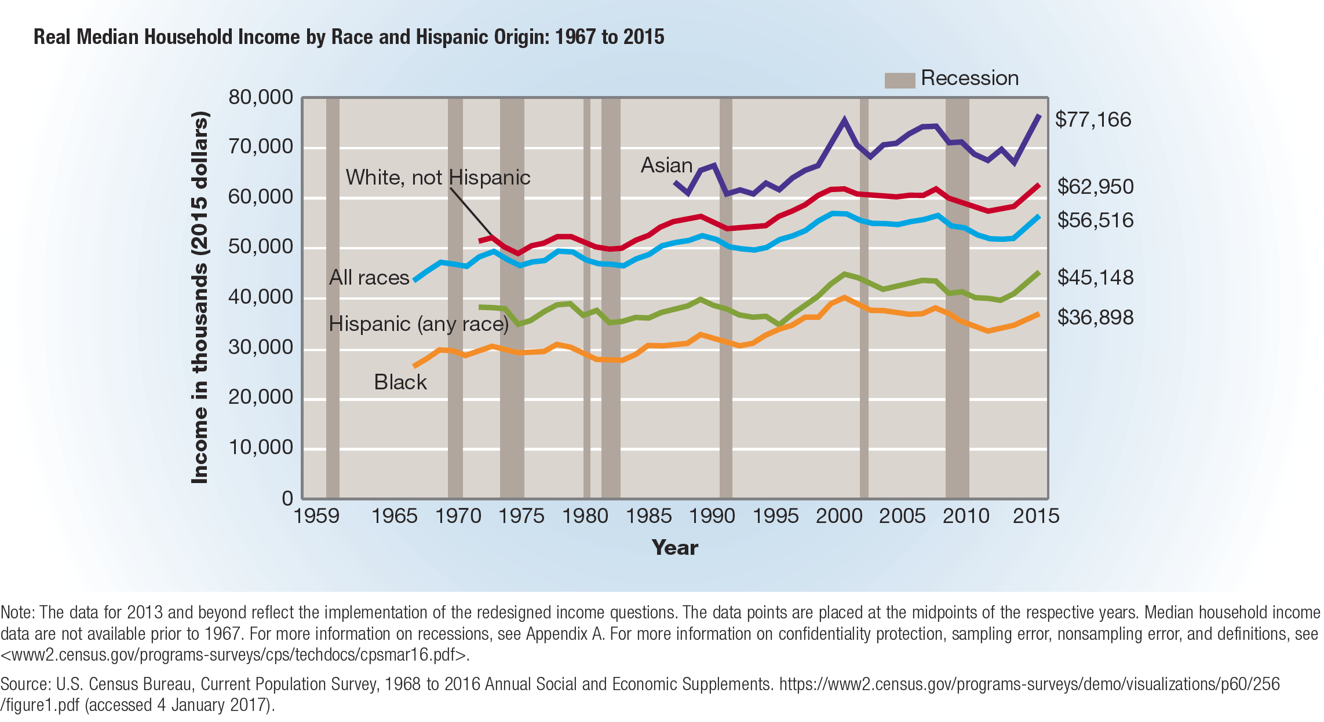
FIGURE 2-3 Comparative Income Levels

Slide 37
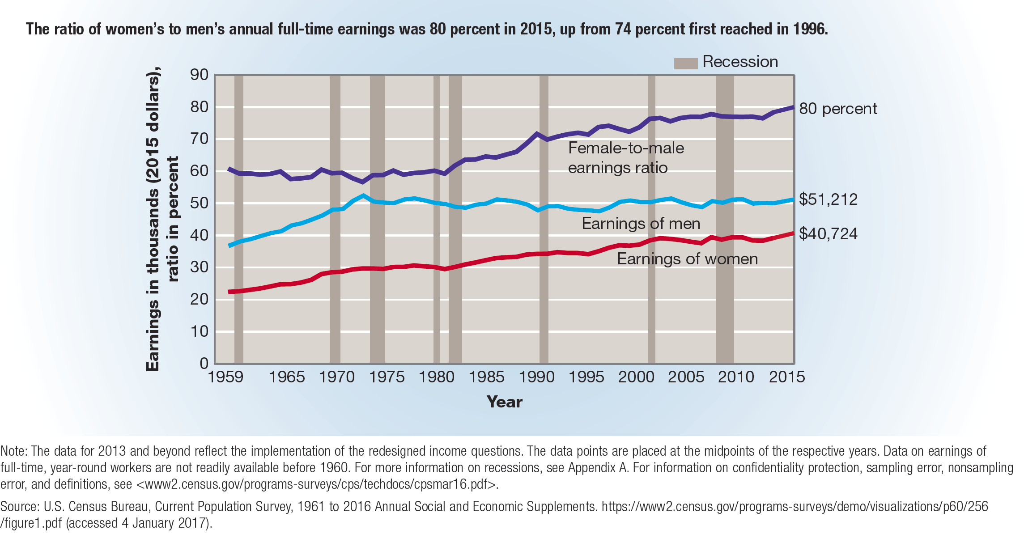
FIGURE 2-4 Relative Earning of Male and Female Workers

Slide 38
Affirmative Action Programs
Affirmative action program – a plan designed to increase the number of minority employees at all levels within an organization
Employers with federal contracts of more than $50,000 per year must have written affirmative action plans.
Affirmative action programs have been plagued by two problems:
  Quotas
  Lack of support by some businesspeople
  Equal Employment Opportunity Commission (EEOC) – a government agency with the power to investigate complaints of employment discrimination and the power to sue firms that practice it

Slide 39
Training Programs for the Hard-Core Unemployed
Hard-core unemployed – workers with little education or vocational training and a long history of unemployment
Many firms have assumed the task of helping the hard-core unemployed.
  Example: The Hard Rock Hotel & Casino teamed up with the College of Menominee Nation and Gateway Technical College in Kenosha, Wisconsin, to create a Job Training Institute to recruit and train Native Americans for casino and related jobs in the Kenosha area.

Slide 40
Programs to Reduce Sexual Harassment and Abusive Behavior
The Workplace Bullying Institute (WBI) defines bullying in the workplace as repeated work sabotage; verbal abuse; and/or abusive conduct that is threatening, humiliating, or intimidating.
When bullying takes on sexual overtones, it becomes sexual harassment, which the U.S. Equal Employment Opportunity Commission defines as unwelcome sexual advances, requests for sexual favors, and other verbal or physical harassment of a physical nature.
  Unlike bullying, sexual harassment is illegal.
To create a workplace environment that stifles bullying, sexual harassment, and other abusive conduct, managers need to provide programs, much like the ones that are used to foster more ethical conduct in the workplace, and create formal policies that define and prohibit unacceptable abusive conduct.

Slide 41
Environmental Concerns
Major environmental issues include:
  The amount of waste produced by businesses and society
  Pollution – the contamination of water, air, or land through the actions of people in an industrialized society

Slide 42
Effects of Environmental Legislation
Legislation and regulations play a crucial role in pollution control.
Current environmental legislation includes laws to promote clean air, clean water, and even quiet work and living environments.
Of major importance was the creation of the Environmental Protection Agency (EPA), the federal agency charged with enforcing laws designed to protect the environment.

Slide 43
TABLE 2-5 Summary of Major Environmental Laws (slide 1 of 3)
Legislation | Major Provisions
National Environmental Policy Act (1970) | Established the Environmental Protection Agency (EPA) to enforce federal laws that involve the environment
Clean Air Amendment (1970) | Provided stringent automotive, aircraft, and factory emission standards
Water Quality Improvement Act (1970) | Strengthened existing water pollution regulations and provided for large monetary fines against violators
Resource Recovery Act (1970) | Enlarged the solid-waste disposal program and provided for enforcement by the EPA
Water Pollution Control Act Amendment (1972) | Established standards for cleaning navigable streams and lakes and eliminating all harmful waste disposal by 1985

Slide 44
TABLE 2-5 Summary of Major Environmental Laws (slide 2 of 3)
Legislation | Major Provisions
Noise Control Act (1972) | Established standards for major sources of noise and required the EPA to advise the Federal Aviation Administration on standards for airplanes
Clean Air Act Amendment (1977) | Established new deadlines for cleaning up polluted areas; also required review of existing air-quality standards
Resource Conservation and Recovery Act (1984) | Amended the original 1976 act and required federal regulation of potentially dangerous solid-waste disposal
Clean Air Act Amendment (1987) | Established a national air-quality standard for ozone
Oil Pollution Act (1990) | Expanded the nation’s oil-spill prevention and response activities; also established the Oil Spill Liability Trust Fund

Slide 45
TABLE 2-5 Summary of Major Environmental Laws (slide 3 of 3)
Legislation | Major Provisions
Clean Air Act Amendments (1990) | Required that motor vehicles be equipped with onboard systems to control about 90 percent of refueling vapors
Food Quality Protection Act (1996) | Amended the Federal Insecticide, Fungicide and Rodenticide Act and the Federal Food Drug and Cosmetic Act; the requirements included a new safety standard—reasonable certainty of no harm—that must be applied to all pesticides used on foods
American Recovery and Reinvestment Act (2009) | Provided $7.22 billion to the EPA to protect and promote “green” jobs and a healthier environment

Slide 46
Business Response to
Environmental Concerns (slide 1 of 2)
Companies can reduce their impact on the environment by:
  Identifying and eliminating inefficiencies in production and operations
  Finding alternative uses for waste
  Striving to recycle as much as possible
    Recycling – converting used materials into new products or components for new products in order to prevent their unnecessary disposal
  Using “greener” forms of power to counter their use of huge quantities of energy during operations and other activities

Slide 47
Business Response to
Environmental Concerns (slide 2 of 2)
Recognizing public demand for greater environmental responsibility, more and more firms are adopting environmentally friendly practices and products that are less harmful to the environment.
  Green marketing – the process of creating, making, delivering, and promoting products that are environmentally safe
  Example: Chipotle Mexican Grill’s products include only natural animal products (treated humanely and fed a vegetarian diet that does not include growth hormones or antibiotics).

Slide 48
Implementing a Program of Social Responsibility
In most cases, developing and implementing an effective program for social responsibility will require four steps:
  Securing the commitment of top executives
  Planning
  Appointing a director
  Preparing a social audit—a comprehensive report of what an organization has done and is doing with regard to social issues that affect it

