Slide 1
Using Management Information Systems and Accounting Information

Slide 2
Why Accounting Information
Is Important
Accounting is a system for recognizing, organizing,
analyzing, and reporting information about the
financial transactions that affect an organization?
What does accounting do?
“Language” of business
Record transactions
Track income & expenses
Prepare financial statements
Helps answer and assist with important business decisions
Managers
Owners
Employees
Creditors
What other groups would be interested
in accounting information?

Slide 3
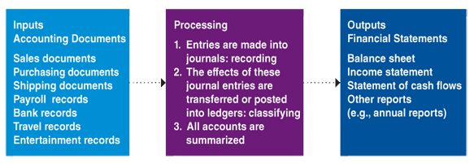
The Accounting System

Slide 4
Accounting: Who Does It?
What Accountants Do:
  Public and Private Accountants
  Forensic Accountants
  Corporate Accountants
  Internal/External Auditors
  Government Accountants
Accountants require expertise
  Certified Public Accountant (CPA) Certification
    150-semester hours of college
    Rigorous Exam
    Direct Work Experience in accounting
  Certified Management Accountant (CMA)
  Certified Fraud Examiners
Managerial accounting is responsible for tracking sales and the costs of producing the sales (production, marketing, and distribution).
    Geared towards INTERNAL users (hence name)
Financial accounting produces financial documents to aid decision makers outside an organization in making decisions regarding investments and credibility.
  Geared towards OUTSIDE users (although internal users also rely heavily on financial accounting information)

Slide 5
Different Types of Accounting
Managerial accounting: Provides information to internal users that need to make decisions about:
  Firm’s financing
  Investing
  Marketing
  Operating activities
Financial accounting: Generates financial statements and reports for interested people outside an organization

Slide 6
Accounting Fraud
Corporate accounting issues in recent years have forced many investors, lenders and suppliers, and government regulators to question motives behind accounting practices
Much pressure on corporate executives to look good to Wall Street analysts and investors
Ones hurt when companies report inaccurate or misleading accounting information
  Employees who lose their jobs
  Investors, lenders, and suppliers
  Not high-paid corporate executives

Slide 7
Sarbanes–Oxley Act
To help ensure that corporate financial information is accurate and to prevent accounting scandals, Congress enacted the Sarbanes–Oxley Act in 2002; key components include:
  The SEC must establish an oversight board to police the accounting industry
  Top executives must certify periodic financial reports and are liable for intentional violations of reporting requirements
  Accounting firms cannot provide many types of non-audit and consulting services to the companies they audit
Additional key components include:
  Auditors must maintain financial documents and audit work papers for five years
  Auditors, accountants, and employees can be imprisoned for up to 20 years and subject to fines for destroying financial documents and willful violations of the securities laws.
  A public corporation must change its lead auditing firm every five years.
  There is added protection for whistle-blowers who report violations of the Sarbanes–Oxley Act

Slide 8
Careers in Accounting
Qualities to be successful in accounting:
  Responsible, honest, ethical
  Strong background in financial management
  Knowledge of computer and accounting software
  Able to communicate with people who need accounting information

Slide 9

Special Areas of Accounting
Additional special areas of accounting include:
  Cost accounting
  Tax accounting
  Government accounting
  Not-for-profit accounting

Slide 10
Classifications of Accountants
Private Accountant
  Employed by a specific organization
  Services performed for the employer
    Design its accounting information system
    Manage its accounting department
    Provide managers with accounting information,
    advice and assistance
Public Accountant
  Provides services to clients on a fee basis
  Self-employed or employee of an accounting firm
Certified Public Accountant (CPA)
  Has met state requirements for accounting education and experience and has passed a rigorous accounting examination prepared by the AICPA
  Participates in continuing-education programs to maintain certification

Slide 11

Why Audited Financial Statements
Are Important
Audit: Examination of company’s financial statements and accounting practices
Generally accepted accounting principles (GAAPs): Guidelines and practices for companies reporting financial information and for the accounting profession
An audit does not guarantee that a company has not “cooked” the books, it does imply that the company has followed GAAPs
Fraud damages businesses, no matter the size.
The SEC has committed itself to fighting fraud but not
all auditors and CPAs are trained in finding fraud.
Colleges are offering advanced degrees in forensic
accounting to meet the upcoming demand for these accountants.

Slide 12
Accounting Standards and Procedures
Generally Accepted
Accounting Principles (GAAP) –
accounting standards that
are used in the preparation
of financial statements
Through GAAP,
the FASB aims to
ensure that financial
statements are:
  Relevant
  Reliable
  Consistent
  Comparable
Financial Accounting
Standards Board (FASB) –
private self-regulated board that
establishes and enforces GAAP

Slide 13
The Accounting Process
GAAP establishes two main financial accounting rules:
  The Accounting Equation
    Assets = Liabilities + Owner’s Equity
    Assets – The resources that a business own (ex. Cash, Accounts Receivable, Inventory, Equipment, and Real Estate/Land)
    Liabilities – The firm’s debts, what it owes others (ex. Accounts Payable and Notes Payable)
    Owner’s Equity – The difference between assets and liabilities (what would be left for the owners if the firm’s assets were sold and the money used to pay off its liabilities (ex. Retained Earnings, Stock)
  Double-Entry Bookkeeping System
    Each financial transaction is recorded as two separate accounting entries to maintain the balance of the accounting equation

Slide 14
The Fundamental Accounting Equation
Fundamental Accounting Equation -- The basis for the balance sheet.
The equation must always be balanced and includes the formula:
  Assets = Liabilities + Owners Equity

Slide 15
The Fundamental Accounting Equation
Accounting Equation:
Assets = Liabilities + Owner’s Equity
Own = Owed + Owner’s Claims
Cash, Accounts Receivable,
Inventory, Equipment, Real Estate
Accounts Payable,
Notes Payable
Stock, Retained Earnings (cumulation of company’s profits and losses)
$826,000 = $613,000 + $213,000
Owner’s Equity (what’s left over to owner’s once liabilities are taken from assets), shown as:
Assets – Liabilities = Owner’s Equity

Slide 16
The Balance Sheet
Balance Sheet – summarizes a firm’s financial position at a specific point in time
Assets –
things of
value that
the firm owns
Liabilities –
indicates what
the firm owes to
non-owners
Owner’s
Equity –
the claims owners
have against
their firm’s
assets
Assets = Liabilities + Owner’s Equity

Slide 17
The Balance Sheet
A summary of the dollar amounts of a firm’s assets, liabilities, and owners’ equity accounts at the end of a specific accounting period (also called statement of financial position)
Assets
  Listed in order of liquidity (ease with which an asset can be converted into cash)
  Current assets—can quickly be converted into cash or that will be used in one year or less
  Cash, marketable securities, accounts receivable, notes receivable, merchandise inventory, and prepaid expenses

Slide 18
The Balance Sheet: Assets
Assets (cont’d)
  Fixed assets—will be held or used for a period longer than one year
    Land, buildings, and equipment
    Depreciation—the process of apportioning the cost of a fixed asset over the period during which it will be used
  Intangible assets—do not exist physically but have a value based on the rights or privileges they confer on the firm
    Patents, copyrights, trademarks, and goodwill

Slide 19
Liabilities
Current liabilities—debts to be repaid in one year or less
  Accounts payable—short-term obligations that arise as a result of making credit purchases
  Notes payable—obligations that have been secured with promissory notes
Long-term liabilities—debts that need not be repaid for at least one year
  Mortgages, bonds, and long-term loans

Slide 20
Owners’ or Stockholder’s Equity
For sole proprietorships
Assets – liabilities = owners’ equity
For partnerships—Each partner’s share of ownership is reported separately in each owner’s name
For corporations—stockholders’ equity
Retained earnings—profits not distributed to stockholders

Slide 21
The Balance Sheet
Assets Liabilities
Current assets Current liabilities
+ Fixed assets + Long-term liabilities
= Total Liabilities
Owners’ Equity
= Total Assets = Total Liabilities + Owners’ Equity
Assets
Listed in order of liquidity (ease with which an asset can be converted into cash)
Current assets—can quickly be converted into cash or that will be used in one year or less
  Cash, accounts receivable, notes receivable, and merchandise inventory
Fixed assets—will be held or used for a period longer than one year
  Real estate (Land and buildings), and equipment
Depreciation—the process of apportioning the cost of a fixed asset over the period during which it will be used
Liabilities
Current liabilities—debts to be repaid in one year or less
  Accounts payable—short-term obligations that arise as a result of making credit purchases
  Notes payable—obligations that have been secured with promissory notes
Long-term liabilities—debts that need not be repaid for at least one year
Owners’ or stockholders’ equity
Retained earnings—profits not distributed to stockholders

Slide 22
The Balance Sheet: An Example

Slide 23
The Income Statement
Income Statement – summarizes a firm’s operations over a given period of time in terms of profit and loss.
Also called the Profit and Loss Statement
Revenue–
The $ amount a firm
earns from selling its
products
Expenses –
the cash the firm
spends or other
assets it uses to
generate
revenue
Net Income (Profit) –
the profit or loss
the firm earns
Revenue – Expenses = Net Income (Profit)
Revenues > Expenses = Net Income (Profit)
Expenses > Revenue = Loss

Slide 24
Income Statement Template
The formula for the income statement:
  Revenue (AKA Sales)
  Cost of Goods Sold (BI + Purchases – EI)
  = Gross Profit
  Operating Expenses
  = Net Income before Taxes
  Taxes
  = Net Income or Net Loss

Slide 25
The Income Statement
A summary of a firm’s revenues and expenses during a specified accounting period
  Profit (cash surplus)
  Loss (cash deficit)
Revenues are the dollar amounts earned by a firm from selling goods, providing services, or performing business activities
  Gross sales—the total dollar amount of all goods and services sold during the accounting period
  Net sales—the actual dollar amounts received by a firm for the goods and services it has sold, after adjustment for returns, allowances, discounts

Slide 26
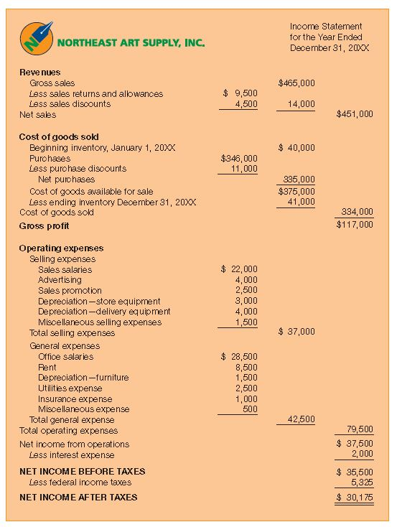
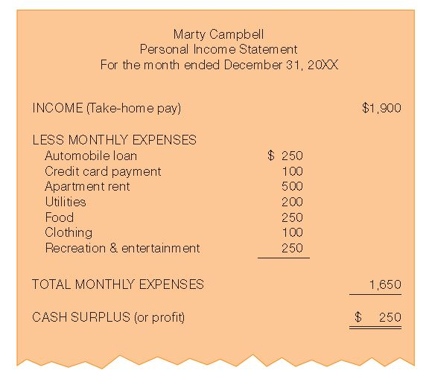
Income Statements

Slide 27
Cost of Goods Sold
The dollar amount equal to beginning inventory plus net purchases less ending inventory
COGS = Beg Inventory + Purchases – Ending Inventory
Gross profit is a firm’s net sales less the cost of goods sold

Slide 28
Operating Expenses and
Net Income or Loss
Operating expenses: All business costs other than the cost of goods sold
Net income: Occurs when revenues exceed expenses (if so, you then need to account for your TAX EXPENSE)
Net loss: Occurs when expenses exceed revenues

Slide 29
Evaluating Financial Statements
Use accounting information to evaluate an investment
  Use common sense to interpret the numbers
  Financial statements should be audited by an outside source and be current
  Look for use of new strategies to reduce costs
  Determine the firm’s ability to pay its debts and borrow money in the future
  Look at how the numbers relate to each other
  Understand the financial ratios
  Read letters from top executives
  Examine the footnotes closely, look for red flags
  Examine the comparative data to analyze trends

Slide 30
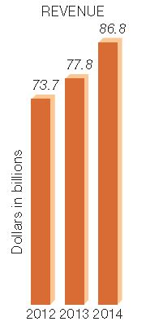
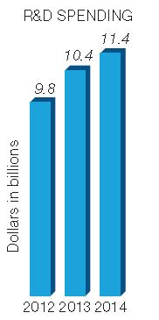
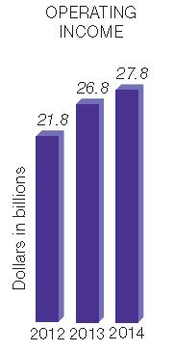
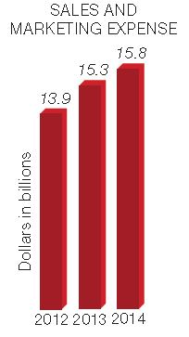
Comparisons of Present and Past Financial Statements for Microsoft
Most corporations include in their annual reports comparisons of the important elements of their financial statements for recent years
Source: Adapted from the Microsoft Corporation 2014 Annual Report, www.microsoft.com (accessed February 4, 2015).

Slide 31
Comparing Data with Other Firms’ Data
Comparisons are possible because of GAAP
Managers can get a general idea of a firm’s relative effectiveness and its standing within the industry
Data are available from annual reports of public corporations
Industry averages are available from Dun & Bradstreet, Standard & Poor’s, industry trade associations

Slide 32
Financial Ratios
Numbers that show the relationship between two elements of a firm’s financial statements
Can be compared with
  The firm’s own past ratios
  Ratios of competitors
  Industry averages
Information to calculate ratios is found on a firm’s balance sheet, income statement, and statement of cash flows

