Slide 1
Chapter 13
Distributing and Promoting Products

Slide 2
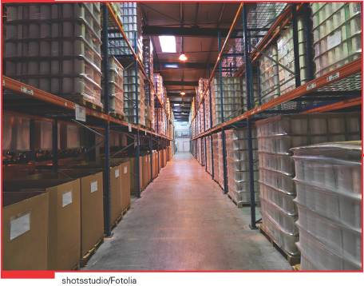
What is the Distribution (Place) Element of the Marketing Mix?
The process that makes products available to consumers when and where consumers want them.

Slide 3
Distribution Channels and Market Coverage
Distribution channel (or marketing channel) – a sequence of marketing organizations that directs a product from the producer to the ultimate user (i.e. THE PATH THAT A PRODUCT TAKES FROM PRODUCER TO CONSUMER)
Middleman (or marketing intermediary) – a marketing organization that links a producer and user within a marketing channel (i.e. THE COMPANIES THAT HELP FACILITATE IN THE MOVEMENT A PRODUCT TAKES FROM PRODUCER TO CONSUMER)
  Merchant middleman – a middleman that actually takes title to products by buying them
  Functional middleman – a middleman that helps in the transfer of ownership of products but does not take title to the products
Distribution Strategy: getting the right product to the right person at the right place, at the right time

Slide 4
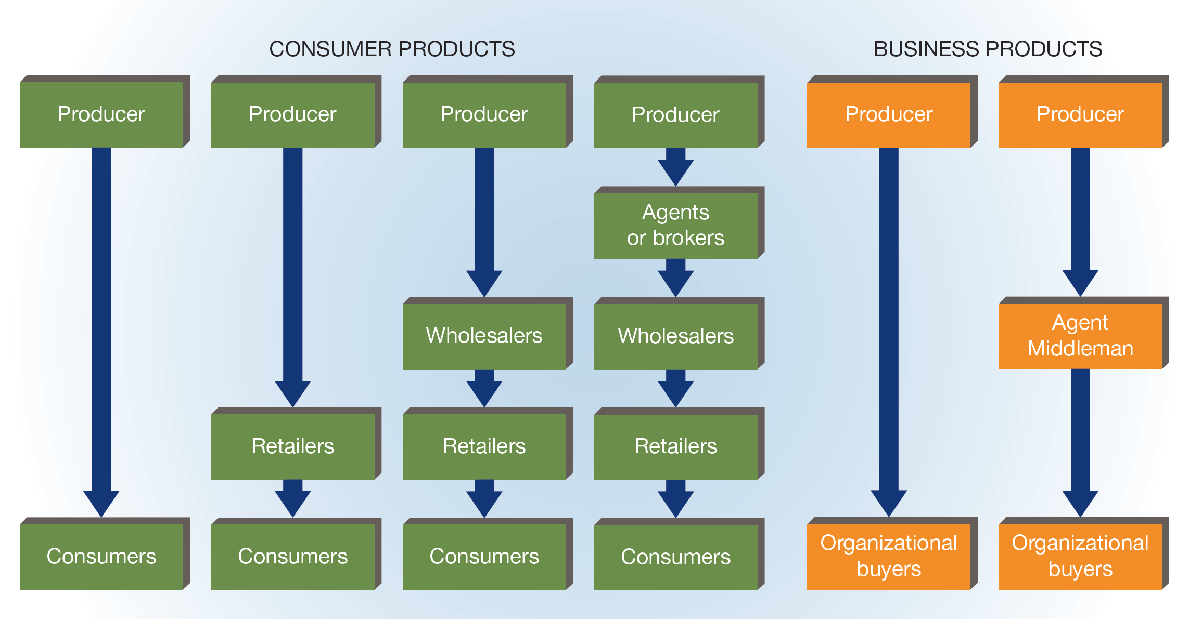
FIGURE 13-1 Distribution Channels

Slide 5
Commonly Used
Distribution Channels (slide 1 of 3)
Producer to Consumer
Includes no marketing intermediaries
  Example: buying a laptop directly from Dell’s Web site
Producer to Retailer to Consumer
Retailer – a middleman that buys from producers or other middlemen and sells to consumers
This channel is used most often for products that are bulky for which additional handling would increase selling costs.
  Examples: automobiles, furniture

Slide 6
Commonly Used
Distribution Channels (slide 2 of 3)
Producer to Wholesaler to Retailer to Consumer
Wholesaler – a middleman that sells products to other firms
A producer uses wholesalers when its products are carried by so many retailers that the producer cannot manage and distribute all of them.
  Example: chewing gum and soft drink manufacturers
  Producer to Agent to Wholesaler to Retailer to Consumer
Agents – functional middlemen that do not take title to products and that are compensated by commissions paid by producers
This channel is used for seasonal products (such as Christmas decorations) and by producers that do not have in-house sales forces.

Slide 7
Commonly Used
Distribution Channels (slide 3 of 3)
Producer to Organizational Buyer
The manufacturer’s own sales force sells directly to organizational buyers, or business users.
Heavy machinery and airplanes usually are distributed in this way.
  Producer to Agent Middleman to Organizational Buyer
Manufacturers use this channel to distribute such items as operating supplies, accessory equipment, small tools, and standardized parts.
Using Multiple Channels
Often a manufacturer uses different distribution channels to reach different market segments.
Many retailers now employ multiple distribution channels that complement their brick-and-mortar stores with Web sites, catalogs, and apps where consumers can research products, read other buyers’ reviews, and make actual purchases.

Slide 8
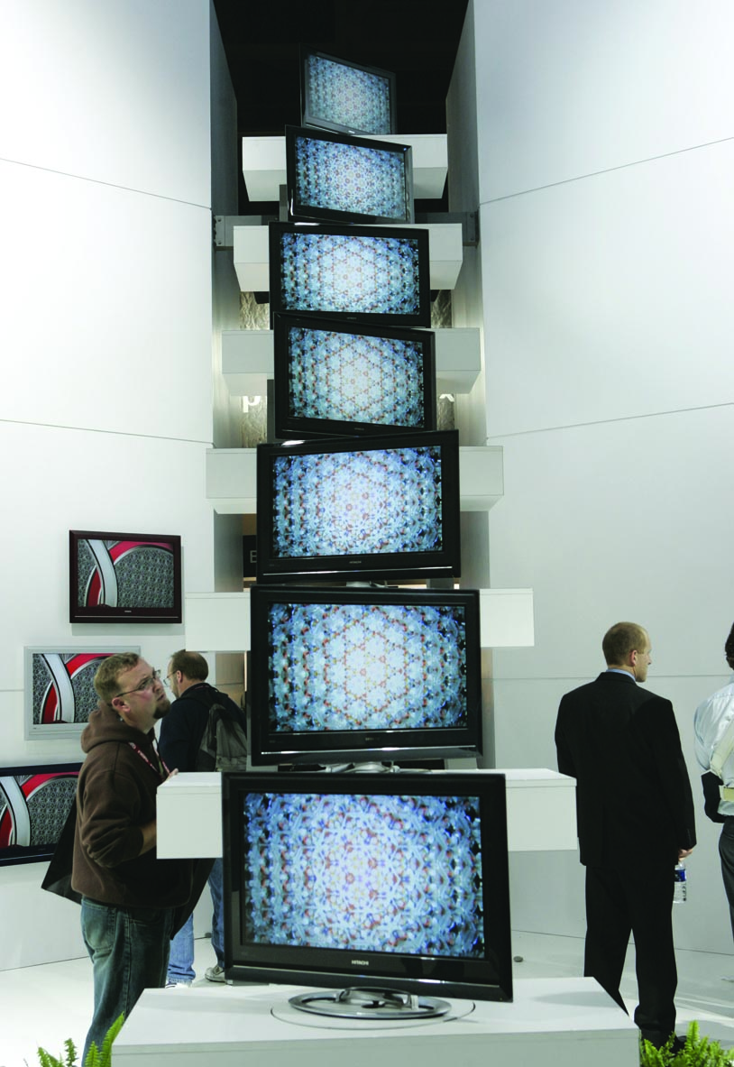
Why Use Marketing Intermediaries?
Justifications for marketing intermediaries
  Intermediaries perform essential marketing services (promotion of products, help sell product)
  Intermediaries provide important market information to producers (what’s selling, who’s buying, customer feedback)
  Intermediaries help store products (producers won’t be burdened with storage costs)
  Intermediaries provide customers with convenience and choice selection
  Intermediaries accept risk for customer non-payment or non-sold products
  Intermediaries create EFFICIENCY and UTILITY
  Intermediaries help REDUCE COSTS and provide VALUE! How?

Slide 9
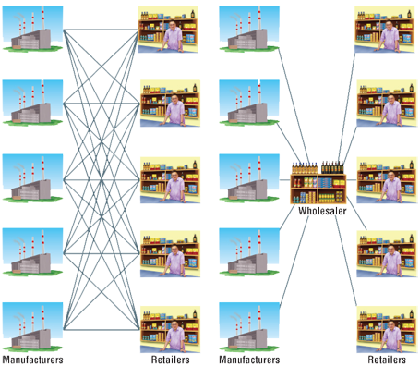
How Intermediaries Create Exchange Efficiency

Slide 10
Level of Market Coverage
Intensive distribution – the use of all available outlets for a product
  Many convenience goods, including candy, gum, and soft drinks, are distributed intensively.
Selective distribution – the use of only a portion of the available outlets for a product in each geographic area
  Manufacturers of goods such as furniture, home appliances, and clothing typically prefer selective distribution.
    Example: Hanes brand socks are distributed through Target and Kohl’s.
Exclusive distribution – the use of only a single retail outlet for a product in a large geographic area
  Exclusive distribution usually is limited to prestigious products.

Slide 11
Partnering Through
Supply-Chain Management
Supply-chain management – long-term partnership among channel members working together to create a distribution system that reduces inefficiencies, costs, and redundancies while creating a competitive advantage and satisfying customers
Supply-chain management requires cooperation throughout the entire marketing channel, including manufacturing, research, sales, advertising, and shipping.
Supply chains focus not only on producers, wholesalers, retailers, and customers, but also on component-parts suppliers, shipping companies, communication companies, and other organizations that participate in product distribution.
Category management – A practice in which the retailer asks a supplier in a particular category how to stock the shelves
Technology has enhanced the implementation of supply-chain management significantly.

Slide 12
Wholesalers Provide Services to Retailers and Manufacturers
Wholesalers help retailers by:
  Buying in large quantities and selling to retailers in smaller quantities and delivering goods to retailers
  Stocking in one place the variety of goods that retailers otherwise would have to buy from many producers
  Providing assistance in other vital areas, including promotion, market information, and financial aid
Wholesalers help manufacturers by:
  Performing functions similar to those provided to retailers
  Providing a sales force, reducing inventory costs, assuming credit risks, and furnishing market information

Slide 13
Types of Wholesalers (slide 1 of 3)
Merchant Wholesalers
Merchant wholesaler – a middleman that purchases goods in large quantities and sells them to other wholesalers or retailers and to institutional, farm, government, professional, or industrial users
Merchant wholesalers have the following characteristics:
  They usually operate one or more warehouses at which they receive, take title to, and store goods.
  Most merchant wholesalers are businesses composed of salespeople, order takers, receiving and shipping clerks, inventory managers, and office personnel.
  The successful merchant wholesaler must analyze available products and market needs, as well as be able to adapt the type, variety, and quality of its products to changing market conditions.

Slide 14
Types of Wholesalers (slide 2 of 3)
Merchant Wholesalers (cont.)
Merchant wholesalers may be classified as full-service or limited-service wholesalers depending on the number of services they provide.
  Full-service wholesaler – a middleman that performs the entire range of wholesaler functions
    Three types of full-service wholesalers:
    1. General-merchandise wholesaler – a middleman that deals in a wide variety of products
    2. Limited-line wholesaler – a middleman that stocks only a few product lines but carries numerous product items within each line
    3. Specialty-line wholesaler – a middleman that carries a select group of products within a single line

Slide 15
Types of Wholesalers (slide 3 of 3)
Agents and Brokers
Agent – a middleman that expedites exchanges, represents a buyer or a seller, and often is hired permanently on a commission basis
Broker – a middleman that specializes in a particular commodity, represents either a buyer or a seller, and is likely to be hired on a temporary basis

Slide 16
TABLE 13-1 The Ten Largest U.S. Retailers
Rank | Company | Sales (in millions) | # of Stores
1 | Walmart | $353,108 | 5,182
2 | Kroger | $103,878 | 3,747
3 | Costco | $83,545 | 476
4 | The Home Depot | $79,297 | 1,965
5 | Walgreens Boots Alliance | $76,604 | 8,052
6 | Target | $73,226 | 1,774
7 | CVS Health | $72,151 | 9,659
8 | Amazon.com | $61,619 | N/A
9 | Albertson’s | $58,443 | 2,311
10 | Lowe’s | $57,486 | 1,805

Slide 17
Types of Retail Stores (slide 1 of 2)
One way to classify retailers is by the number of stores owned and operated by the firm.
  Independent retailer – a firm that operates only one retail outlet
  Chain retailer – a company that operates more than one retail outlet
Another way to classify retail stores is by store size and the kind and number of products carried.
  Department store – a retail store that (1) employs 25 or more persons and (2) sells at least home furnishings, appliances, family apparel, and household linens and dry goods, each in a different part of the store
    Examples: Macy’s, Kohl’s, JCPenney
  Discount store – a self-service general-merchandise outlet that sells products at lower-than-usual prices
    Examples: Kmart, Walmart, Target

Slide 18
Types of Retail Stores (slide 2 of 2)
  Warehouse showroom – a retail facility in a large, low-cost building with a large on-premises inventory and minimal service
    Example: IKEA
  Convenience store – a small food store that sells a limited variety of products but remains open well beyond normal business hours
    Examples: 7-Eleven, Circle K
  Supermarket – a large self-service store that sells primarily food and household products
    Examples: Kroger, Publix
  Superstore – a large retail store that carries not only food and nonfood products ordinarily found in supermarkets but also additional product lines
    Examples: Target and Walmart operate some superstores.
  Warehouse club – a large-scale members-only establishment that combines features of cash-and-carry wholesaling with discount retailing
    Examples: Sam’s Club, Costco
  Traditional specialty store – a store that carries a narrow product mix with deep product lines
    Examples: Gap, Bath and Body Works
  Off-price retailer – a store that buys manufacturers’ seconds, overruns, returns, and off-season merchandise for resale to consumers at deep discounts
    Examples: T.J. Maxx, Nordstrom Rack
  Category killer – a very large specialty store that concentrates on a single product line and competes on the basis of low prices and product availability
    Examples: Best Buy, Toys “R” Us

Slide 19
Types of Nonstore Selling
Nonstore retailing – a type of retailing whereby consumers purchase products without visiting a store
Nonstore retailers use direct selling, direct marketing, and vending machines.
Direct Selling
Direct selling – the marketing of products to customers through face-to-face sales presentations at home or in the workplace
Direct selling sometimes involves the “party plan,” which requires effective salespeople who identify potential hosts and provide encouragement and incentives for them to organize a gathering in their home or workplace
Direct Marketing
Direct marketing – the use of the telephone, Internet, and nonpersonal media to introduce products to customers, who then can purchase them via mail, telephone, or the Internet
  log marketing – a type of marketing in which an organization provides a catalog from which customers make selections and place orders by mail, telephone, or the Internet
  Direct-response marketing – a type of marketing in which a retailer advertises a product and makes it available through mail, telephone, or online orders
  Telemarketing – the performance of marketing-related activities by telephone
  Television home shopping – a form of selling in which products are presented to television viewers, who can buy them by calling a toll-free number and paying with a credit card
  Online retailing – retailing that makes products available to buyers through computer connections
  Automatic vending – the use of machines to dispense products

Slide 20
Types of Shopping Centers
Planned shopping center – a self-contained retail facility constructed by independent owners and consisting of various stores
  Types of planned shopping centers:
    Lifestyle shopping center – an open-air-environment shopping center with upscale chain specialty stores
    Neighborhood shopping center – a planned shopping center consisting of several small convenience and specialty stores
    Community shopping center – a planned shopping center that includes one or two department stores and some specialty stores, along with convenience stores
    Regional shopping center – a planned shopping center containing large department stores, numerous specialty stores, restaurants, movie theaters, and sometimes even hotels

Slide 21
Physical Distribution
Physical distribution – all those activities concerned with the efficient movement of products from the producer to the ultimate user
It combines several interrelated business functions, the most important of which are:
  Inventory management
  Order processing
  Warehousing
  Materials handling
  Transportation

Slide 22
Inventory Management
Inventory management – the process of managing inventories in such a way as to minimize inventory costs, including both holding costs and potential stockout costs
  Holding costs – the expenses of storing products until they are purchased or shipped to customers
    Include:
      The money invested in inventory
      The cost of storage space
      Insurance costs
      Inventory taxes
  Stockout costs – sales lost when items are not in inventory

Slide 23
Order Processing
Order processing – activities involved in receiving and filling customers’ purchase orders

Slide 24
Warehousing
Warehousing – the set of activities involved in receiving and storing goods and preparing them for reshipment
Warehousing includes the following activities:
  Receiving goods
  Identifying goods
  Sorting goods
  Dispatching goods to storage
  Holding goods
  Recalling, picking, and assembling goods
  Dispatching shipments

Slide 25
Materials Handling
Materials handling – the actual physical handling of goods, in warehouses as well as during transportation
Unit loading – a method of materials handling in which several smaller cartons, barrels, or boxes are combined into a single standard-size load that can be moved efficiently by forklift, conveyer, or truck

Slide 26
Transportation
Transportation – the shipment of products to customers
Carrier – a firm that offers transportation services
  Types of carriers:
    Common carrier – a transportation firm whose services are available to all shippers
      Examples: railroads, airlines
    Contract carrier – do not serve the general public and the number of firms they can handle at a time is limited by law
    Private carrier – owned and operated by the shipper

Slide 27
TABLE 13-2 Characteristics of Transportation Modes (slide 1 of 2)
Selection Criteria | Railroads | Trucks | Pipelines
Cost | Moderate | High | Low
Speed | Average | Fast | Slow
Dependability | Average | High | High
Load flexibility | High | Average | Very low
Accessibility | High | Very high | Very limited
Frequency | Low | High | Very high
Percent of use* | 25.6% | 42.6% | 14.6%
Products carried | Coal, grain, lumber, heavy equipment, paper and pulp products, chemicals | Clothing, computers, books, groceries and produce, livestock | Oil, processed coal, natural gas, wood chips

Slide 28
TABLE 13-2 Characteristics of Transportation Modes (slide 2 of 2)
Selection Criteria | Waterways | Airplanes
Cost | Very low | Very high
Speed | Very slow | Very fast
Dependability | Average | High
Load flexibility | Very high | Low
Accessibility | Limited | Average
Frequency | Very low | Average
Percent of use* | 6.4% | 0.2%
Products carried | Chemicals, bauxite, grain, motor vehicles, agricultural implements | Flowers, food (highly perishable), technical instruments, emergency parts and equipment, overnight mail

Slide 29
The Promotion Mix: An Overview
Promotion – communication about an organization and its products that is intended to inform, persuade, or remind target-market members
Promotion mix – the particular combination of promotion methods a firm uses to reach a target market
  Four elements of the promotion mix:
    1. Advertising – a paid nonpersonal message communicated to a select audience through a mass medium
    2. Personal selling – paid, personal communication aimed at informing customers and persuading them to buy a firm’s products
    3. Sales promotion – the use of activities or materials as direct inducements to customers or salespersons
    4. Public relations – communication activities used to create and maintain favorable relationships between an organization and various public groups, both internal and external

Slide 30
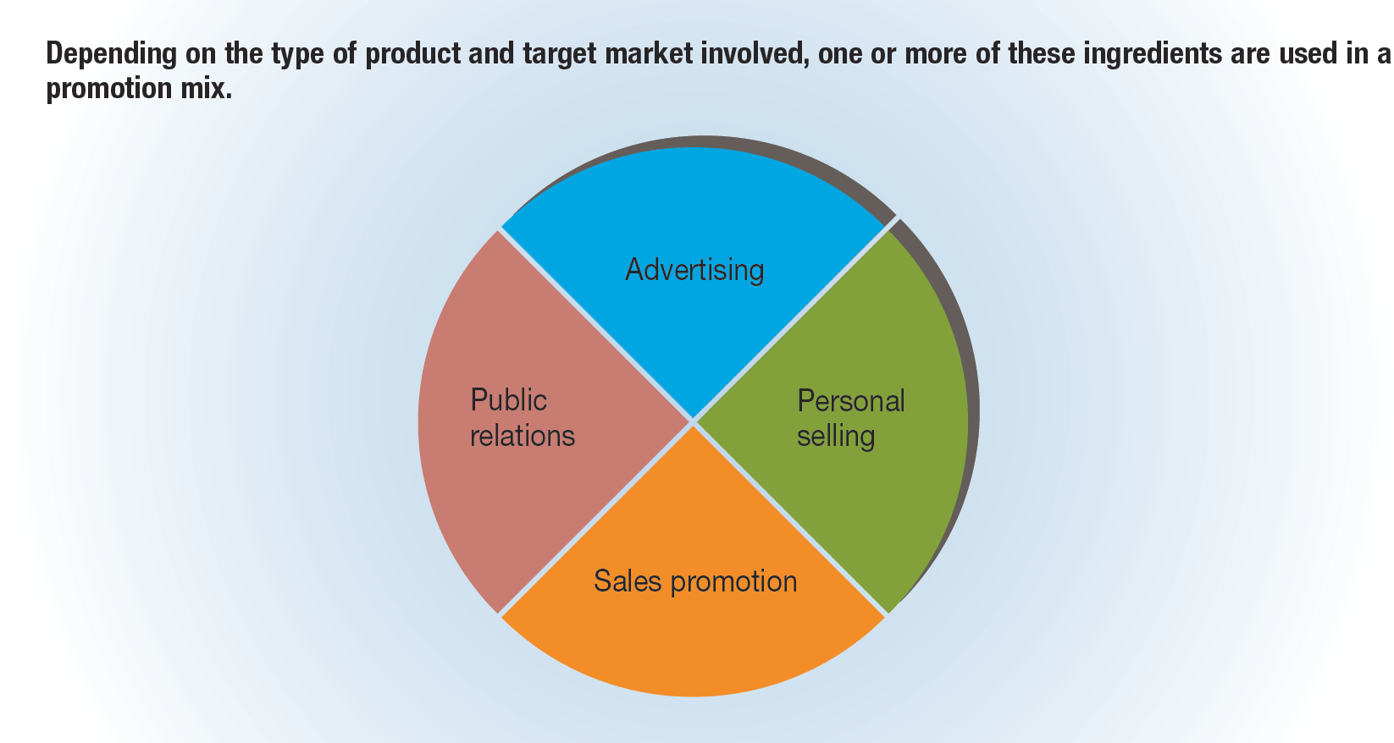
FIGURE 13-2 Possible Elements of a Promotion Mix

Slide 31
What Is Integrated Marketing Communications?
Integrated marketing communications – coordination of promotion efforts to ensure maximum informational and persuasive impact on customers
  GOAL=CONSISTENT MESSAGES TO CUSTOMERS
Results in a consistent message to customers, long-term customer relationships, and the efficient use of promotional resources
  Mass media advertising has given way to targeted promotional tools (e.g., cable TV, direct mail, and the Internet)
  The overall cost of marketing communications has risen significantly, pressuring managers to make the most efficient use of marketing resources

Slide 32
Types of Advertising by Purpose
Primary-demand advertising – advertising whose purpose is to increase the demand for all brands of a product within a specific industry
  Example: the National Association of Realtors’ “Get Realtor” campaign that highlights the value of local realtors’ insight for those seeking to buy a home
Selective-demand (or brand) advertising – advertising that is used to sell a particular brand of product
  It is by far the most common type of advertising, and it accounts for the majority of advertising expenditures.
  Immediate-response advertising
  Reminder advertising
  Comparative Advertising
Institutional advertising – advertising designed to enhance a firm’s image or reputation
  Example: Citibank sponsored the U.S. Summer Olympics and Paralympics and ran advertisements highlighting its value as an international banking firm in fostering the global economy.

Slide 33





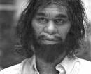
Advertising Appeals
The 5 Appeals of Product Advertisements
Humor
Informational
Sex
Emotional (ex. Fear/Heartfelt)
Celebrity

Slide 34
Major Steps in Developing an Advertising Campaign
Identify and analyze the target audience
Define the advertising objectives
Create the advertising platform
  An advertising platform includes the important selling points, or features, that an advertiser will incorporate into the advertising campaign.
Determine the advertising appropriation
  The advertising appropriation is the total amount of money designated for advertising in a given time period.
Develop the media plan
  A media plan outlines a timetable for advertisements and which media will be used.
Create the advertising message
Execute the campaign
Evaluate advertising effectiveness

Slide 35
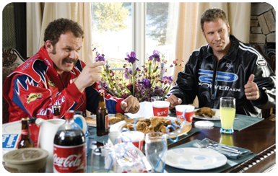
Popular Advertising Media
  TV advertising is still the dominant media.
  Digital Video Recorders (DVRs) challenge TV advertising because viewers can skip ads.
  Product Placement -- Advertisers pay to put their products into TV shows and movies where the audience will see them.

Slide 36
TABLE 13-3 Advantages and Disadvantages of Major Media Classes (slide 1 of 4)
 | Advantages | Disadvantages
Television | Reaches large audiences, high frequency available, dual impact of audio and video, highly visible, high prestige, geographic and demographic selectivity, difficult to ignore, on-demand capabilities | Very expensive, highly perishable message, size of audience not guaranteed, amount of prime time limited, lack of selectivity in target market
Direct mail | Little wasted circulation, highly selective, circulation controlled by advertiser, few distractions, personal, stimulates actions, easy to measure performance, hidden from competitors | Very expensive, lacks editorial content to attract readers, often thrown away unread as junk mail, criticized as invasion of privacy, consumers must choose to read the ad

Slide 37
TABLE 13-3 Advantages and Disadvantages of Major Media Classes (slide 2 of 4)
 | Advantages | Disadvantages
Newspapers | Reaches large audience, purchased to be read, geographic flexibility, short lead time, frequent publication, favorable for cooperative advertising | Not selective for socioeconomic groups or target market, short life, limited reproduction capabilities, large advertising volume limits exposure
Radio | Reaches a large proportion of consumers, mobile and flexible, low relative costs, ad can be changed quickly, high level of geographic and demographic selectivity, encourages use of imagination | Lacks visual imagery, short life of message, listeners’ attention limited, market fragmentation, difficult buying procedures, limited media and audience research

Slide 38
TABLE 13-3 Advantages and Disadvantages of Major Media Classes (slide 3 of 4)
 | Advantages | Disadvantages
Magazines | Demographic selectivity, good reproduction, long life, prestige, geographic selectivity when regional issues available | High costs, 30- to 90-day average lead time, high level of competition, limited reach, communicates less frequently
Internet/Digital Media | Immediate response, potential to reach a precisely targeted audience, ability to track customers and build databases, highly interactive medium, real-time analytics | Costs of precise targeting can be high, inappropriate ad placement, effects difficult to measure, concerns about security and privacy

Slide 39
TABLE 13-3 Advantages and Disadvantages of Major Media Classes (slide 4 of 4)
 | Advantages | Disadvantages
Outdoor | Allows for frequent repetition, low cost, message can be placed close to point of sale, geographic selectivity, operable 24 hours a day, high creativity | Message must be short and simple, no demographic selectivity, seldom attracts readers’ full attention, criticized as traffic hazard and blight on landscape, much wasted coverage, limited capabilities
Social Media | Target, interact, and connect more personally with customers, receive real-time feedback, direct messages to specific individuals, effectively reach target market/followers | Restricted number of contacts per message because of highly targeted nature, new media—unsure of best applications and how to calculate ROI, large time commitment to monitor

Slide 40
TABLE 13-4 Most Effective Advertisers
Ranking | Advertiser
1 | Coca-Cola
2 | Unilever
3 | Procter & Gamble
4 | Nestlé
5 | PepsiCo

Slide 41
Advertising Agencies
Advertising agency – an independent firm that plans, produces, and places advertising for its clients

Slide 42
Personal Selling
Personal selling is the most adaptable of all promotional methods because the person presenting the message can modify it to suit the individual buyer.
Paid, personal communication between buyer and seller
However, it is also the most expensive method because it involves salespeople communicating with customers one at a time or in small groups.

Slide 43
Kinds of Salespersons
Order getter – a salesperson who is responsible for selling a firm’s products to new customers and increasing sales to present customers (known as creative selling)
Order taker – a salesperson who handles repeat sales in ways that maintain positive relationships with customers
Sales support personnel – employees who aid in selling but are more involved in locating prospects, educating customers, building goodwill for the firm, and providing follow-up service
  Three kinds of sales support personnel:
    1. Missionary salesperson – a salesperson—generally employed by a manufacturer—who visits retailers to persuade them to buy the manufacturer’s products
    2. Trade salesperson – a salesperson—generally employed by a food producer or processor—who assists customers in promoting products, especially in retail stores
    3. Technical salesperson – a salesperson who assists a company’s current customers in technical matters

Slide 44
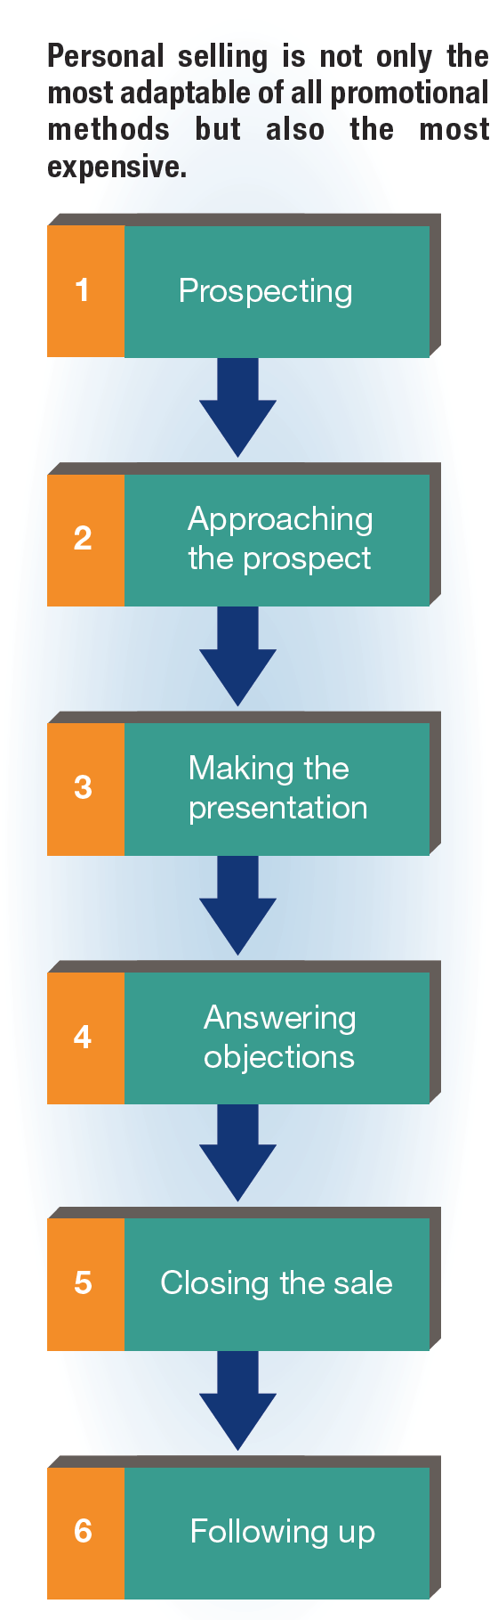
FIGURE 13-3 The Six Steps of the Personal-Selling Process

Slide 45
Major Sales Management Tasks
Sales managers must:
  Set sales objectives in concrete, quantifiable terms and specify a specific period of time and geographic area
  Adjust the size of the sales force to meet changes in the firm’s marketing plan and the marketing environment
  Attract and hire effective salespersons
  Develop a training program and decide where, when, how, and for whom to conduct the training
  Formulate a fair and adequate compensation plan to retain qualified employees
  Motivate salespersons to keep their productivity high
  Define sales territories and determine scheduling and routing of the sales force
  Evaluate the operation holistically, through sales reports, communications with customers, and invoices

Slide 46
Sales Promotion Methods
Most sales promotion methods can be classified as promotional techniques for either consumer sales or trade sales.
  Consumer sales promotion method – a sales promotion method designed to attract consumers to particular retail stores and to motivate them to purchase certain new or established products
  Trade sales promotion method – a sales promotion method designed to encourage wholesalers and retailers to stock and actively promote a manufacturer’s product

Slide 47
Selection of Sales
Promotion Methods (slide 1 of 2)
Several factors affect a marketer’s choice of sales promotion method, including:
  The objectives of the promotional effort
  Product characteristics
    Size, weight, cost, durability, uses, features, and hazards
  Target-market profiles
    Age, gender, income, location, density, usage rate, and buying patterns
  Distribution channels and availability of appropriate resellers
  The competitive and regulatory forces in the environment

Slide 48
Selection of Sales
Promotion Methods (slide 2 of 2)
Rebate – a return of part of the purchase price of a product
Coupon – reduces the retail price of a particular item by a stated amount at the time of purchase
Sample – a free product given to customers to encourage trial and purchase
Premium – a gift that a producer offers a customer in return for buying its product
Frequent-user incentive – a program developed to reward customers who engage in repeat (frequent) purchases
Point-of-purchase display – promotional material placed within a retail store
Trade show – an industry-wide exhibit at which many sellers display their products
Buying allowance – a temporary price reduction to resellers for purchasing specific quantities of a product
Cooperative advertising – an arrangement whereby a manufacturer agrees to pay a certain amount of a retailer’s media cost for advertising the manufacturer’s product

Slide 49
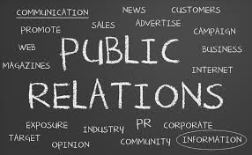
Public-Relations
A broad set of communication activities used to create and maintain favorable relationships between an organization and various public groups, both internal and external
Groups include: customers, employees, stockholders, suppliers, educators, the media, government officials, society in general

Slide 50
Types of Public-Relations Tools
Written materials
  Brochures, newsletters, company magazines, annual reports
Corporate-identity materials
Speeches
Event sponsorship
Publicity – communication in news-story form about an organization, its products, or both
  News release – a typed page of about 300 words provided by an organization to the media as a form of publicity
  Feature article – a piece (of up to 3,000 words) prepared by an organization for inclusion in a particular publication
  Captioned photograph – a picture accompanied by a brief explanation
  Press conference – a meeting at which invited media personnel hear important news announcements and receive supplementary textual materials and photographs

