Slide 1
Chapter 12
Creating and Pricing Products That Satisfy Customers

Slide 2
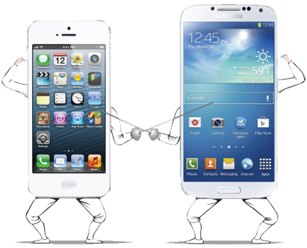
Introduction
Product – everything one receives in an exchange, including all tangible and intangible attributes and experienced benefits; it may be a good, a service, or an idea
  Everything one receives in an exchange, including all tangible and intangible attributes and expected benefits – TOTAL PRODUCT OFFER
  A good is a real, physical thing that we can touch.
    Example: a cookie
  A service is the result of applying human or mechanical effort to a person or thing.
    Example: a barber giving a hair cut
  An idea may take the form of philosophies, lessons, concepts, or advice.
Bundle of Expected Benefits
  Products are nothing more than expected
  benefits that should satisfy consumer
  needs/wants

Slide 3
Total Product Offer: Peeling Back the Layers of the Product
Core product – the primary benefit that satisfies the consumers need (ex. Soft drink->thirst quench)
The actual product – the physical good or tangible aspect of the purchase that you can touch, see, hear, smell, or taste (ex. Soft drink->soft drink can or soda flavor)
Augmented product – consists of the core product and the actual product PLUS other real or perceived benefits that provided add’l value to a customer’s purchase (Ex. warrantees, free service, instruction manuals, help lines, product image)

Slide 4
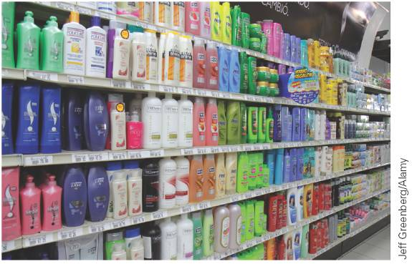
Product Planning and Management
2 Ways to Compete:
Price
Product Differentiation – Creating real or perceived product differences; the attributes that make a good or service different from other products that compete to meet the same or similar customer needs
How to Plan/Differentiate?
Product Classifications (we’ll focus on Consumer Products)
Product Life Cycle
Product Mix and Line Management
Product Branding
Packaging and Labeling

Slide 5
Classification of Products
Products can be grouped into two general categories:
  1. Consumer product – a product purchased to satisfy personal and family needs
  2. Business product – a product bought for resale, for making other products, or for use in a firm’s operations

Slide 6
Consumer Product Classifications
Three categories of consumer products:
  1. Convenience product – a relatively inexpensive, frequently purchased item for which buyers want to exert only minimal effort
    Examples: bread, gasoline, newspapers
  2. Shopping product – an item for which buyers are willing to expend considerable effort on planning and making the purchase
    Examples: appliances, bicycles, mobile phones
  Specialty product – an item that possesses one or more unique characteristics for which a significant group of buyers is willing to expend considerable purchasing effort
    Examples: sports cars, original artwork
  Unsought product – an item for which buyers purchase infrequently and fulfills an immediate need
    Examples: funeral service, insurance, umbrellas

Slide 7
Business Product Classifications
Categories of business products:
  Raw material – a basic material that actually becomes part of a physical product; usually comes from mines, forests, oceans, or recycled solid wastes
  Major equipment – large tools and machines used for production purposes
    Examples: cranes, stamping machines
  Accessory equipment – standardized equipment used in a firm’s production or office activities
    Examples: hand tools, photocopiers, calculators
  Component part – an item that becomes part of a physical product and is either a finished item ready for assembly or a product that needs little processing before assembly
    Examples: tires, computer chips
  Process material – a material that is used directly in the production of another product but is not readily identifiable in the finished product
    Examples: industrial glue, food preservatives
  Supply – an item that facilitates production and operations but does not become part of a finished product
    Examples: paper, pencils
  Business service – an intangible product that an organization uses in its operations
    Examples: financial services, legal services

Slide 8
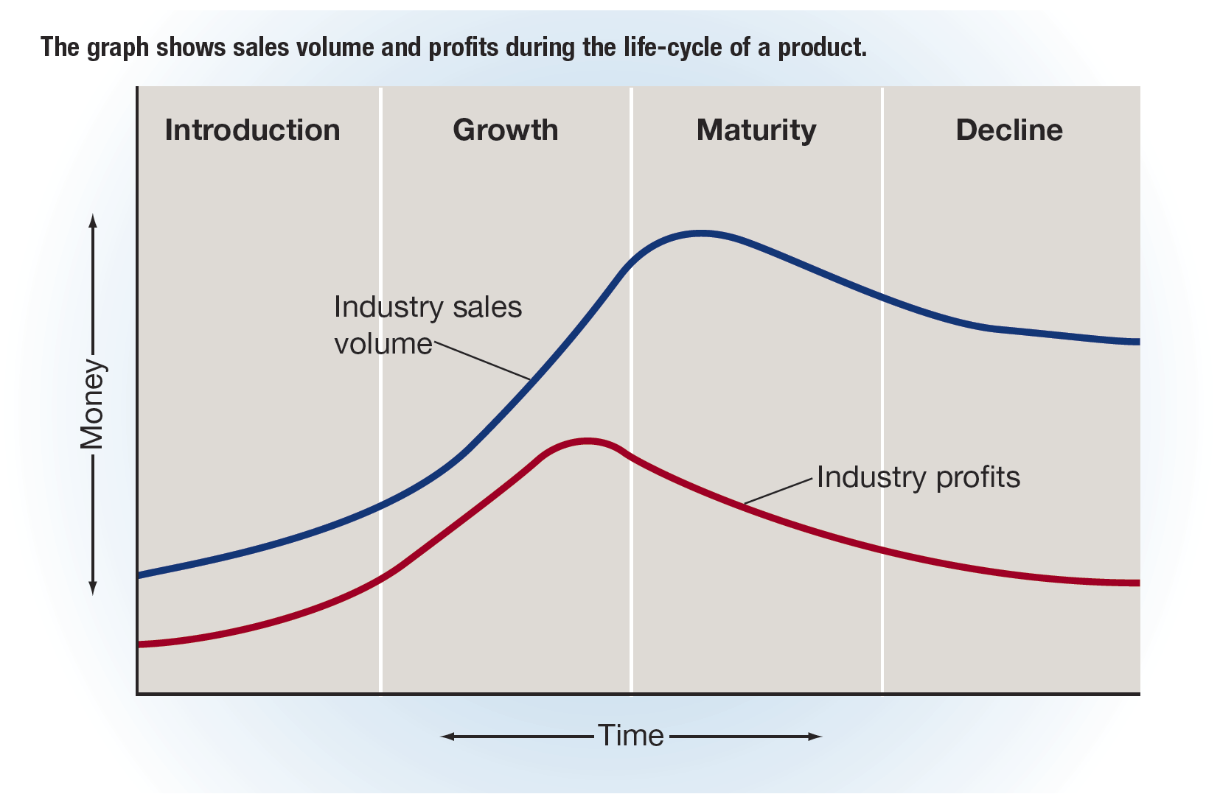
The Product Life-Cycle
Product life-cycle – a series of stages in which a product’s sales revenue and profit increase, reach a peak, and then decline

Slide 9
Stages of the Product Life-Cycle
Four stages of the product life-cycle:
  Introduction
    Customer awareness and acceptance of the new product are low.
    Sales rise gradually as a result of promotion and distribution activities.
    There are no competitors.
    High development and marketing costs result in low profit, or even in a loss, initially.
  Growth
    Sales increase rapidly as consumers gain awareness of the product.
    Other firms begin to market competing products.
    The competition and decreased unit costs result in a lower price, which reduces the profit per unit.
    Industry profits reach a peak and begin to decline.
    Promotional efforts attempt to build brand loyalty among customers.
  Maturity
    Sales are still increasing at the beginning of this stage, but the rate of increase has slowed.
    Later, the sales curve peaks and begins to decline, as do industry profits.
    Weaker competitors leave the market.
    Marketers introduce refinements and extensions of the original product to the market.
  Growth
    Sales volume decreases sharply and profits continue to fall.
    The number of competitors declines, and the only survivors in the marketplace are firms that specialize in marketing the product.
    Production and marketing costs become the most important determinant of profit.

Slide 10
Product Line and Product Mix
Product line – a group of similar products that differ only in relatively minor characteristics
  Example: Procter & Gamble manufactures and markets several shampoos, including Pantene, Head & Shoulders, and Ivory.
Product mix – all the products a firm offers for sale
  Three dimensions are often applied to a firm’s product mix.
    Width of the mix
      The number of product lines the mix contains
    Length of the mix
      The number of different products within an individual product line
    Depth of the mix
      The average number of individual products within each line

Slide 11
Product Management Strategies
Three basic ways to manage products:
  Product Modification
  Product Deletion
  New Product Development

Slide 12
Managing Existing Products
Product modification – the process of changing one or more of a product’s characteristics
  Example: Panera reformulated its soups to avoid using artificial ingredients.
Existing products can be modified in three ways.
  Quality modifications – changes that relate to a product’s dependability and durability and are usually achieved by alterations in the materials or production process
  Functional modifications – affect a product’s versatility, effectiveness, convenience, or safety, and usually require redesign of the product
  Aesthetic modifications – change the sensory appeal of a product by altering its taste, texture, sound, smell, or visual characteristics
Line extension – development of a new product that is closely related to one or more products in the existing product line but designed specifically to meet somewhat different customer needs
  Example: Arby’s sliders—miniature versions of its sandwiches

Slide 13
Deleting Products
To maintain an effective product mix, an organization often has to eliminate some products.
  Product deletion – the elimination of one or more products from a product line
A weak and unprofitable product costs a company, time, money, and resources that could be used to modify other products or develop new ones.
A weak product’s unfavorable image can negatively impact the customer perception and sales of other products sold by the firm.

Slide 14
Developing New Products
Developing and introducing new products is frequently time consuming, expensive, and risky.
For most firms, more than half of new products will fail.
New products are generally grouped into three categories on the basis of their degree of similarity to existing products.
  Imitations – products designed to compete with existing products of other firms
  Adaptations – variations of existing products that are intended for an established market.
  Innovations – entirely new products
  The process of developing a new product consists of seven phases.

Slide 15
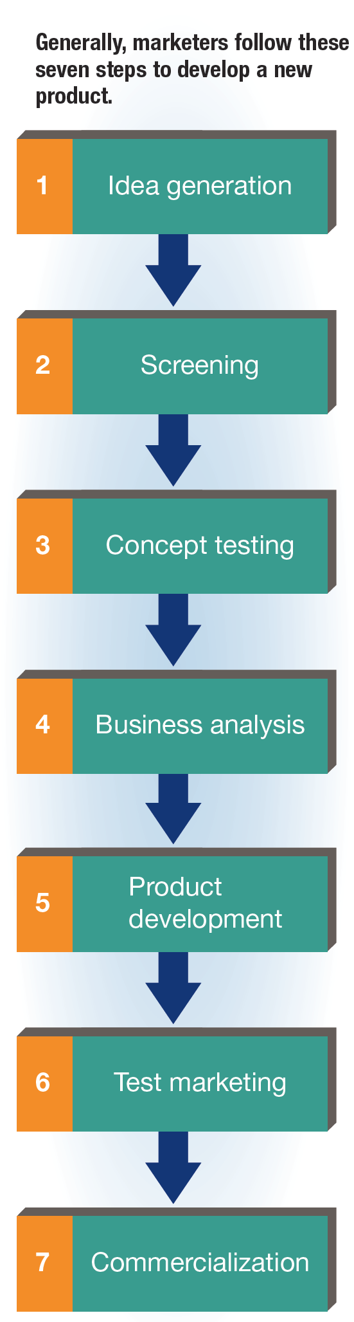
FIGURE 12-2 Phases of New-Product Development

Slide 16
Why Do Products Fail?
New products fail mainly because the product and its marketing program are not planned and tested as thoroughly as they should be.
  Example: Amazon’s Fire cell phone failed largely because it didn’t have any features that stood out in a competitive field of innovative mobile phones, and the phone was priced at the upper end of the market.

Slide 17
TABLE 12-1 Examples of Product Failures
Company | Product
Microsoft | Zune (2006)
Apple | Newton (1993)
Mattel | Earring Magic Ken (1993)
Coca-Cola | New Coke (1985)
Colgate | Kitchen Entrees (1982)
Ford | Edsel (1957)
Barnes & Noble | The Nook (2009)

Slide 18
What Is a Brand?
Brand – a name, term, symbol, design, or any combination of these that identifies a seller’s products as distinct from those of other sellers
Brand name – the part of a brand that can be spoken
Brand mark – the part of a brand that is a symbol or distinctive design
  Example: the Nike “swoosh”
  Trademark – a brand name or brand mark that is registered with the U.S. Patent and Trademark Office and thus is legally protected from use by anyone except its owner
  Trade name – the complete and legal name of an organization

Slide 19
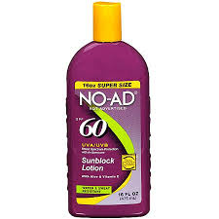
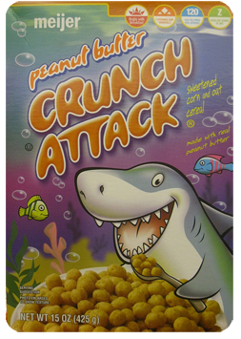

Types of Brands
Manufacturer (or producer) brand – a brand that is owned by a manufacturer
  Examples: Many foods (Kellogg’s Frosted Flakes), major appliances (Whirlpool), gasoline (Exxon Mobil), automobiles (Honda), and clothing (Levi’s) are sold as manufacturers’ brands.
Store (or private) brand – a brand that is owned by an individual wholesaler or retailer
  Examples: Kenmore (Sears), Kirkland Signature (Costco)
Generic product (or generic brand) – a product with no brand at all

Slide 20
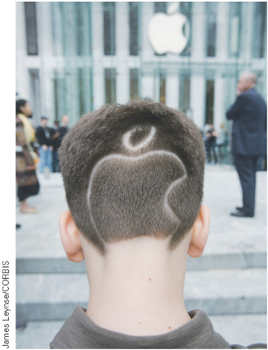
Benefits of Branding (slide 1 of 2)
Because brands are easily recognizable, they reduce the amount of time buyers spend on shopping.
Brands help to reduce the perceived risk of purchase.
Brands help consumers judge quality.
Customers may receive a psychological reward from owning a brand that symbolizes status.
Branding helps a firm to introduce a new product that carries a familiar brand name because buyers already know the brand.
Branding aids sellers in their promotional efforts because promotion of each branded product indirectly promotes other products of the same brand.

Slide 21
Benefits of Branding (slide 2 of 2)
Brand loyalty – extent to which a customer is favorable toward buying a specific brand
  Three levels of brand loyalty:
    Brand recognition – know brand exists and are familiar with the distinctive qualities or image of a particular brand
    Brand preference - prefer the brand but will purchase competing brand is preferred brand is unavailable
    Brand insistence - prefer the brand and will NOT purchase comparable substitute
    Brand equity – marketing and financial value associated with a brand’s strength in a market
  The four major factors that contribute to brand equity are:
    Brand awareness - How quickly or easily a given brand name comes to mind when someone mentions a product category
    Brand associations - The linkage which a buyer forms in one's mind with the brand
    Perceived brand quality
    Brand loyalty

Slide 22
TABLE 12-2 Top Ten Most Valuable Brands in the World
Brand | Brand Value (million $)
Apple | 178,119
Google | 133,252
Coca-Cola | 73,102
Microsoft | 72,795
Toyota | 53,580
IBM | 52,500
Samsung | 51,808
Amazon | 50,338
Mercedes-Benz | 43,490
GE | 43,130

Slide 23
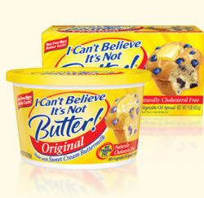


Choosing and Protecting a Brand
Choosing a brand:
  The brand name should be easy for customers to say, spell, and recall.
  The brand name should suggest, in a positive way, the product’s uses, special characteristics, and major benefits.
  The brand should be distinctive enough to set it apart from competing brands.
  Protecting a brand:
  A firm should select a brand that can be protected through registration, reserving it for exclusive use by that firm.
    So as not to become a generic term that refers to a general product category (which cannot be legally protected as an exclusive brand name), the firm should spell the name with a capital letter and use it as an adjective to modify the name of the general product class.
Kleenex® or tissue?

Slide 24
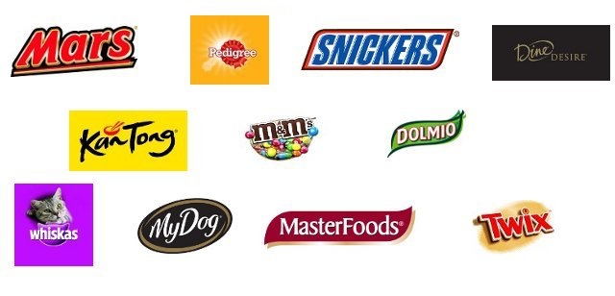
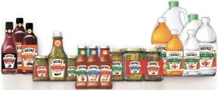
Branding Strategies
Individual branding – the strategy in which a firm uses a different brand for each of its products
  Example: Mars uses Mars, Snickers, M&Ms, etc. for its line of candy
  Advantages:
    A problem with one product will not affect the good name of the firm’s other products.
    The different brands can be directed toward different market segments.
Family branding – the strategy in which a firm uses the same brand for all or most of its products
  Example: Heinz uses family branding for all its product mixes
  Advantages:
    Successful promotion for any one item that carries the family brand can help all other products with the same brand name.
    A new product has a head-start when its brand name is already known and accepted by customers.
Individual Branding
Family Branding

Slide 25
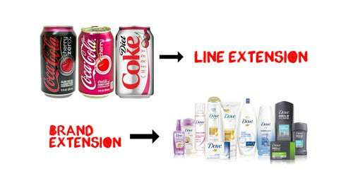
Brand Extensions
Brand extension – using an existing brand to brand a new product in a different product category
  Example: West Elm, a furniture retailer, partnered with DKK, a hospitality management firm, to extend its brand into boutique hotels—naturally, furnished with West Elm furniture that guests can buy online.
Marketers must be careful not to extend a brand too many times or extend too far outside the original product category, as either action may weaken the brand.
  Example: Kellogg’s extended its brand name to a line of hip-hop street clothing that was a failure

Slide 26
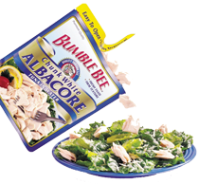
Packaging
Packaging – all the activities involved in developing and providing a container with graphics for a product
Packaging Functions
Protect the product
Maintain the product’s functional form
Offer consumer convenience
Promote a product by communicating its features, uses, benefits, and image
Packaging Design Considerations
Cost
Single or multiple units
Consistency among package designs
The promotional role
Environmental responsibility

Slide 27
Labeling
Labeling – the presentation of information on a product or its package
Label – the part of a package that contains information, including:
  The brand name and mark
  The registered trademark symbol®
  The package size and contents
  Product claims
  Directions for use and safety precautions
  Ingredients
  The name and address of the manufacturer
  The Universal Product Code (UPC) symbol
Labels may also carry the details of written, or express, warranties.
  Express warranty – a written explanation of the producer’s responsibilities in the event that a product is found to be defective or otherwise unsatisfactory

Slide 28

The Meaning and Use of Price
Price
    The amount of money a seller is willing to accept in exchange for a product at a given time and under certain circumstances
Price Objectives
  Increase sales, profit, and/or market share
  Increase store traffic
  Create image/quality
  Combat competition
How do you determine price?
  Cost-Based
    Mark-Up on Cost
    Break-Even Analysis
  Demand Based
    ↑D, ↑P
    ↓D, ↓P
  Competition Based
    Set a price based on what your competition is doing

Slide 29
The Meaning and Use of Price
Price – the amount of money a seller is willing to accept in exchange for a product at a given time and under given circumstances
Price serves the function of allocator.
  It allocates goods and services among those who are willing and able to buy them.
  Price allocates financial resources (sales revenue) among producers according to how well they satisfy customers’ needs.
  Price helps customers to allocate their own financial resources among various want-satisfying products.

Slide 30
Price and Non-Price Competition
Price competition – an emphasis on setting a price equal to or lower than competitors’ prices to gain sales or market share
  Used most effectively when a seller must have the flexibility to change prices often, rapidly, and aggressively in response to competitors’ price changes
  Allows a marketer to set prices based on product demand or in response to changes in the firm’s finances
Non-price competition – competition based on factors other than price
  Used most effectively when a seller can make its product stand out through distinctive product quality, customer service, promotion, packaging, or other features
  Product differentiation – the process of developing and promoting differences between one’s product and all similar products

Slide 31
Pricing Objectives
One objective of pricing is to make a profit, but one or more of the following factors may be just as important:
  Survival
  Profit maximization
  Target return on investment
    Return on investment (ROI) – the amount earned as a result of a financial investment
  Market-share goals
    Market share – the proportion of total industry sales
  Status-quo pricing

Slide 32
Pricing Methods
Two important factors in setting prices:
  Recognition that the market, and not the firm’s costs, ultimately determines the price at which a product will sell
  Awareness that costs and expected sales can be used only to establish a price floor
    Price floor – the minimum price at which the firm can sell its product without incurring a loss
    Three kinds of pricing methods:
  1. Cost-based pricing
  Demand-based pricing
  Competition-based pricing

Slide 33
Cost-Based Pricing (slide 1 of 2)
Method:
  The seller determines the total cost of producing (or purchasing) one unit of the product.
  The seller adds an amount to cover additional costs and profit.
    Markup – the amount a seller adds to the cost of a product to determine its basic selling price
  The total of the cost plus the markup is the product’s selling price.

Slide 34
Cost-Based Pricing (slide 2 of 2)
  The costs involved in operating a business can be broadly classified as either fixed or variable.
  Fixed cost – a cost incurred no matter how many units of a product are produced or sold
  Variable cost – a cost that depends on the number of units produced
Cost-based pricing can be calculated through breakeven analysis.
  Breakeven quantity – the number of units that must be sold for the total revenue (from all units sold) to equal the total cost (of all units sold)
    Total revenue – the total amount received from the sales of a product
    Total cost – the sum of the fixed costs and the variable costs attributed to a product

Slide 35
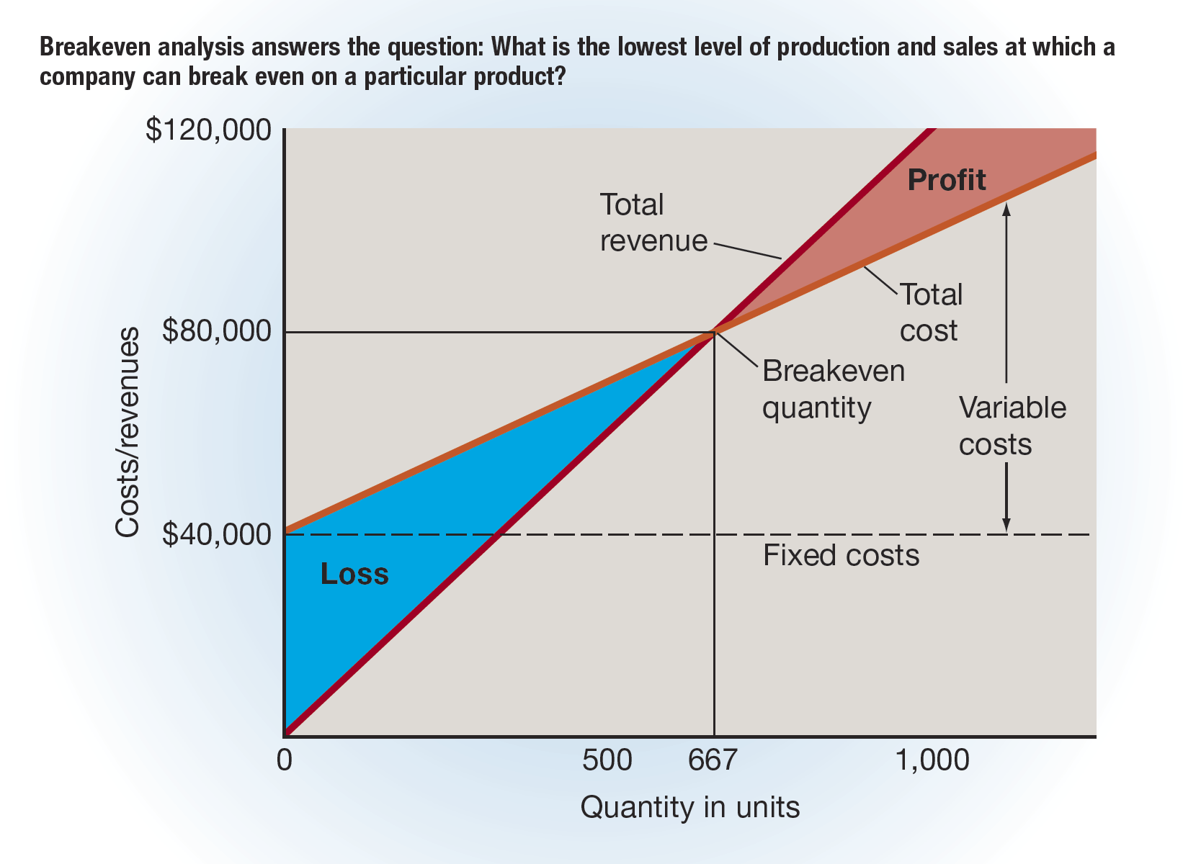
FIGURE 12-3 Breakeven Analysis

Slide 36
Demand-Based Pricing
Demand-based pricing is based on the level of demand for a product.
  Demand-based pricing results in a higher price when product demand is strong and a lower price when demand is weak.
To use this method, a marketer estimates the amount of a product that customers will demand at different prices and then chooses the price that should generate the highest total revenue.
Compared with cost-based pricing, demand-based pricing places a firm in a better position to attain higher profit levels, assuming that buyers value the product at levels sufficiently above the product’s cost.

Slide 37
Competition-Based Pricing
  In using competition-based pricing, an organization considers costs and revenue secondary to competitors’ prices.
  The importance of this method increases if competing products are similar and the organization is serving markets in which price is the crucial variable of the marketing strategy.
  A firm that uses competition-based pricing may choose to sell:
  Below competitors’ prices
  Slightly above competitors’ prices
  At the same level as competitors’ prices

Slide 38
Common Pricing Strategies
New Product Pricing
Price Skimming: Charge highest possible price during introduction stage
Penetration Pricing: Setting low price for new product to build market share
Differential Pricing - Charging different prices to different buyers for same quality and quantity
Negotiated: Final price comes from bargaining
Periodic Discounting: Temporary price reduction on patterned/systematic basis
Random Discounting: Temporary price reduction on unsystematic basis
Psychological Pricing
Odd-Number: use odd numbers just below whole-dollar amounts
Multiple-Unit: single price for 2+ units (aka BOGO)
Reference: price at moderate level and positioning it near a more expensive model
Bundle: package 2+ products and selling for single price
EDLP: consistently low price

Slide 39
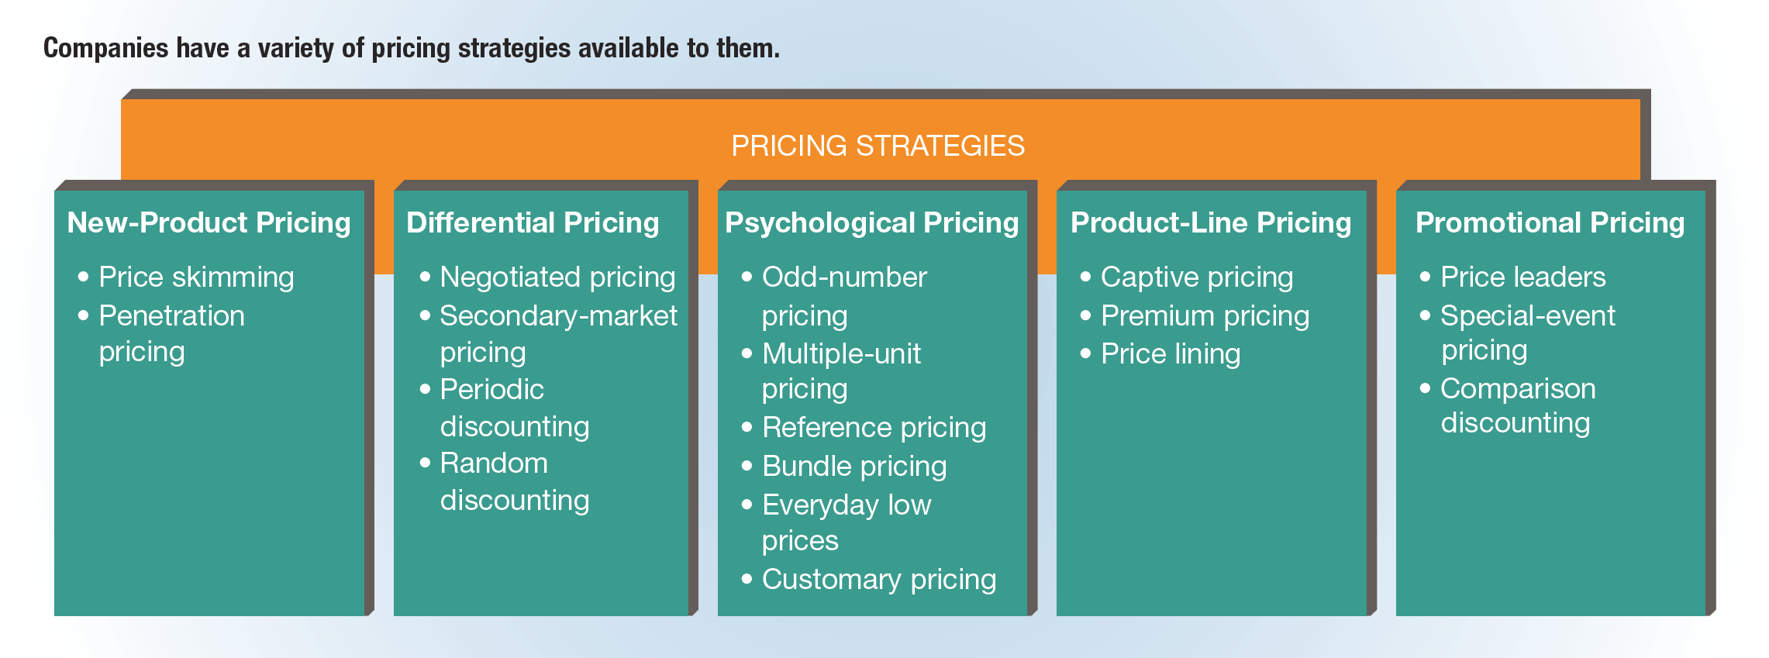
FIGURE 12-4 Types of Pricing Strategies

Slide 40
New-Product Pricing
  Price skimming – the strategy of charging the highest possible price for a product during the introduction stage of its life-cycle
  Penetration pricing – the strategy of setting a low price for a new product

Slide 41
Differential Pricing
  Negotiated pricing – establishing a final price through bargaining
  Secondary-market pricing – setting one price for the primary target market and a different price for another market
  Periodic discounting – temporary reduction of prices on a patterned or systematic basis
  Example: annual holiday sales, seasonal sales
  Random discounting – temporary reduction of prices on an unsystematic basis

Slide 42
Psychological Pricing
  Odd-number pricing – the strategy of setting prices using odd numbers that are slightly below whole-dollar amounts
  Example: charging $4.99 for an item, rather than $5
  Multiple-unit pricing – the strategy of setting a single price for two or more units
  Example: two cans for 99 cents, rather than 50 cents a can
  Reference pricing – pricing a product at a moderate level and positioning it next to a more expensive model or brand
  Bundle pricing – packaging together two or more complementary products and selling them for a single price
  Example: telecommunications companies selling service bundles of cable, Internet, and phone service for one price
  Everyday low prices (EDLPs) – setting a low price for products on a consistent basis
  Customary pricing – pricing on the basis of tradition

Slide 43
Product-Line Pricing
  Captive pricing – pricing the basic product in a product line low, but pricing related items at a higher level
  Example: A razor handle is generally priced quite low, but the razor blades are usually very expensive.
  Premium pricing – pricing the highest-quality or most-versatile products higher than other models in the product line
  Examples: small kitchen appliances, beer, ice cream
  Price lining – the strategy of selling goods only at certain predetermined prices that reflect definite price breaks
  Example: A shop may sell men’s ties only at $22 and $37.

Slide 44
Promotional Pricing
  Price leaders – products priced below the usual markup, near cost, or below cost
  Special-event pricing – advertised sales or price cutting linked to a holiday, season, or event
  Comparison discounting – setting a price at a specific level and comparing it with a higher price

Slide 45
Pricing Business Products
  Three types of pricing for business products:
  Geographic pricing – deals with delivery costs
    FOB origin pricing
    FOB destination
  2. Transfer pricing – prices charged in sales between an organization’s units
  Discounting
    Discount – a deduction from the price of an item
      Trade discounts
      Quantity discounts
      Cash discounts
      Seasonal discounts
      Allowances

Slide 46
TABLE 12-3 Discounts Used for Business Markets (slide 1 of 2)
Type | Reasons for Use | Examples
Trade (functional) | To attract and maintain effective resellers by compensating them for performing certain functions, such as transportation, warehousing, selling, and providing credit. | A college bookstore pays about one-third less for a new textbook than the retail price a student pays.
Quantity | To encourage customers to buy large quantities when making purchases and, in the case of cumulative discounts, to encourage customer loyalty. | Numerous companies serving business markets allow a 2 percent discount if an account is paid within ten days.

Slide 47
TABLE 12-3 Discounts Used for Business Markets (slide 2 of 2)
Type | Reasons for Use | Examples
Seasonal | To allow a marketer to use resources more efficiently by stimulating sales during off-peak periods. | Florida hotels provide companies holding national and regional sales meetings with deeply discounted accommodations during the summer months.
Allowance | In the case of a trade-in allowance, to assist the buyer in making the purchase and potentially earn a profit on the resale of used equipment. In the case of a promotional allowance, to ensure that dealers participate in advertising and sales support programs. | A farm equipment dealer takes a farmer’s used tractor as a trade-in on a new one. Nabisco pays a promotional allowance to a supermarket for setting up and maintaining a large end-of-aisle display for a two-week period.

