Slide 1
Chapter 11
Building Customer Relationships Through Effective Marketing

Slide 2
What is Marketing?
According to the American Marketing Associaiton…
Marketing – the activity, set of institutions, and processes for creating, communicating, delivering, and exchanging offerings that have value for customers, clients, partners, and society at large
Value – a customer’s estimation of the worth of a product based on a comparison of its costs and benefits, including quality, relative to other products

Slide 3
Marketing – A Better Definition
Process of planning and executing the conception, pricing, promotion and distribution of ideas, goods and services to facilitate exchanges that satisfy customer needs and organization objectives
Product
Pricing
Promotion
Place
Ideas
Services
Goods
2 Important Functions
Facilitate Exchanges
(Encourage Purchase)
Satisfy Customer
Needs

Slide 4
TABLE 11-1 Eight Major Marketing Functions (slide 1 of 2)
Exchange functions: All companies—manufacturers, wholesalers, and retailers—buy and sell to market their merchandise.
1. Buying includes obtaining raw materials to make products, knowing how much merchandise to keep on hand, and selecting suppliers.
2. Selling creates possession utility by transferring the title of a product from seller to customer.
Physical distribution functions: These functions involve the flow of goods from producers to customers.
3. Transporting involves selecting a mode of transport that provides an acceptable delivery schedule at an acceptable price.
4. Storing goods is often necessary to sell them at the best selling time.

Slide 5
TABLE 11-1 Eight Major Marketing Functions (slide 2 of 2)
Facilitating functions: These functions help the other functions to take place.
5. Financing helps at all stages of marketing. To buy raw materials, manufacturers often borrow from banks or receive credit from suppliers. Wholesalers may be financed by manufacturers, and retailers may receive financing from the wholesaler or manufacturer. Finally, retailers often provide financing to customers.
6. Standardization sets uniform specifications for products or services. Grading classifies products by size and quality, usually through a sorting process. Together, standardization and grading facilitate production, transportation, storage, and selling.
7. Risk taking—even though competent management and insurance can minimize risks—is a constant reality of marketing because of such losses as bad-debt expense, obsolescence of products, theft by employees, and product-liability lawsuits.
8. Gathering market information is necessary for making all marketing decisions.

Slide 6
Managing Customer Relationships
Relationship marketing – establishing long-term, mutually satisfying buyer–seller relationships
Customer relationship management (CRM) – using information about customers to create marketing strategies that develop and sustain desirable customer relationships
  Managing customer relationships requires identifying patterns of buying behavior and using this information to focus on the most promising and profitable customers.
  It may be more profitable for a company to focus on satisfying a valuable existing customer than to attempt to attract a new one.
    Customer lifetime value – a measure of a customer’s worth (sales minus costs) to a business over one’s lifetime

Slide 7
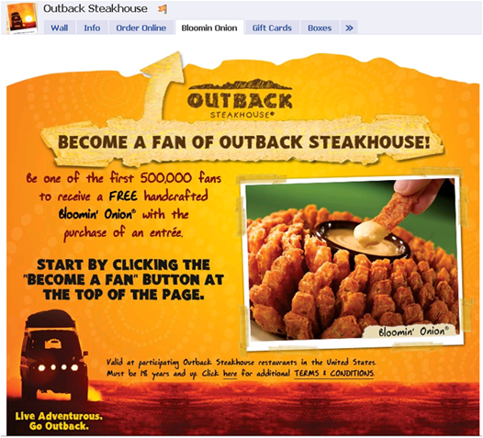
Customer Loyalty
What do customers want?
Sometimes it’s more profitable to retain customers by offering them big rewards than attracting new customers who may never develop the same loyalty.

Slide 8
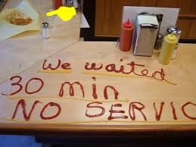
Understanding Today’s Customers
Today’s Customers are:
Sophisticated
Demanding
Price Sensitive
Why is Customer Satisfaction Important?
Getting new customers costs more than
keeping them.
Long-term customers boost profits.
Satisfied customers tell their friends.
Customers pay more for good service.
Unhappy customers spread the word.

Slide 9
The Marketing Concept
Marketing concept – a business philosophy that a firm should provide goods and services that satisfy customers’ needs through a coordinated set of activities that allow the firm to achieve its objectives
  The Marketing Concept includes three parts:
    Customer Orientation -- Finding out what customers want and then providing it.
    Service Orientation -- Making sure everyone in an organization is committed to customer satisfaction.
    Profit Orientation -- Focusing on the goods and services that will earn the most profit.

Slide 10
Utility:
The Value Added by Marketing
Utility – the ability of a good or service to satisfy a human need
There are four kinds of utility.
  1. Form utility – utility created by converting production inputs into finished products
  2. Place utility – utility created by making a product available at a location where customers wish to purchase it
    Example: A pair of shoes shipped from a factory to a department store
  3. Time utility – utility created by making a product available when customers wish to purchase it
    Example: Halloween costumes that are manufactured in April but not displayed until September, when consumers start buying them
  4. Possession utility – utility created by transferring title (or ownership) of a product to a buyer

Slide 11
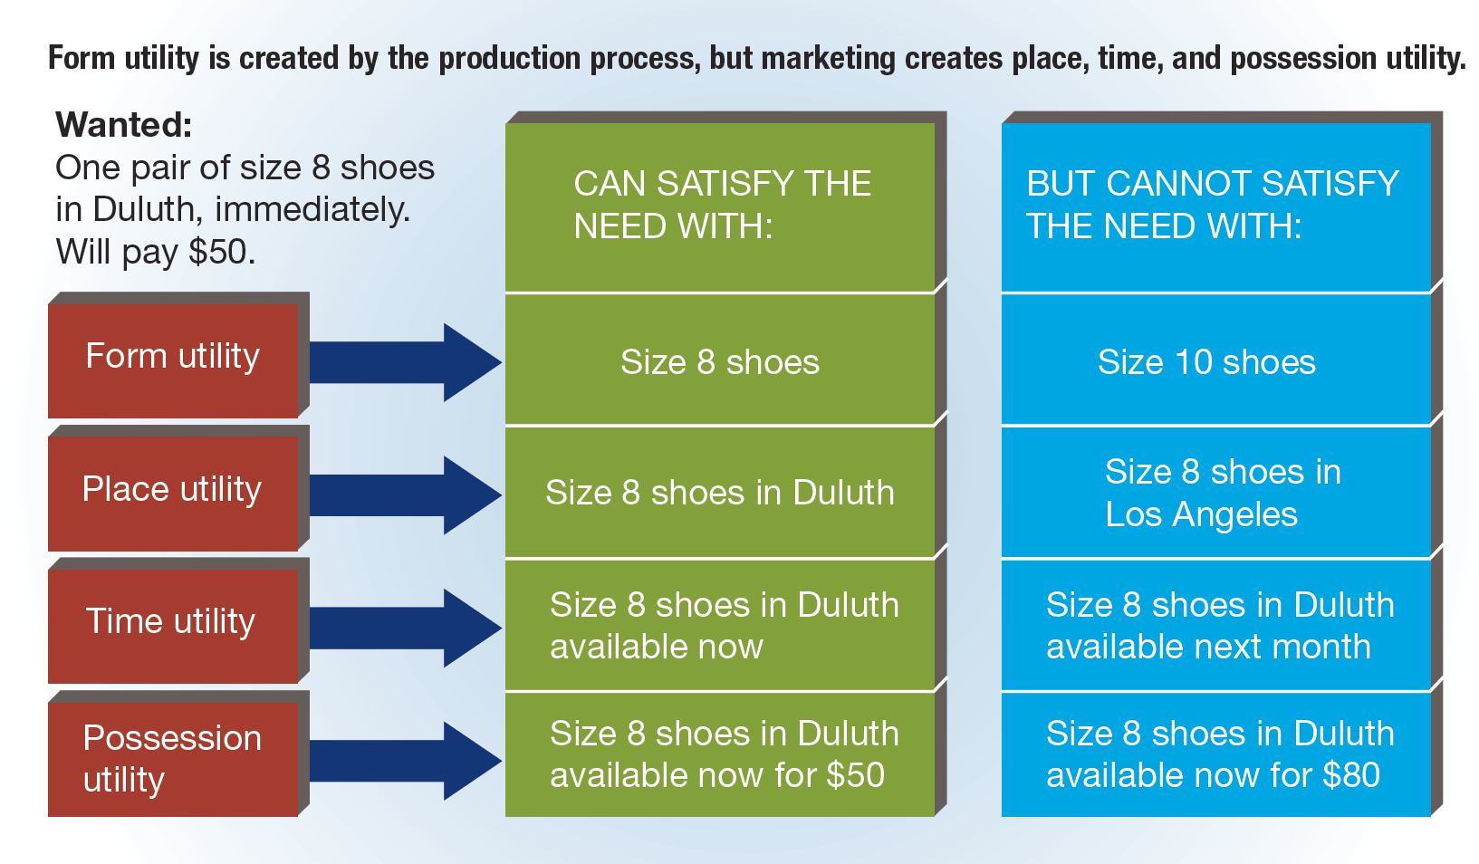
FIGURE 11-1 Types of Utility

Slide 12
Markets and Their Classification
Market: A group of individuals or organizations, or both, that need products in a given category and that have the ability, willingness, and authority to purchase such products
Consumer markets:
  Purchasers and/or households members who intend to consume or benefit from the purchased products and who do not buy products to make a profit
Business-to-business (industrial) markets:
  Producer, reseller, governmental, and institutional customers that purchase specific kinds of products for use in making other products for resale or for day-to-day operations

Slide 13
Developing Marketing Strategies
Marketing strategy – a plan that will enable an organization to make the best use of its resources and advantages to meet its objectives
  Consists of:
    The selection and analysis of a target market
    The creation and maintenance of an appropriate marketing mix—a combination of product, price, distribution, and promotion developed to satisfy a particular target market

Slide 14
Target Market Selection and Evaluation
Target market
  A group of individuals, organizations, or both, for which a firm develops and maintains a marketing mix suitable for the specific needs and preferences of that group
Market segment
  A group of individuals or organizations within a market that share one or more common characteristics
Market segmentation
  The process of dividing a market into segments and directing a marketing mix at a particular segment or segments rather than at the total market

Slide 15
A Well-Chosen Market
  Size: There must be enough people in your target group to support a business
  Profitability: The people must be willing and able spend more than the cost of producing and marketing the product
  Accessibility: Your target must be reachable through channels that your business can afford
  Limited Competition: Look for markets with limited competition; a crowded market is tough to crack

Slide 16
TABLE 11-3 Common Bases of Market Segmentation
Demographic
Age | Gender |  |  | Race |  | Ethnicity |  | Income |  |  | Education
Occupation |  | Family size |  |  | Family life cycle |  | Religion |  |  | Social class
Psychographic
Personality attributes |  |  |  | Motives |  |  |  | Lifestyles
Geographic
Region |  |  | Urban, suburban, rural |  |  | Market density |  |  | Climate
Terrain |  |  | City size |  |  | County size |  |  | State size
Behavioristic
Volume usage |  | End use |  |  | Benefit expectations |  | Brand loyalty |  |  | Price sensitivity

Slide 17
Creating a Marketing Mix (slide 1 of 3)
A business firm controls four important elements of marketing that it combines in a way that reaches the firm’s target market.
  Product
  Price
  Place (Distribution)
  Promotion
When combined, these four elements form a marketing mix.

Slide 18
Creating a Marketing Mix (slide 2 of 3)
Ingredients of the marketing mix:
  Product – includes decisions about the product’s design, brand name, packaging, and warranties.
    Example: the decisions McDonald’s makes about package designs, sizes of orders, and flavors of sauces
  Pricing – concerned with both base prices and discounts
    Example: rebates offered by automobile manufacturers
  Place (Distribution) – involves not only transportation and storage, but also selecting intermediaries
  Promotion – focuses on providing information to target markets
    Major forms:
      Advertising
      Personal selling
      Sales promotion
      Public relations

Slide 19
Marketing Mix – The Four P’s
Product
  Product differentiation
  Brand
Product
Decisions about product’s design, purpose, brand name, packaging, and warranties
Price
  Cover costs
  Competitively priced
Price
Decisions based on price setting (what to charge for product) including rebates, and discounts
Promotion
  Inform and persuade customers to buy
  Build positive customer relationships
Promotion
Decisions that sellers use to persuade and communicate to people to buy their products / services
Place
  Distribution channel
  Distributors and wholesalers
Place (Distribution)
Decisions based on moving products from producers to consumers (marketing channels)

Slide 20
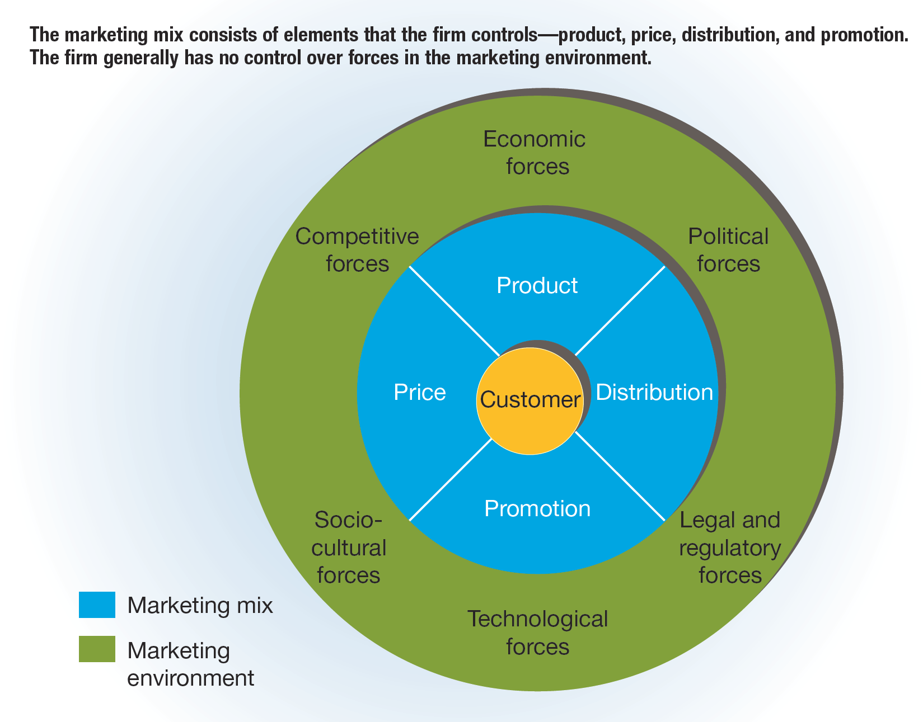
FIGURE 11-3 The Marketing Mix and the Marketing Environment

Slide 21
Marketing Strategy and the Marketing Environment
The following forces make up the external marketing environment:
  Economic forces – the effects of economic conditions on customers’ ability and willingness to buy
  Sociocultural forces – influences in a society and its culture that result in changes in attitudes, beliefs, norms, customs, and lifestyles
  Political forces – influences that arise through the actions of political figures
  Competitive forces – the actions of competitors, who are in the process of implementing their own marketing plans
  Legal and regulatory forces – laws that protect consumers and competition and government regulations that affect marketing
  Technological forces – technological changes that can create new marketing opportunities or cause products to become obsolete rapidly

Slide 22
Developing a Marketing Plan
Marketing plan – a written document that specifies an organization’s resources, objectives, strategy, and implementation and control efforts to be used in marketing a specific product or product group
  The marketing plan describes the firm’s current position or situation, establishes marketing objectives for the product, and specifies how the organization will attempt to achieve these objectives.
Developing a clear, well-written marketing plan is important.
  Helps establish a unified vision for an organization
  Is used for communication among the firm’s employees
  Covers responsibilities, tasks, and schedules for implementation
  Specifies how resources are to be allocated to achieve marketing objectives
  Helps marketing managers monitor and evaluate the performance of the marketing strategy

Slide 23
TABLE 11-4 Components of the Marketing Plan (slide 1 of 2)
Plan Component | Component Summary | Highlights
Executive summary | One- or two-page synopsis of the entire marketing plan | Stress key points Include one to three key points that make the company unique
Environmental analysis | Information about the company’s current situation with respect to the marketing environment | Assessment of marketing environment factors Assessment of target market(s) Assessment of current marketing objectives and performance
SWOT analysis | Assessment of the organization’s strengths, weaknesses, opportunities, and threats | Strengths of the company Weaknesses of the company Opportunities in the environment and industry Threats in the environment and industry

Slide 24
TABLE 11-4 Components of the Marketing Plan (slide 2 of 2)
Plan Component | Component Summary | Highlights
Marketing objectives | Specification of the firm’s marketing objectives | Qualitative measures of what is to be accomplished Quantitative measures of what is to be accomplished
Marketing strategies | Outline of how the firm will achieve its objectives | Target market(s) Marketing mix
Marketing implementation | Outline of how the firm will implement its marketing strategies | Marketing organization Activities and responsibilities Implementation timetable
Performance evaluation | Explanation of how the firm will measure and evaluate the results of the implemented plan | Performance standards Financial controls Monitoring procedures (audits)

Slide 25
Marketing Information Systems
Marketing information system – a system for managing marketing information that is gathered continually from internal and external sources
  Data from internal sources include sales figures, product and marketing costs, inventory levels, and activities of the sales force.
  Data from external sources relate to the organization’s suppliers, intermediaries, and customers, and also come from competitors’ marketing activities and economic conditions.
    All these data are stored and processed by the marketing information system.
    Marketers then choose the output format most useful for making marketing decisions, such as daily sales reports by territory and product and forecasts of sales or buying trends.

Slide 26
Marketing Research
  Marketing research – the process of systematically gathering, recording, and analyzing data concerning a particular marketing problem
  Marketers collect primary data directly from consumers when they conduct:
    Mail, telephone, personal interview, online, focus group, or social networking surveys
    Direct observation of consumer behavior
  Marketers collect secondary data from sources compiled inside or outside the firm for purposes other than specific marketing research, such as:
    Commercial reports
    Government reports
    Internal databases

Slide 27
TABLE 11-5 The Six Steps of Marketing Research (slide 1 of 2)
Define the problem. | The problem is stated clearly and accurately, as it will determine the research issues and approaches, the right questions to ask, and the types of solutions that are acceptable. This is a crucial step that should not be rushed.
Make a preliminary investigation. | The preliminary investigation aims to develop a sharper definition of the problem and a set of tentative answers, which are developed by examining internal information and published data and by talking with persons who have experience with the problem. These answers will be tested by further research.
Plan the research. | At this stage, researchers know what facts are needed to resolve the identified problem and what facts are available. They make plans on how to gather needed but missing data.

Slide 28
TABLE 11-5 The Six Steps of Marketing Research (slide 2 of 2)
Gather factual information. | Once a plan is in place, researchers can collect primary data from surveys and/or observation, and get secondary data from commercial or government data sources. The choice depends on the plan and the available sources of information.
Interpret the information. | Facts by themselves do not always provide a sound solution to a marketing problem. They must be interpreted and analyzed to determine the choices available to management.
Reach a conclusion. | Once the data have been evaluated, researchers seek to draw conclusions and make recommendations. These may be obvious or not, depending on intangible factors and whether data used were complete. When there are gaps in the data, it is important for researchers to state this.

Slide 29
Using Technology to Gather and Analyze Marketing Information
  Database – a collection of information arranged for easy access and retrieval
  Examples: LEXIS-NEXIS, Dun & Bradstreet’s Global Commercial database
  Single-source data – information provided by a single firm on household demographics, purchases, television-viewing behavior, and responses to promotions such as coupons and free samples
  Online information services – offer subscribers access to email, Web sites, downloadable files, news, databases, and research materials
  Internet

Slide 30
TABLE 11-6 Sources of Secondary Information (slide 1 of 2)
Government sources
Economic census | www.census.gov/
Export.gov—country market research | https://www.export.gov/ccg
National Technical Information Services | www.ntis.gov/
Strategis—Canadian trade | http://strategis.ic.gc.ca/
Trade associations and shows
American Society of Association Executives | www.asaecenter.org/
Directory of Associations | http://www.marketingsource.com/directories/associations/us
Trade Show News Network | www.tsnn.com

Slide 31
TABLE 11-6 Sources of Secondary Information (slide 2 of 2)
Magazines, newspapers, video, and audio news programming
Google Video Search | http://www.google.com/videohp?hl=en
Google News Directory | https://news.google.com/
Yahoo! Video Search | http://video.search.yahoo.com/
Corporate information
The Public Register Online | www.annualreportservice.com/
Bitpipe | www.bitpipe.com/
Business Wire—press releases | www.businesswire.com/
Hoover’s Online | www.hoovers.com/
PR Newswire—press releases | www.prnewswire.com/

Slide 32
Types of Buying Behavior
  Buying behavior – the decisions and actions of people involved in buying and using products

Slide 33
Consumer Buying Behavior (slide 1 of 2)
  Consumer buying behavior – the purchasing of products for personal or household use, not for business purposes
  A person deciding on a purchase goes through some or all of the following steps:
  The consumer acknowledges that a problem exists that might be solved by a good or service.
  The buyer looks for information, which may include brand names, product characteristics, warranties, and other features, as well as product reviews.
  The buyer weighs the various alternatives, makes a choice, and acquires the item.
  The consumer evaluates the suitability of the product, which will affect future purchases.

Slide 34
Consumer Buying Behavior (slide 2 of 2)
  The buying process is influenced by:
  Situational factors
  Psychological factors
  Social factors
  Consumer buying behavior is also affected by the ability to buy, called one’s buying power, which is largely determined by income.
  Marketers consider income in three different ways.
    1. Personal income – the income an individual receives from all sources less the Social Security taxes the individual must pay
    2. Disposable income – personal income less all additional personal taxes
    3. Discretionary income – disposable income less savings and expenditures on food, clothing, and housing

Slide 35
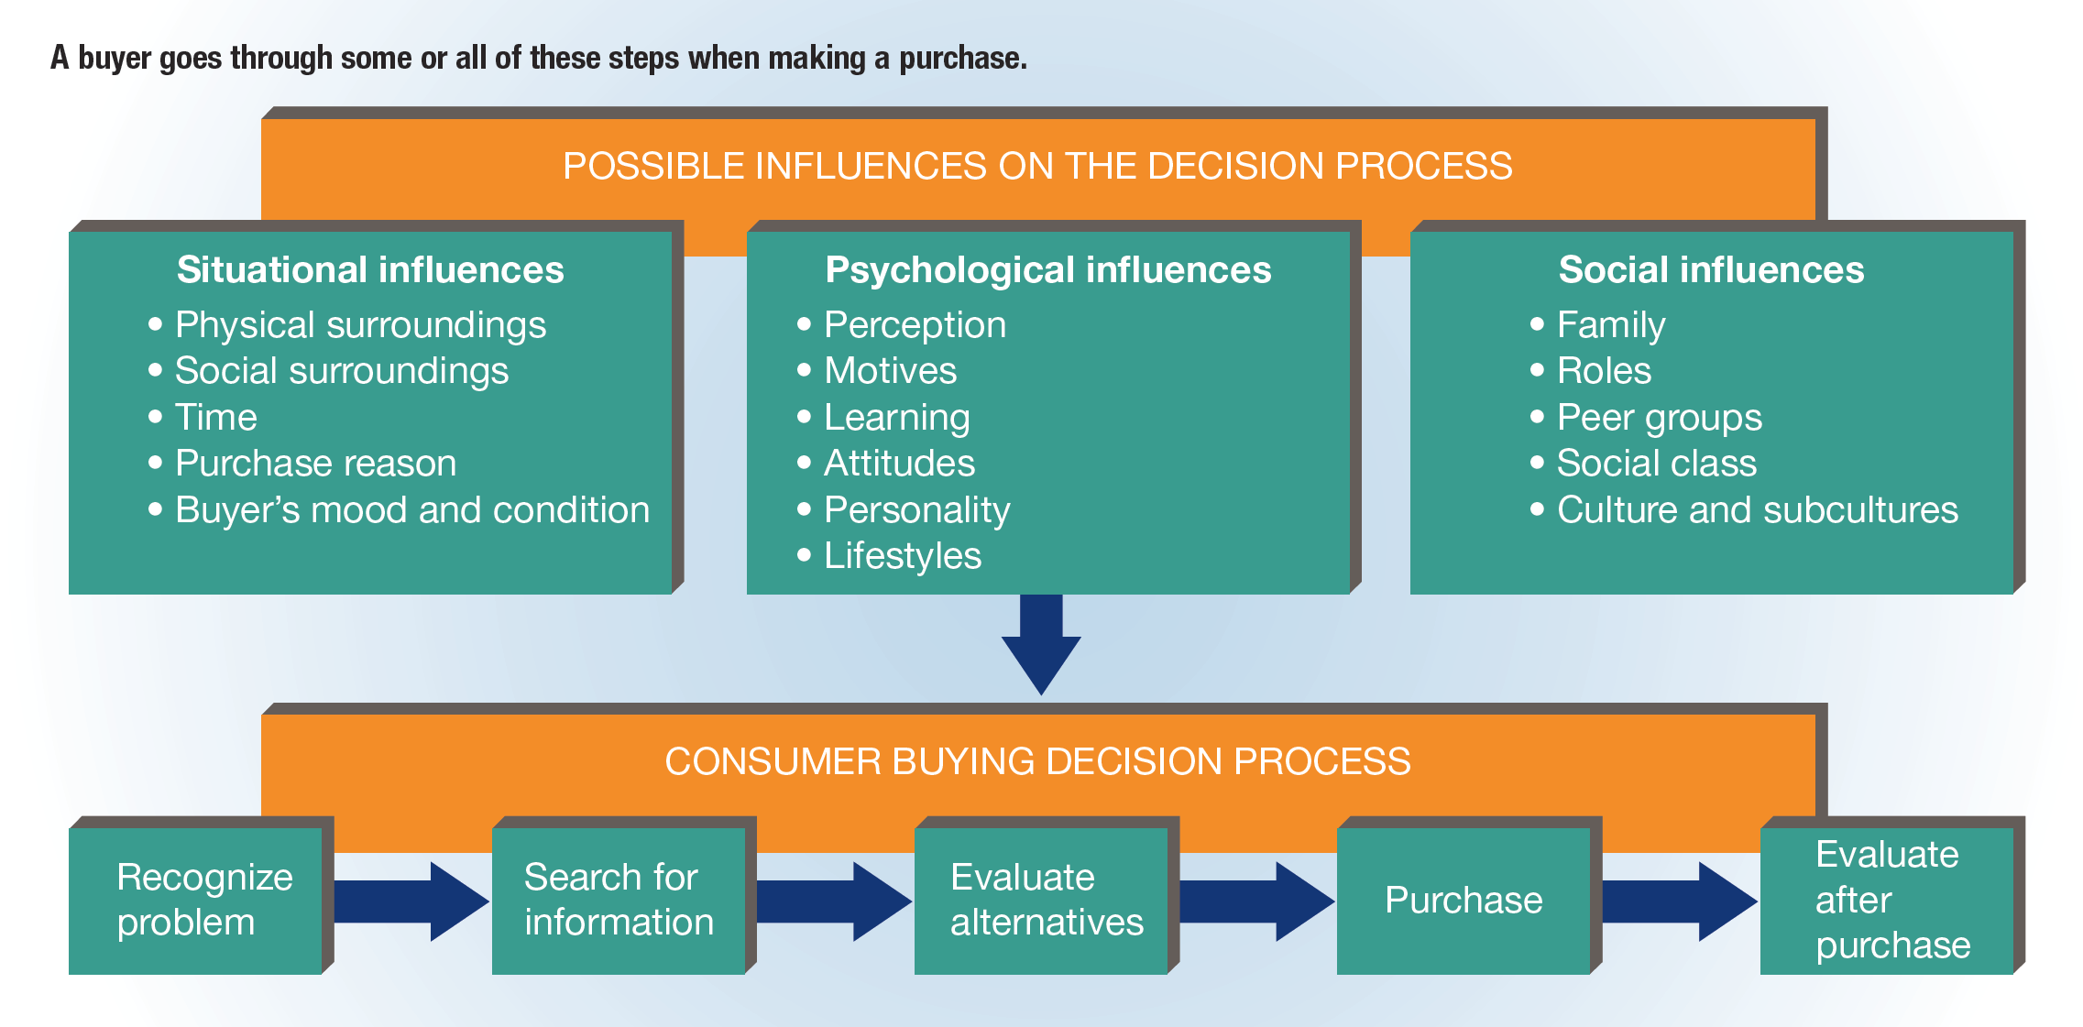
FIGURE 11-4 Consumer Buying Decision Process and Possible Influences on the Process

Slide 36
Business Buying Behavior
  Business buying behavior – the purchasing of products by producers, resellers, governmental units, and institutions

