Slide 1
Chapter 10 Motivating and Satisfying Employees and Teams

Slide 2
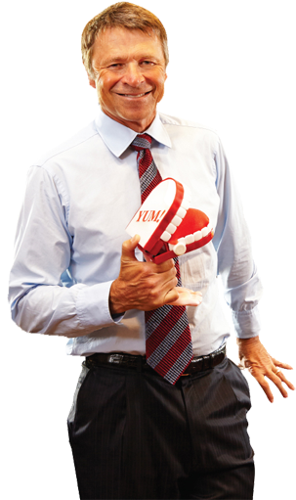
What Is Motivation?
What is Motivation?
The individual internal process that energizes, directs, and sustains behavior; the personal “force” that causes us to behave in a particular way
Morale
An employee’s feelings about his or her job, superiors, and about the firm itself
High morale results from the satisfaction of needs or as a result of the job and leads to dedication, loyalty, and the desire to do the job well
Low morale leads to shoddy work, absenteeism, and high turnover rates
Good managers motivate others to reach their best
Motivated workers feel great about work
Workers who feel good, produce more
There are multiple motivation theories and techniques (including tapping into employee’s intrinsic and extrinsic rewards)

Slide 3
Scientific Management
Scientific management – the application of scientific principles to management of work and workers
Frederick W. Taylor
Was interested in improving the efficiency of individual workers
This interest led to the development of scientific management.
Observed that workers “soldiered,” or worked slowly, because they feared that they would run out of work and lose their jobs
Developed the piece-rate system – a compensation system under which employees are paid a certain amount for each unit of output they produce

Slide 4
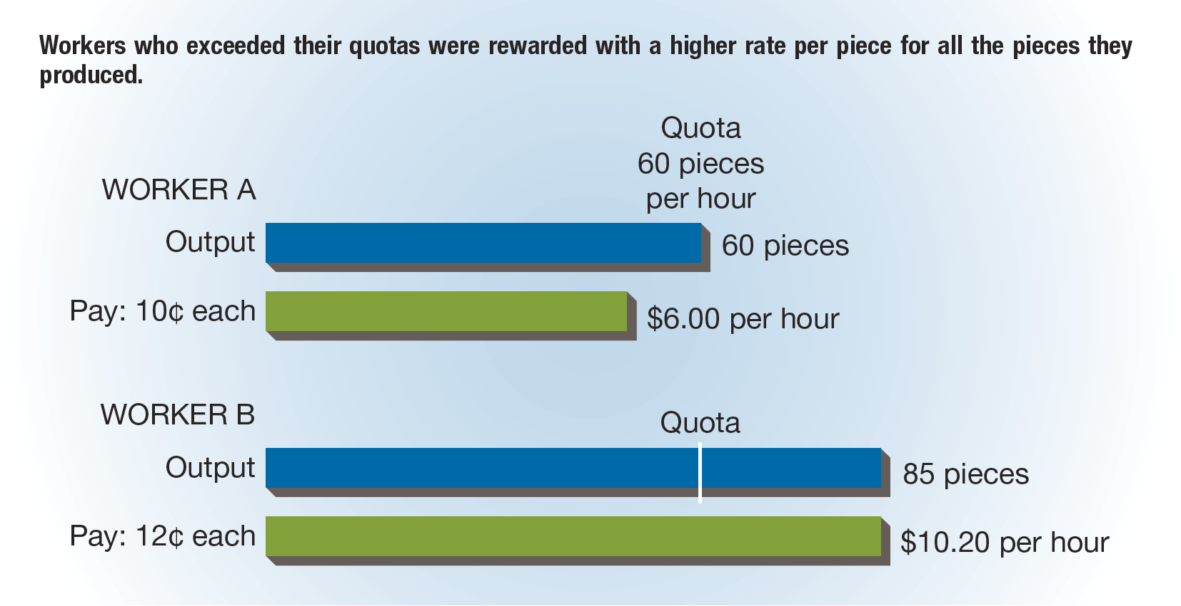
FIGURE 10-1 Taylor’s Piece-Rate System

Slide 5
The Hawthorne Studies
Conducted by Elton Mayo between 1927 and 1932 in order to determine the effects of the work environment on employee productivity
The first set of experiments tested the effect of lighting levels on productivity by subjecting one group of workers to varying lighting and the second group to none.
Productivity increased for both groups.
The second set of experiments focused on the effectiveness of the piece-rate system in increasing the output of groups of workers.
Output remained constant irrespective of the “standard” rates management set.
Researchers concluded that human factors were responsible for the results and, thus, they are at least as important to motivation as pay rates.

Slide 6
Reinforcement Theory
Reinforcement theory – a theory of motivation based on the premise that rewarded behavior is likely to be repeated, whereas punished behavior is less likely to recur
Reinforcement – an action that follows directly from a particular behavior
Example: a reprimand for coming late to work
Forms of reinforcement:
Positive reinforcement – one that strengthens desired behavior by providing a reward
Example: praise from supervisors for a job well done
Negative reinforcement – one that strengthens desired behavior by eliminating an undesirable task or situation
Punishment – a consequence of undesirable behavior
Examples: reduced pay and termination
Extinction – not responding to undesirable behavior with the hope that the behavior will eventually go “extinct”

Slide 7
Behavior Modification
Behavior modification – a systematic program of reinforcement to encourage desirable behavior
Behavior modification involves both rewards to encourage desirable actions and punishments to discourage undesirable actions.
Steps:
A target behavior—the behavior that is to be changed—is identified and measured.
Managers provide positive reinforcement in the form of a reward when employees exhibit the desired behavior.
Example: Apple offers Corporate Gifts and Rewards Programs to give companies the ability to reward their staff or very loyal customers with iPods, iPhones, iPads, Mac computers, or iTunes gift cards.
The levels of the target behavior are measured again to determine whether the desired changes have been achieved.
If the target behavior has not changed significantly in the desired direction, the reward system must be changed to one that is likely to be more effective.

Slide 8
Maslow’s Hierarchy of Needs
Hierarchy of Needs -- Theory of motivation based on unmet human needs in order of their individual importance.
Need – A personal requirement
Physiological needs – Basic survival needs (food, water, shelter)
Safety needs – The need to feel safe and secure at work (job security, health insurance, safe working conditions)
Social needs – The need to feel love, accepted, and part of the group (working relationships, social networks)
Esteem needs – The need for respect, recognition, and a sense of our own accomplishment and worth (personal accomplishments, promotions, honors and awards)
Self-actualization needs – The need to grow and develop and become all that we are capable of being. This is the hardest need to identify (learning a new skill, starting a new career, or becoming “the best there is” at their craft
How to use this theory?
Needs that have already been met do not motivate.
If a need is filled, another higher-level need emerges.

Slide 9
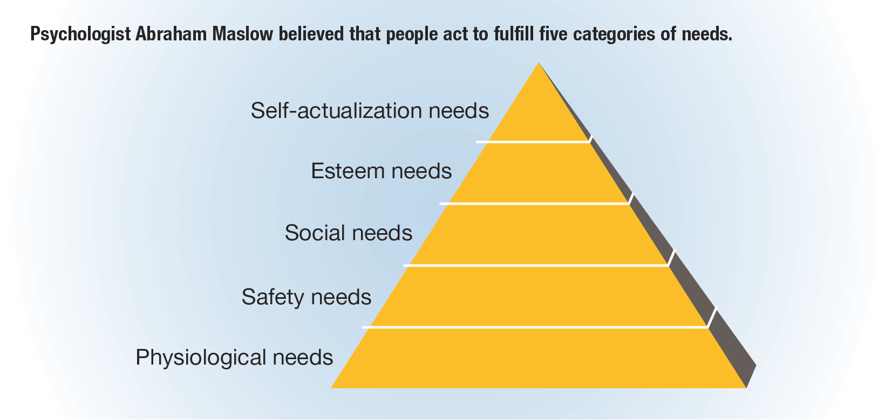
FIGURE 10-2 Maslow’s Hierarchy of Needs
Dissatisfaction
Satisfaction

Slide 10
Herzberg’s Motivation–Hygiene Theory
Motivation–hygiene theory – the idea that satisfaction and dissatisfaction are separate and distinct dimensions
Motivation factors – job factors that increase motivation, although their absence does not necessarily result in dissatisfaction
When motivation factors are present, they act as satisfiers.
Hygiene factors – job factors that reduce dissatisfaction when present to an acceptable degree but that do not necessarily result in high levels of motivation
When hygiene factors are present, they act as dissatisfiers.
Understanding this Theory:
Hygiene factors lead to job dissatisfaction. If Hygiene factors are not present, employees tend to get dissatisfied. If Hygiene factors are present, employees tend to ignore these factors and take them for granted.
Motivation factors lead to job satisfaction. If motivational factors are present, employees tend to get motivated and it can lead to long-term job satisfaction.

Slide 11
FIGURE 10-3 Herzberg’s Motivation–Hygiene Factors

Slide 12
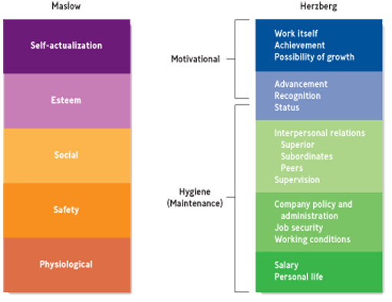
Comparison of Maslow’s Hierarchy of Needs and Herzberg’s Motivation–Hygiene Factors

Slide 13
Theory X and Theory Y (slide 1 of 2)
Douglas McGregor
Sets of assumptions about managerial attitudes and beliefs regarding worker behavior
Theory X – a concept of employee motivation generally consistent with Taylor’s scientific management; assumes that employees dislike work and will function only in a highly controlled work environment
Theory X is based on the following assumptions:
People dislike work and try to avoid it.
Because people dislike work, managers must coerce, control, and frequently threaten employees to achieve organizational goals.
People generally must be led because they have little ambition and will not seek responsibility; they are concerned mainly about security.

Slide 14
Theory X and Theory Y (slide 2 of 2)
Theory Y – a concept of employee motivation generally consistent with the ideas of the human relations movement; assumes responsibility and work toward organizational goals, and by doing personal rewards are also achieved
Theory Y is based on the following assumptions:
People do not naturally dislike work.
People will work toward goals to which they are committed.
People become committed to goals when it is clear that accomplishing the goals will bring personal rewards.
People often seek out and willingly accept responsibility.
Employees have the potential to help accomplish organizational goals.
Organizations generally do not make full use of their human resources.

Slide 15
TABLE 10-1 Theory X and Theory Y Contrasted
Area | Theory X | Theory Y
Attitude toward work | Dislike | Involvement
Control systems | External | Internal
Supervision | Direct | Indirect
Level of commitment | Low | High
Employee potential | Ignored | Identified
Use of human resources | Limited | Not limited

Slide 16
Theory Z
Theory Z – the belief that some middle ground between type A and type J practices is best for American business
Developed by William Ouchi
Emphasizes participative decision making

Slide 17
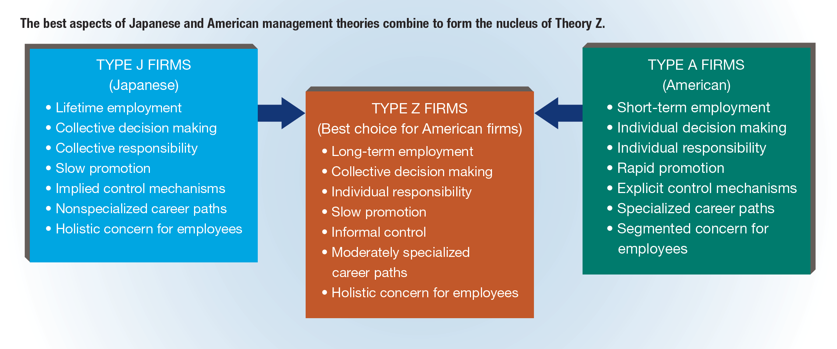
FIGURE 10-4 The Features of Theory Z

Slide 18
Equity Theory
Equity theory – a theory of motivation based on the premise that people are motivated to obtain and preserve equitable treatment for themselves
Equity – the distribution of rewards in direct proportion to each employee’s contribution to the organization
We conceive of equity in the following way:
We develop our own input-to-outcome ratio.
Inputs are the time, effort, skills, education, experience, and so on that we contribute to the organization.
Outcomes are the rewards we get from the organization, such as pay, benefits, recognition, and promotions.
We compare this ratio to what we perceive as the input-to-outcome ratio for some other person (or comparison other).
If the two ratios are roughly the same, we feel that the organization is treating us equitably.
If our ratio is the higher of the two, we feel under-rewarded and may decrease our own inputs by (1) not working as hard, (2) trying to increase our outcome by asking for a raise, (3) trying to get the comparison other to increase some inputs, (4) leaving the work situation, or (5) conducting a new comparison with a different person.

Slide 19
Expectancy Theory
Expectancy theory – a model of motivation based on the assumption that motivation depends on how much we want something and on how likely we think we are to get it
Developed by Victor Vroom
Expectancy theory is complex because each action we take is likely to lead to several outcomes, some of which we want and others we do not.
Implies that managers must recognize that
Employees work for a variety of reasons
The reasons, or expected outcomes, may change over time
It is necessary to show employees how they can attain the outcomes they desire

Slide 20
FIGURE 10-5 Expectancy Theory

Slide 21
Goal-Setting Theory
Goal-setting theory – a theory of motivation suggesting that employees are motivated to achieve goals that they and their managers establish together
The goal should be:
Very specific
Moderately challenging
One that the employee will be committed to achieve
Rewards should be tied directly to goal achievement.

Slide 22
Management by Objectives
Management by objectives (MBO) – a motivation technique in which managers and employees collaborate in setting goals
The primary purpose of MBO is to clarify the roles employees are expected to play in reaching the organization’s goals.
MBO increases employee motivation by empowering them with an active role in goal-setting and performance evaluation.
Most MBO programs consist of a series of five steps.
The acceptance of top management must be secured.
Top management and other parties must establish preliminary goals that reflect a firm’s mission and strategy.
The third step consists of the following three smaller steps:
The manager explains to each employee that he or she has accepted certain organizational goals and asks the individual to think about how he or she can help to achieve these goals.
The manager later meets with each employee individually and, together, they establish individual goals for the employee.
The manager and the employee decides what resources the employee will need to accomplish his or her goals.
The manager and employees meet periodically to review each employee’s progress.
At the end of the designated time period, the manager and each employee meet again to determine which of the individual’s goals were met and which were not, and why.

Slide 23
Job Enrichment
Job enrichment – a motivation technique that provides employees with more variety and responsibility in their jobs
Job enlargement – expanding a worker’s assignments to include additional but similar tasks
Job redesign – a type of job enrichment in which work is restructured to cultivate the worker–job match

Slide 24
Flexible Scheduling Options
Flextime – a system in which employees set their own work hours within employer-determined limits
Compressed workweek – allows employees to work a 40-hour week in four days instead of five

Slide 25
Part-Time Work and Job Sharing
Part-time work – permanent employment in which individuals work less than a standard work week
Job sharing – an arrangement whereby two people share one full-time position
Advantages:
May contribute to greater job satisfaction and ease in creating work–life balance
Can lead people to be more productive
Combines the security of a full-time position with the flexibility of a part-time one
Disadvantages:
May mean loss of benefits for employees
Is difficult if tasks are not easily divisible or if two people do not work or communicate well with one another

Slide 26
Telecommuting
Telecommuting – working at home all the time or for a portion of the work week
Advantages:
For employees:
Increased productivity
Higher levels of happiness and personal satisfaction
For companies:
Lower real estate and travel expenses
Improved morale
Flexibility to access larger labor pools
Disadvantages:
For employees:
Feelings of isolation
Putting in longer hours
Distractions at home
For companies:
Difficulty monitoring productivity

Slide 27
Employee Empowerment
Empowerment – making employees more involved in their jobs by increasing their participation in decision making
For empowerment to work effectively, managers should set expectations, communicate standards, institute periodic evaluations, and guarantee follow-up.
Benefits:
Increased job satisfaction
Improved job performance
Higher self-esteem
Increased organizational commitment
Obstacles:
Resistance on the part of management
Distrust of management on the part of workers
Inadequate training of employees
Poor communication between levels of the organization

Slide 28
Employee Ownership
Employee ownership – a situation in which employees own the company they work for by virtue of being stockholders
Examples: Employee-owned companies include Publix Super Markets, Harpoon Brewing, and Davey Tree.
As a means to motivate executives and managers to feel invested in the company, some firms provide stock options as part of the employee compensation package.
An option is simply the right to buy shares of the firm within a prescribed time at a set price.
If the firm does well and its stock price rises past the set price, the employee can exercise the option and sell the stock to cash in on the company’s success.

Slide 29
What Is a Team?
Team – two or more workers operating as a coordinated unit to accomplish a specific task or goal

Slide 30
Types of Teams
Problem-solving team – a team of knowledgeable employees brought together to tackle a specific problem
Self-managed teams – groups of employees with the authority and skills to manage themselves
Cross-functional team – a team of individuals with varying specialties, expertise, and skills that are brought together to achieve a common task
Virtual team – a team consisting of members who are geographically dispersed but communicate electronically

Slide 31
FIGURE 10-6 Advantages and Disadvantages of Self-Managed Teams

Slide 32
FIGURE 10-7 Stages of Team Development

Slide 33
Roles Within a Team
Task-specialist role
Played by the group member who pushes the team toward achieving goals and objectives by concentrating fully on the assigned task
Socioemotional role
Played by the individual who supports and encourages the emotional needs of the other members, placing the team members’ personal needs above the task at hand
Dual role
A combination of the socioemotional and task-specialist roles
Nonparticipant role
Played by a person who does not contribute to accomplishing the task and does not provide favorable input with respect to team members’ socioemotional needs

Slide 34
Team Cohesiveness
To ensure cohesiveness, the ideal team size is generally 5 to 12.
Anything larger and relationship development becomes too complicated.
Anything smaller and the group may be excessively burdened and tasks may not get completed.
One of the most reliable ways to build cohesiveness within a team is through competition with other teams.
When two teams are competing for a single prize or recognition, they are forced to become more goal-oriented and to put aside conflict.
A favorable appraisal from an outsider may strengthen team cohesiveness.
Teams are also more successful when goals have been agreed upon beforehand.
Frequent interaction also builds team cohesiveness through increasing familiarity.

Slide 35
Benefits and Limitations of Teams
Benefits:
Reduces turnover and costs
Increases productivity, customer service, and product quality
Leads to higher levels of job satisfaction among employees
Leads to a harmonious work environment
Limitations:
Stressful and time-consuming organization process
No guarantee that the team will develop effectively
May experience lower productivity if there is a lack of cohesiveness or too much conflict

