Slide 1
Chapter 1
Exploring the World of Business and Economics

Slide 2
Tips for Studying Business
Prepare before you go to class
Read the chapter
Underline or highlight important concepts
Review PP Slides and Take notes
  Note: My PP Slides are CUSTOMIZED for this BUS 150 course
Apply the concepts
Practice critical thinking
Prepare for the examinations

Slide 3
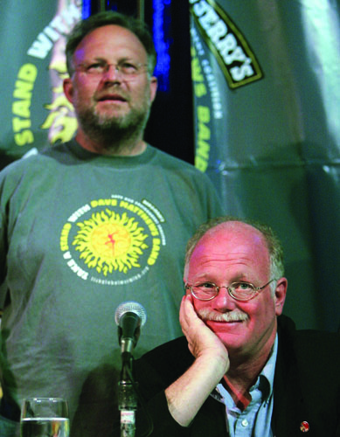
Why Study Business?
For help in choosing a career
To be a successful employee
    Cultural (or workplace) diversity – differences among people in a workforce owing to race, ethnicity, and gender
To improve your management skills
To start your own business
To become a better informed consumer
and investor

Slide 4
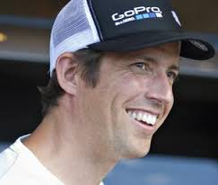
Understanding Business and Entrepreneurship
Free enterprise – the system of business in which individuals are free to decide what to produce, how to produce it, and at what price to sell it
  Example: Our free enterprise system ensures that Amazon.com can sell everything from televisions, toys, and tools to computers, cameras, and clothing.
Business (description) -- Any activity that seeks to provide goods and services to others while operating at a profit.
Entrepreneur -- A person who risks time and money to start and manage a business.
  Success in business is often based on the strategy of finding a need and filling it.
Nick Woodman, Founder/CEO, GoPro
  A profit is earned when a company’s revenue (the money a business brings in) is greater than its expenses (the money a business pays out).
  Nonprofit organizations focus on causes not profit

Slide 5
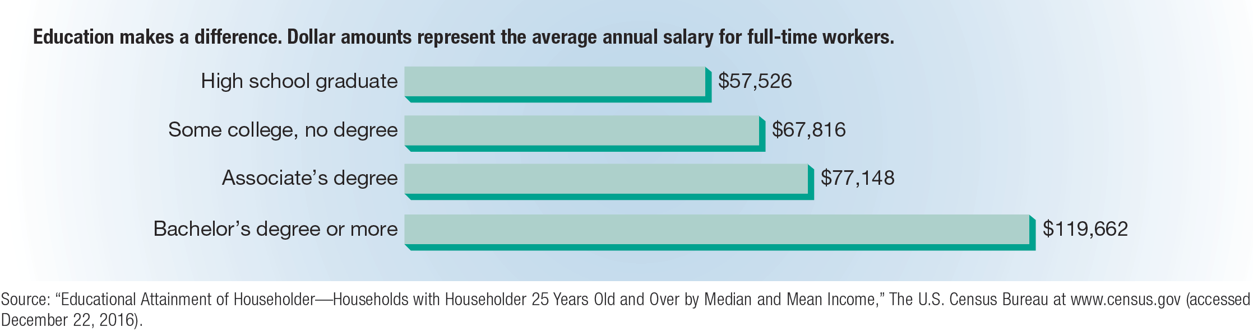
FIGURE 1-1 Who Makes the Most Money?

Slide 6
Business: A Definition
Business – the organized effort of individuals to produce and sell, for a profit, the goods and services that satisfy society’s needs
Important Components of Business
  Organized Effort of Individuals (Buyers, Sellers, and Resources)
  Product Elements
  Profit Motivation
  Customer Satisfaction
  Stakeholders
  Changing Business Environment

Slide 7
The Organized Effort of Individuals
Buyers
Consumers (people who buy products for personal consumption)
Business (organizations who buy products for to resell to others, use as part of their product, or help in the operation of their business)
Government (organizations that purchase products for societal purposes, i.e. military, roads, park maintenance, etc.)
Other (non-profit institutions, churches, libraries, etc.)
Sellers
Manufacturers (businesses that assemble and make products, i.e. Apple, Kodak, Stone Container)
Resellers (businesses that resell tangible products to customers or to the other businesses, i.e. Wal-Mart, Target, Lowes, Home Depot)
Service Providers (businesses that provide intangible products or perform useful labor on behalf of their customers, i.e. insurance, banking, haircuts, cleaning service)
Combination
Resources
Human/Labor (physical labor and knowledge)
Capital (raw/natural materials, Real-physical facilities, machines, computers)
Entrepreneurship (Willingness to start business)
Financial (Checking, Savings, Stock, Equity, etc.)
Knowledge/Intellectual/Informational (information technology, business information, patents, copyrights, trademarks)

Slide 8
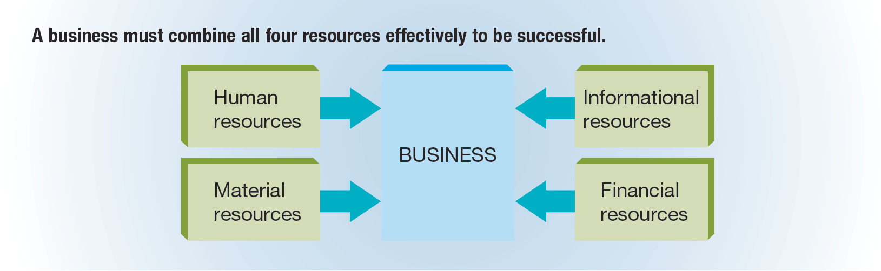
FIGURE 1-2 Combining Resources

Slide 9

Product Elements: Understanding the difference between goods & services
Goods -- Tangible products such as computers, food, clothing, cars and appliances.
Services -- Intangible products (that can’t be held in your hand) like education, healthcare, insurance, recreation and travel.
  PRODUCTS CAN CONSIST OF BOTH GOOD AND SERVICE ELEMENTS!

Slide 10
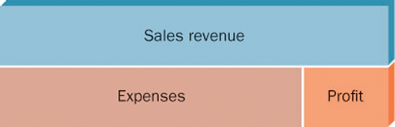
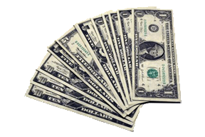
Business Profit
Profit is what remains after all business expenses have been deducted from sales revenue.
Revenue – Expenses = Profit
Sales Revenue = the money a business receive from selling its products (product price * number of products sold)
Expenses = the money a business spends trying to sell its products and operate
A loss (negative profit) results when a firm’s expenses are greater than its revenues.
What do you have when?
Revenue > Expenses
Expenses > Revenue
Sales Revenue
- Business Expenses
Profit (Loss)*
*Profit becomes property of its owners

Slide 11
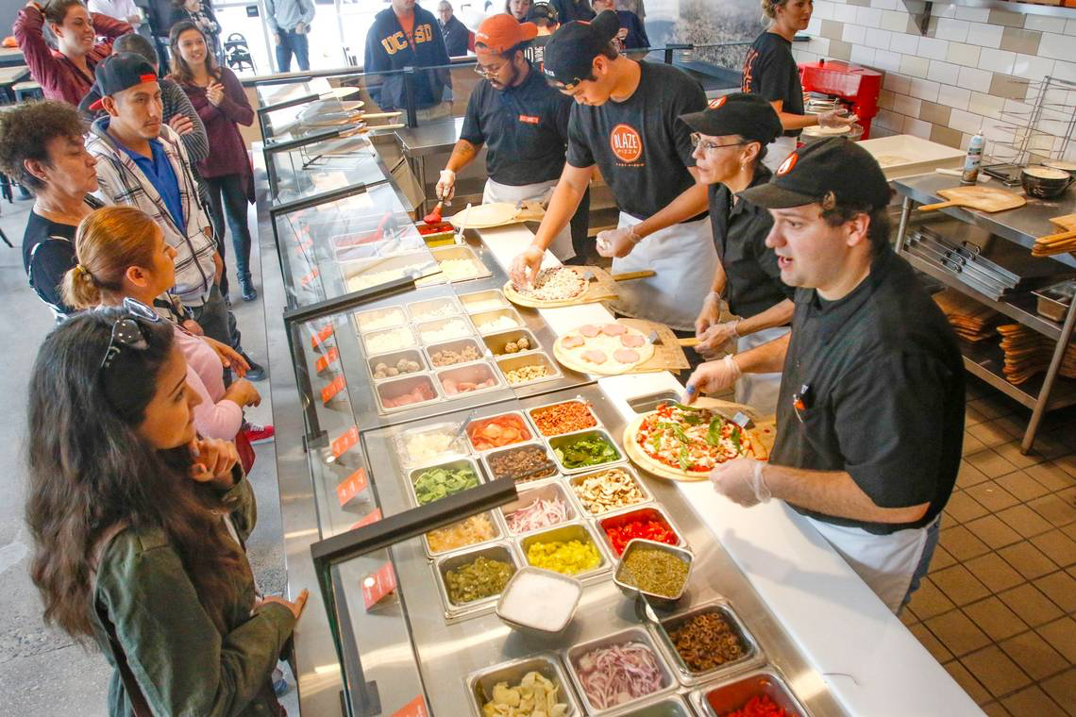
Profit Motivation: Matching Risk with Profit
Risk -- The chance an entrepreneur takes of losing time and money on a business that may not prove profitable
Not all businesses make the same amount of profit.
Businesses take risks, but with great risks could come great profit.
The purposes of profit
  To reward business owners for producing goods and services consumers want
  Profit compensates for RISK
    Non-Payment Risk
    Business Failure Risk

Slide 12

Profit Motivation: Taxes Come From Profit
  Taxes are used to provide:
  Hospitals
  Schools
  Libraries
  Playgrounds
  Roads
  Fire Protection
  Police Protection
  Environmental Programs
  Support for People in Need

Slide 13
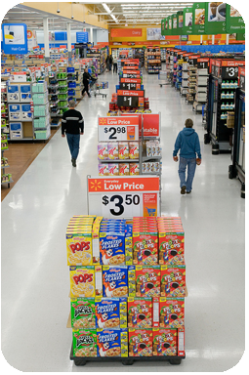

Profit Motivation: Profit Enhances Society
Standard of Living -- The amount of goods and services people can buy with the money they have.
The U.S. has one of the highest standards of living in the world.
Workers in other countries may make more money, but prices for products are higher.
Quality of Life -- The general well-being of a society in terms of its political freedom, natural environment, education, healthcare, safety, amount of leisure and rewards that add to personal satisfaction.

Slide 14

Customer Satisfaction: The Ultimate Objective of Every Business
People buy products not just to own them, but to satisfy particular needs
Goal of businesses are to produce products that people need and want at
a price they are willing to pay
Businesses that understand customer needs, and work to satisfy those
needs, are usually successful
Has a business ever failed or succeeded in satisfying your needs?

Slide 15
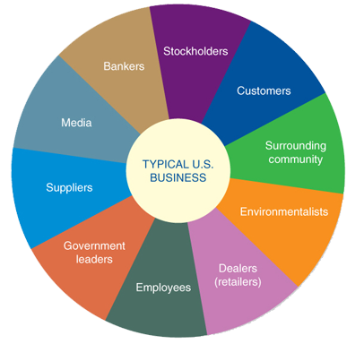
Stakeholders
Stakeholders -- All the people who stand to gain or lose by the policies and activities of a business and whose concerns the businesses need to address.
Who are Stakeholders?
Owners
Customers
Employees
Suppliers
Dealers
Community
Media
Elected Officials
Bankers
Environmentalists

Slide 16
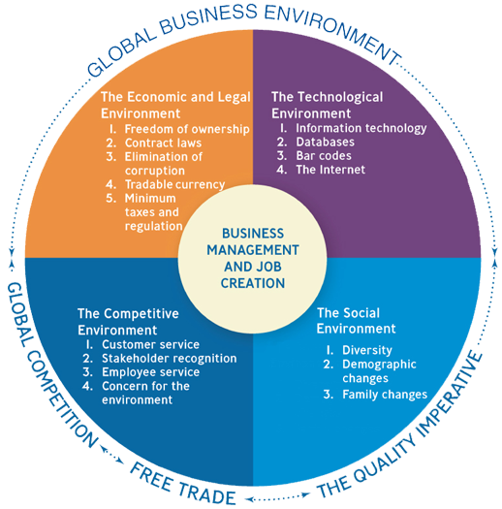
The Business Environment
The business environment is dynamic and constantly changing
Business have to stay abreast of its environment in order to capitalize on potential opportunities or minimize potential threats to its business
What are some outside factors or influences that impact a business’ activities?
  Economic Factors
  Legal (laws)
  Technology
  Competition
  Social changes (attitudes, interests, and beliefs)
  Global influences

Slide 17
Economics
Economics – the study of how society employs resources to produce goods and services for consumption amount various groups and individuals
  In other words, think of Economics as the determining how wealth (i.e. anything of value) is created and distrbuted
Today, experts often study economic problems from two different perspectives:
  1. Microeconomics – the study of the decisions made by individuals and businesses
  2. Macroeconomics – the study of the national economy and the global economy
Economy – the way in which people deal with creation and distribution of wealth

Slide 18
Types of Economic Systems
Economic System aka The Economy – the financial and social system through which a country allocates its resources (factors of production) – aka the system or structure for how resources are used to meet the needs of society (i.e. how society creates and distributes wealth!)
Differences in economic systems determined by how they answer the four basic economic questions:
  What goods and services will be produced?
  How will they be produced?
  For whom will they be produced?
  Who owns and controls the major factors of production?
Economic system – the financial and social system through which a country allocated its resources (factors of production) – aka the structure for how resources are used to meet the needs of society
Types of economic systems:
  Free-Market Economy: The market largely determines what goods and services are produced, who gets them, and how the economy grows
    Capitalism
    Mixed Economy
  Command Economy: The government largely determines what goods and services are produced, who gets them, and how the economy will grow.
    Socialism
    Communism

Slide 19
Capitalism
Capitalism – an economic system in which individuals own and operate the majority of businesses that provide goods and services
Capitalism stems from the theories of the Scottish economist Adam Smith.
  Wealth of Nations
  Adam Smith is considered the father of Capitalism
Invisible hand – a term created by Adam Smith to describe how an individual’s personal gain benefits others and a nation’s economy

Slide 20
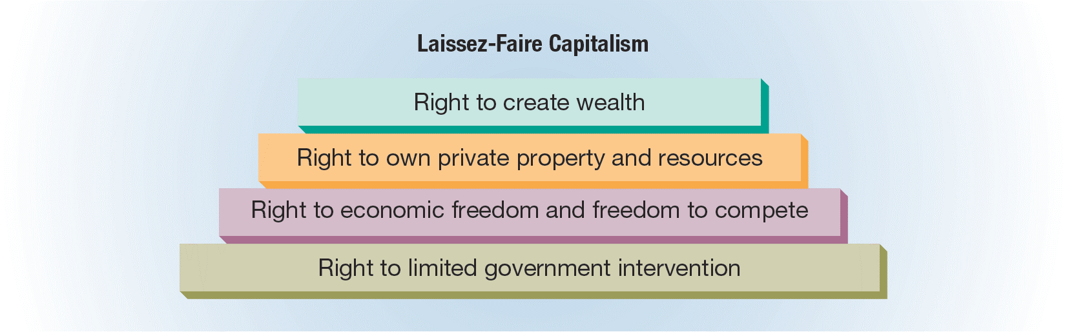
FIGURE 1-4 Basic Assumptions of Adam Smith’s Laissez-Faire Capitalism
  Derived from Adam Smith’s laissez-faire capitalism in which a society’s best interests are served by individuals pursuing their own self-interest
    Creation of wealth is the concern of private individuals
    Resources used to create wealth must be privately owned
    Economic freedom ensures the existence of a free market economy
      - Businesses/individuals decide what to produce and buy
      - The market determines quantities sold and prices
    Limited role of government

Slide 21
Capitalism
The term “laissez-faire” describes Smith’s capitalistic system and implies that there should be no government interference in the economy.
Adam Smith’s laissez-faire capitalism is also based on the concept of a market economy.
  Market economy – an economic system in which businesses and individuals decide what to produce and buy, and the market determines quantities sold and prices
    Example: Ford Motor Company must decide what type of automobiles it will sell, how the automobiles will be produced, and for whom the automobiles will be produced; you, as the consumer, must decide if you will buy a Ford product or an automobile manufactured by another company.

Slide 22
Capitalism in the United States
Mixed economy – an economy that exhibits elements of both capitalism and socialism
  The U.S. economy is a mixed economy.
  In a mixed economy, the four basic economic questions (what, how, for whom, and who) are answered through the interaction of:
    Households (i.e. Consumers)
      Purchases (consume) goods and services - BUYERS
    Businesses
      Utilizes factors of production to produce and sell goods/services to consumers in order to generate revenue and pursue profit
    Governments
      Provides public services in exchange for taxes

Slide 23
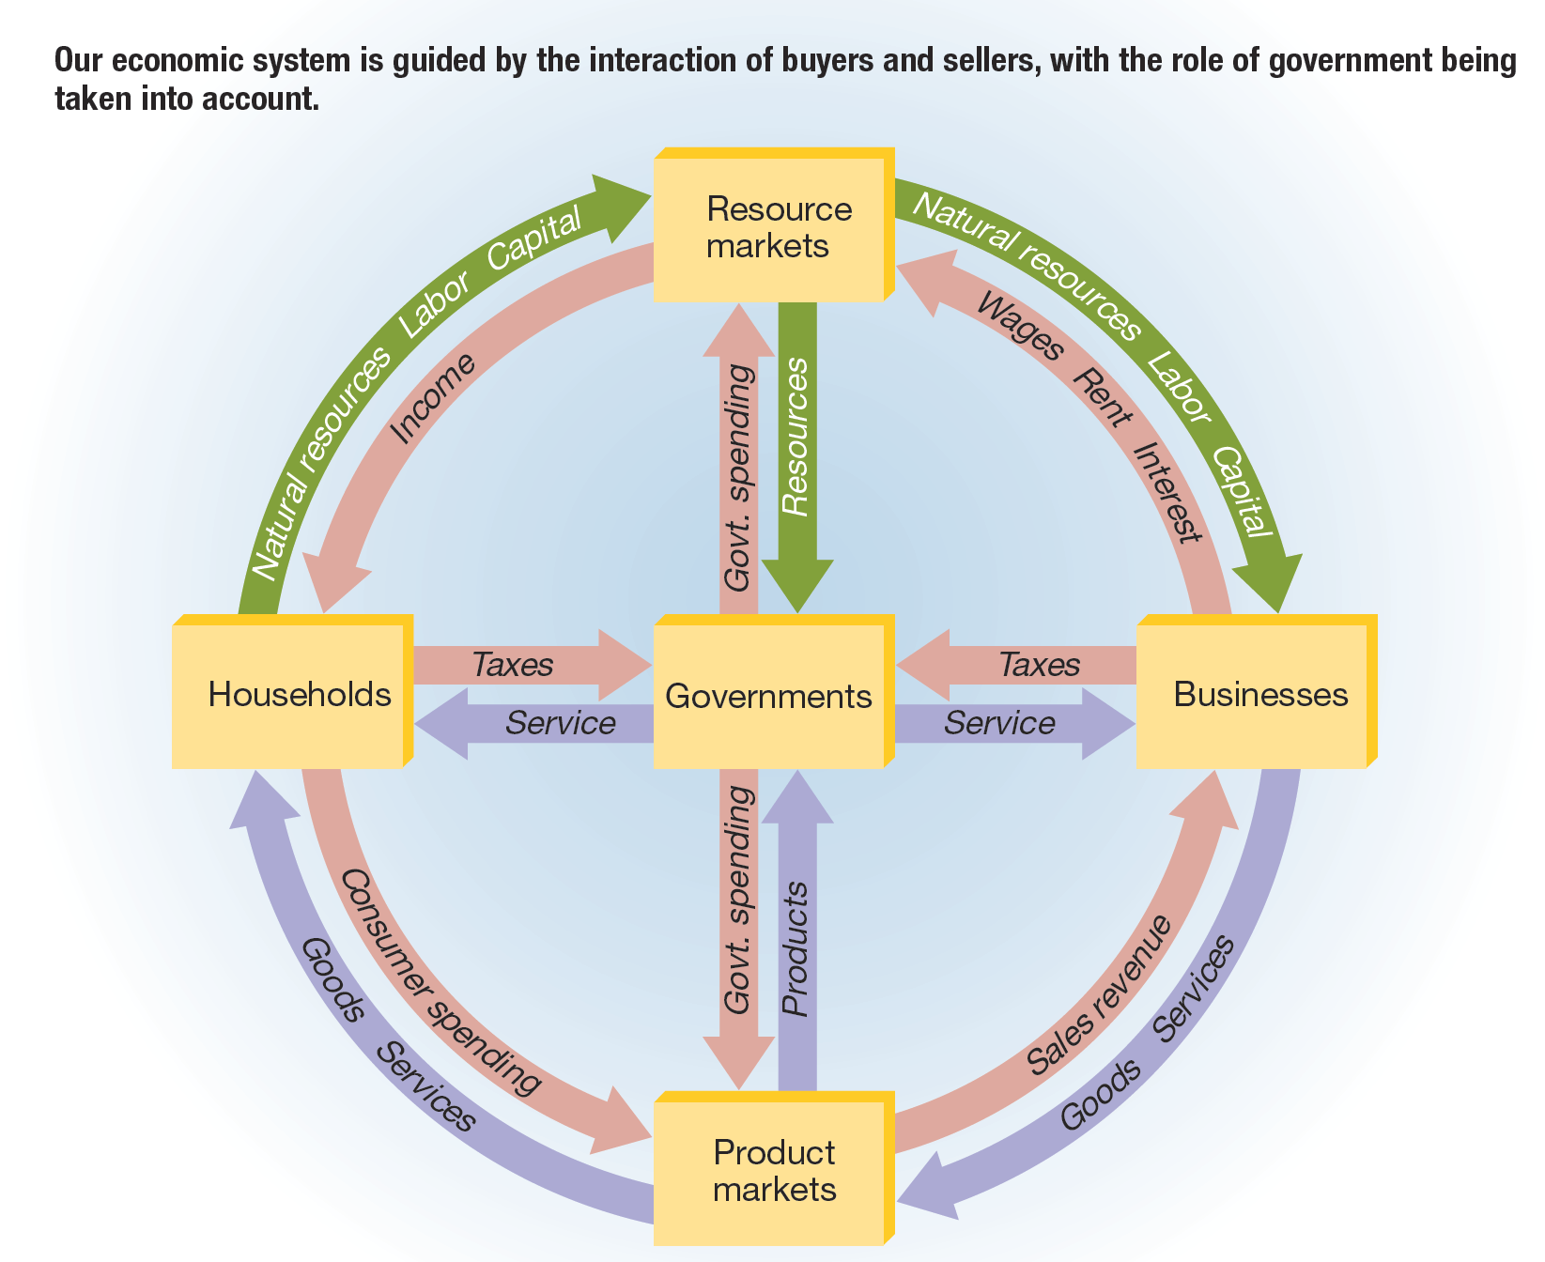
FIGURE 1-5 The Circular Flow in Our Mixed Economy

Slide 24
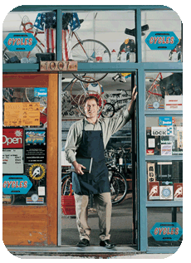
Benefits and Limitations of a Free Market Economy
Benefits:
  It uses resources effectively and efficiently.
  Provides FREEDOM of choice.
  It allows for open competition among companies.
  Provides opportunities for poor people to work their way out of poverty.
  Provides incentive and motivation to owners and workers (profit retention, income retention, etc.)
  Provides for LOWER taxes.
Limitations:
  People may start to let greed drive them.

Slide 25
Command Economies
Command economy – an economic system in which the government decides what goods and services will be produced, how they will be produced, for whom available goods and services will be produced, and who owns and controls the major factors of production
Examples of command economies:
  Socialism
  Communism

Slide 26
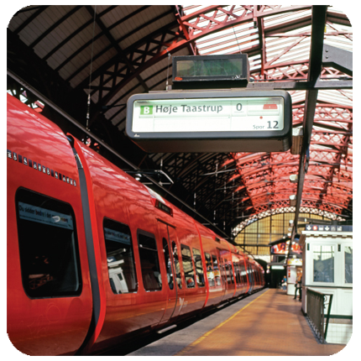
Socialism
Socialism is a populist economic and political system based on the public ownership (also known as collective or common ownership) of the means of production.
Key industries are owned and controlled by the government
Small-scale private businesses may be permitted and workers may choose their own occupations
Production is based on national goals, and distribution is controlled by the state
Intent is the equitable distribution of income, elimination of poverty, social services to all who need them, elimination of the economic waste of capitalistic competition
Benefits of Socialism:
Social equality
Free education
Free healthcare
Free childcare
Longer vacations
Shorter work weeks
Generous sick leave
Drawbacks of Socialism:
Few incentives for businesspeople to take risks.
Brain Drain: Some of a country’s best and brightest workers (i.e. doctors, lawyers and business owners) move to capitalistic countries.
Fewer inventions and innovations because the reward is not as great as in capitalistic countries.

Slide 27
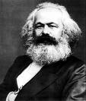
Communism
Communism
  All factors of production are owned and controlled by the government as proxy for ownership by all citizens
  Production is based on centralized state planning to meet the needs of the state and not necessarily the needs of its citizens
  The state dictates occupational choices and sets prices and wages
  Intent is to create Karl Marx’s concept of a classless society where all contribute according to their ability and receive benefits according to their needs

Slide 28
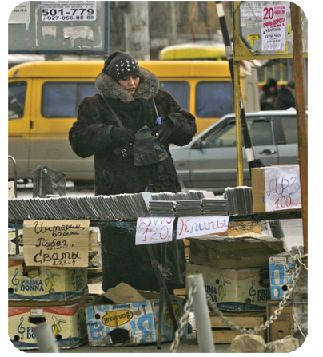
Trending Towards Mixed Economies
Communist governments are disappearing.
Socialist governments are cutting back on social programs, lowering taxes and moving toward capitalism.
Capitalist countries are increasing social programs and moving more toward socialism.

Slide 29
Measuring Economic Performance
Gross domestic product (GDP)
    The total dollar value of all goods & services produced within a country’s borders during a one-year period
    Real GDP (RGDP) – GDP that adjusts for inflation
    Nominal GDP (NGDP) – GDP measured in current year’s prices
    Inflation
    A general rise in the level of prices
  Productivity
    The average level of output per worker per hour
  Unemployment rate
    The percentage of a nation’s labor force unemployed at any time

Slide 30
Understanding RGDP and NGDP
Year Product Price Q
2012 Chips $1 5
2013 Chips $2 10
2012 Beer $3 4
2013 Beer $4 6
•NGDP₂₀₁₂? NGDP₂₀₁₃?
• RGDP₂₀₁₂? RGDP₂₀₁₃?

Slide 31
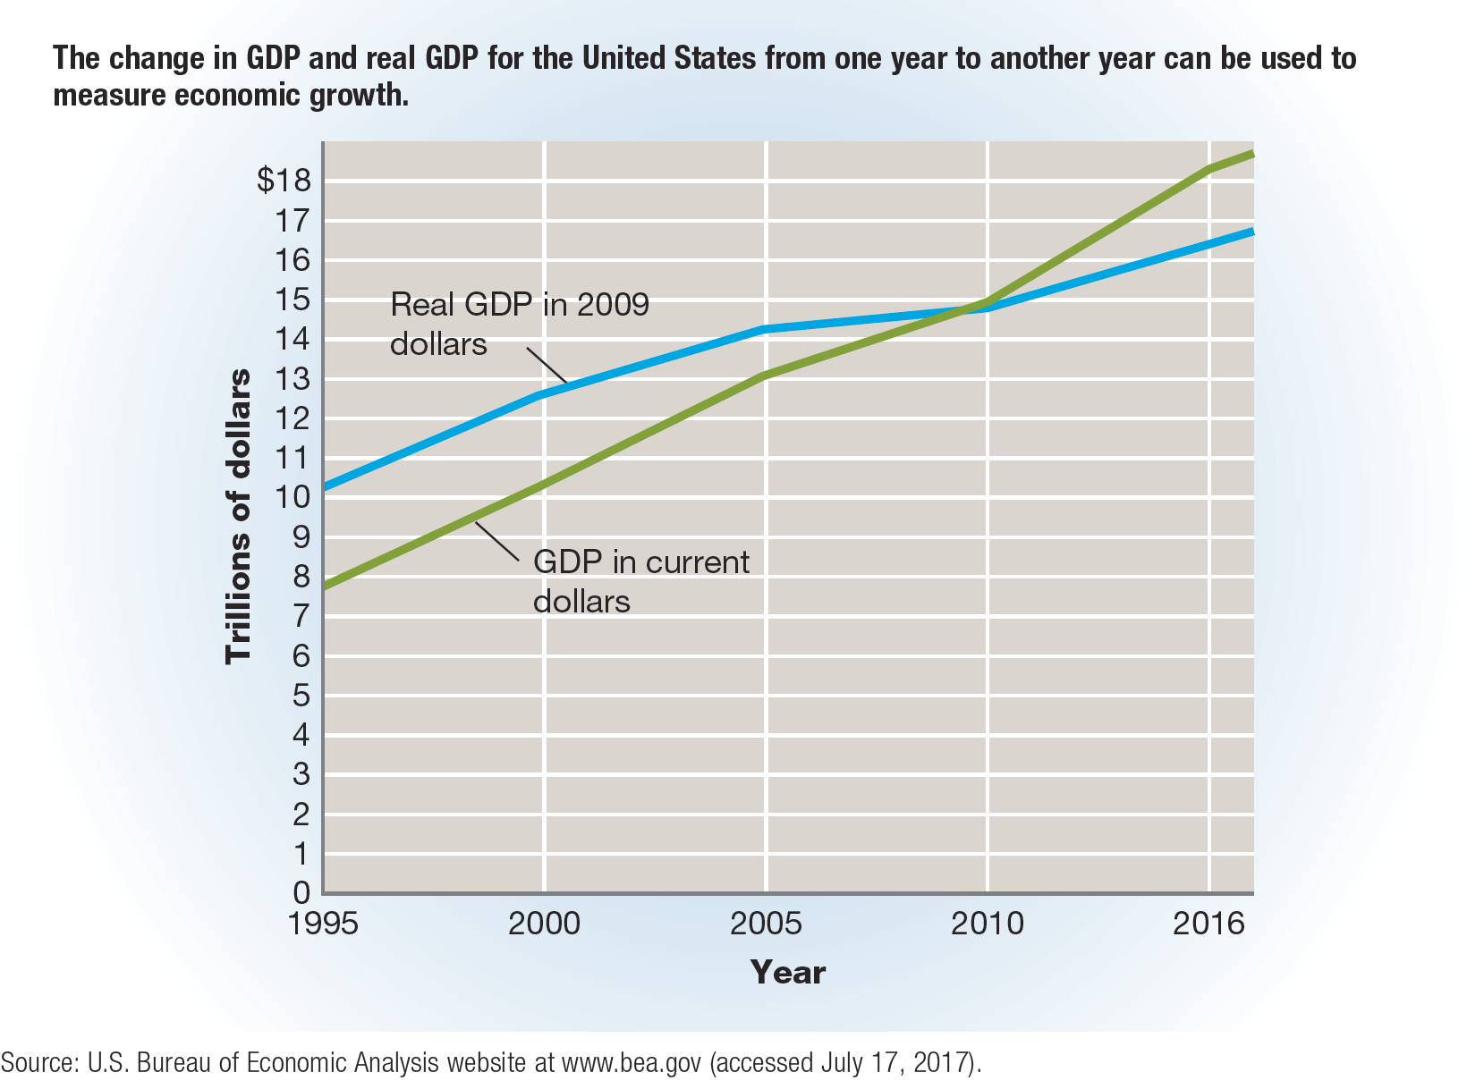
FIGURE 1-6 GDP in Current Dollars and in Inflation-Adjusted Dollars

Slide 32
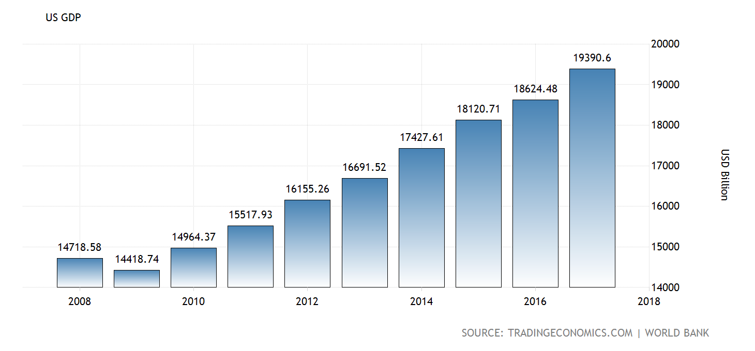
The United States GDP

Slide 33
The Business Cycle
Business Cycles -- Periodic rises and falls that occur in economies over time.
Four Phases of Long-Term Business Cycles:
  Economic Boom (Peak or Prosperity)
  Recession – Two or more consecutive quarters of decline in the GDP.
  Depression (Trough) – A severe recession.
  Recovery – When the economy stabilizes and starts to grow. This leads to an Economic Boom.
Peak
Output (GDP)
Recession
Recovery
Trough
Time

Slide 34
Managing Business Cycles (and the Economy)
Fiscal Policy – Government efforts to influence the economy:
  Taxation
    ⬆ Taxes, ⬇ Economy
  Government Spending
    ⬆ Gov’t Spending, ⬆ Economy
  Controlled by Congress/Budget Process
Monetary Policy – Federal Reserve actions to shape the economy:
  Supply of Money
    ⬆ Money Supply, ⬆ Economy
  Influencing Interest Rates
    ⬆ Interest Rates, ⬇ Economy
  Controlled by Fed

Slide 35
National Deficit, Debt and Surplus
National Deficit -- The amount of money the federal government spends beyond what it gathers in taxes.
  Gov’t Spending > Tax Revenues
National Debt -- The sum of government deficits over time.
National Surplus -- When government takes in more than it spends.
  Tax Revenues > Gov’t Spending

Slide 36
What is our National Debt?
The National Debt has reached nearly $18 trillion.
If $1 bills were stacked, the National Debt would would stretch over 1,000,000 miles. The moon is only 238,857 miles away.
Follow the U.S. National Debt Clock here.

Slide 37
Types of Competition
Competition – rivalry among businesses for sales to potential customers
Economists recognize four different degrees of competition:
  Perfect
  Monopolistic
  Oligopoly
  Monopoly

Slide 38
TABLE 1-2 Four Different Types of Competition
Type of Competition | Number of Business Firms or Suppliers | Real-World Examples
Perfect | Many | Corn, wheat, peanuts, many agricultural products
Monopolistic | Many | Clothing, shoes
Oligopoly | Few | Automobiles, cereals
Monopoly | One | Software protected by copyright, many local public utilities

Slide 39
Perfect Competition (slide 1 of 2)
Perfect (or pure) competition – the market situation in which there are many buyers and sellers of a product, and no single buyer or seller is powerful enough to affect the price of that product
Conditions for a perfect competition:
  The market is for a single product.
  There are no restrictions on firms entering the industry.
  All sellers offer essentially the same product for sale.
  All buyers and sellers know everything there is to know about the market.
  The overall market is not affected by the actions of any one buyer or seller.
  Perfect competition is quite rare in today’s world.

Slide 40
Perfect Competition (slide 2 of 2)
The Basics of Supply and Demand
Supply – the quantity of a product that producers are willing to sell at each of various prices
Demand – the quantity of a product that buyers are willing to purchase at each of various prices
The Equilibrium, or Market, Price
Market price – the price at which the quantity demanded is exactly equal to the quantity supplied

Slide 41
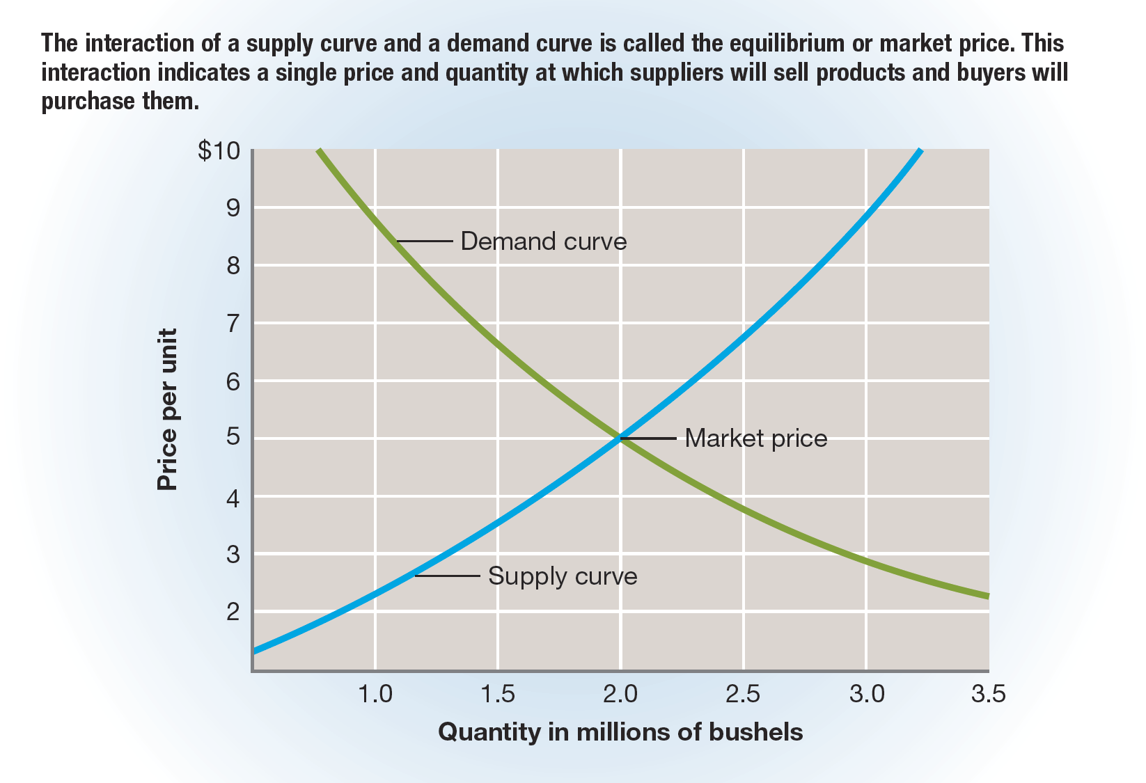
FIGURE 1-7 Supply Curve and Demand Curve

Slide 42
Monopolistic Competition
Monopolistic competition – a market situation in which there are many buyers along with a relatively large number of sellers who differentiate their products from the products of competitors
  Product differentiation – the process of developing and promoting differences between one’s products and all competitive products
  Examples: clothing, shoes, soaps, furniture

Slide 43
Oligopoly
Oligopoly – a market (or industry) in which there are few sellers
Examples: the automobile, airline, and car rental industries

Slide 44
Monopoly
Monopoly – a market (or industry) with only one seller, and there are barriers to keep other firms from entering the industry
Example: public utilities
  Each utility firm operates in a natural monopoly, an industry that requires a huge investment in capital and within which any duplication of facilities would be wasteful.
  A limited (or legal) monopoly is created when a government entity issues a franchise, license, copyright, patent, or trademark.
Except for natural monopolies and legal monopolies, federal antitrust laws discourage or prohibit both monopolies and attempts to form monopolies in order to ensure that competitive markets exist and customers have a choice for products they need or want to purchase.

Slide 45
American Business Today
Our economic system provides Americans with a high standard of living compared with people in other countries throughout the world.
  Standard of living – a loose, subjective measure of how well off an individual or a society is, mainly in terms of want satisfaction through goods and services
Our economic system offers solutions to many of the problems that plague society and provides opportunities for people who are willing to work and to continue learning.
To understand the current business environment and the challenges ahead, it helps to understand how business developed.

